Slide 1

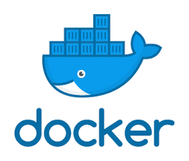
Linux Administration: K8S
Introduction to virtualization

Slide 2
Introduction to Docker
Get Docker

Slide 3
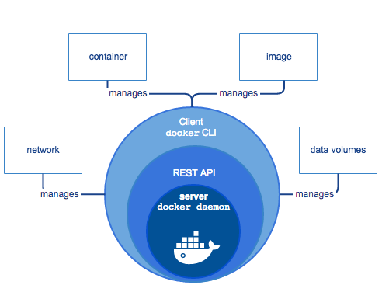
Docker Engine

Slide 4
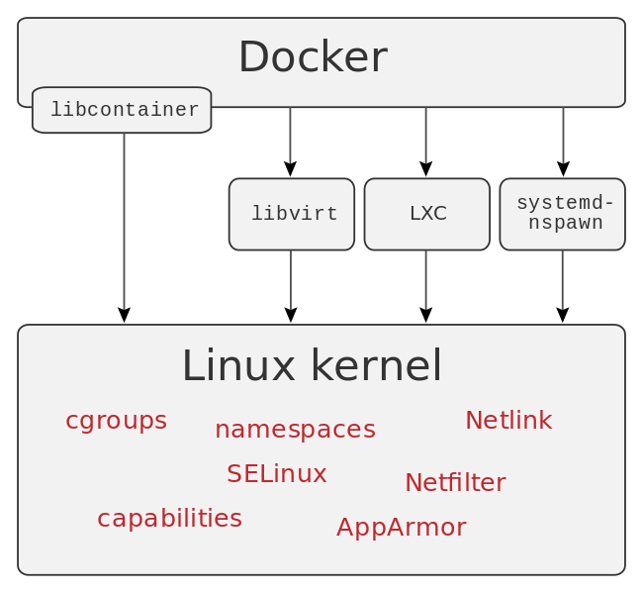
Docker Engine

Slide 5
Get Docker : Software platform
Operation Systems:
  Linux (RedHat / CentOS / Fedora, Debian / Ubuntu, SuSe )
  Microsoft Windows (desktop and server)
  MacOS
Cloud :
  Docker for Azure
  Docker for AWS

Slide 6
Introduction to Docker
Docker concepts

Slide 7
Docker namespaces
Docker Engine uses namespaces such as the following on Linux:
  The pid namespace: Process isolation (PID: Process ID).
  The net namespace: Managing network interfaces (NET: Networking).
  The ipc namespace: Managing access to IPC resources (IPC: InterProcess Communication).
  The mnt namespace: Managing filesystem mount points (MNT: Mount).
  The uts namespace: Isolating kernel and version identifiers. (UTS: Unix Timesharing System).

Slide 8
Docker concepts
Docker is a platform for developers and sysadmins to develop, deploy, and run applications with containers.
Containerization is increasingly popular because containers are:
  Flexible: Even the most complex applications can be containerized.
  Lightweight: Containers leverage and share the host kernel.
  Interchangeable: You can deploy updates and upgrades on-the-fly.
  Portable: You can build locally, deploy to the cloud, and run anywhere.
  Scalable: You can increase and automatically distribute container replicas.
  Stackable: You can stack services vertically and on-the-fly.

Slide 9
Images and containers
A container is launched by running an image. An image is an executable package that includes everything needed to run an application--the code, a runtime, libraries, environment variables, and configuration files.
A container is a runtime instance of an image--what the image becomes in memory when executed (that is, an image with state, or a user process). You can see a list of your running containers with the command, docker ps, just as you would in Linux.

Slide 10
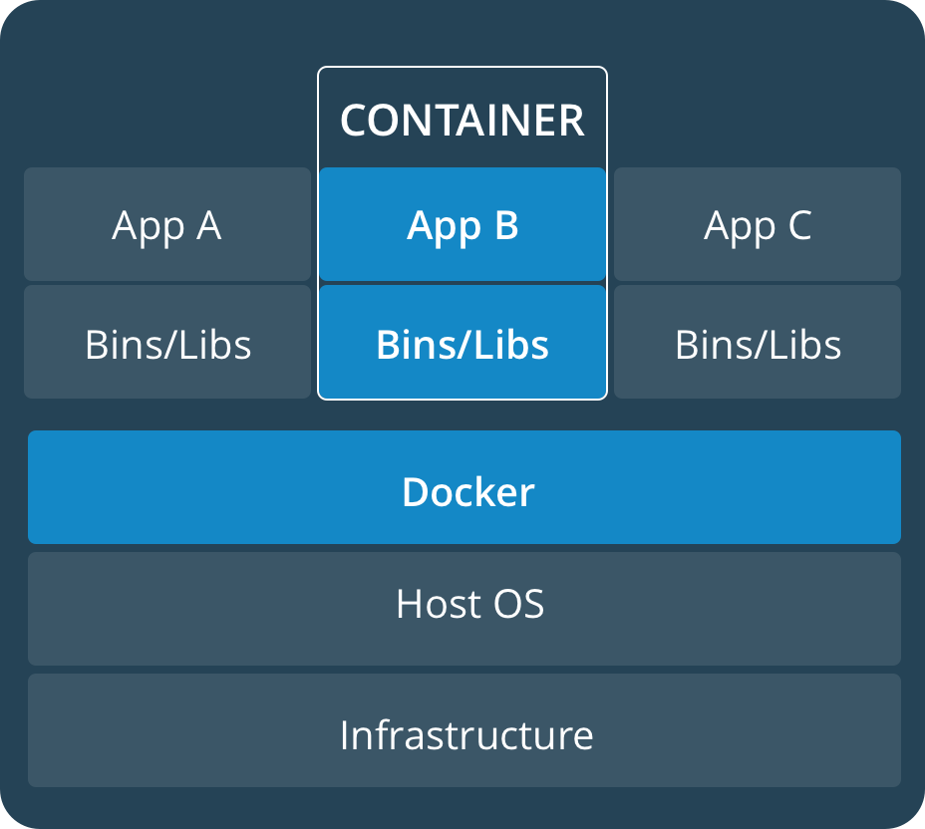
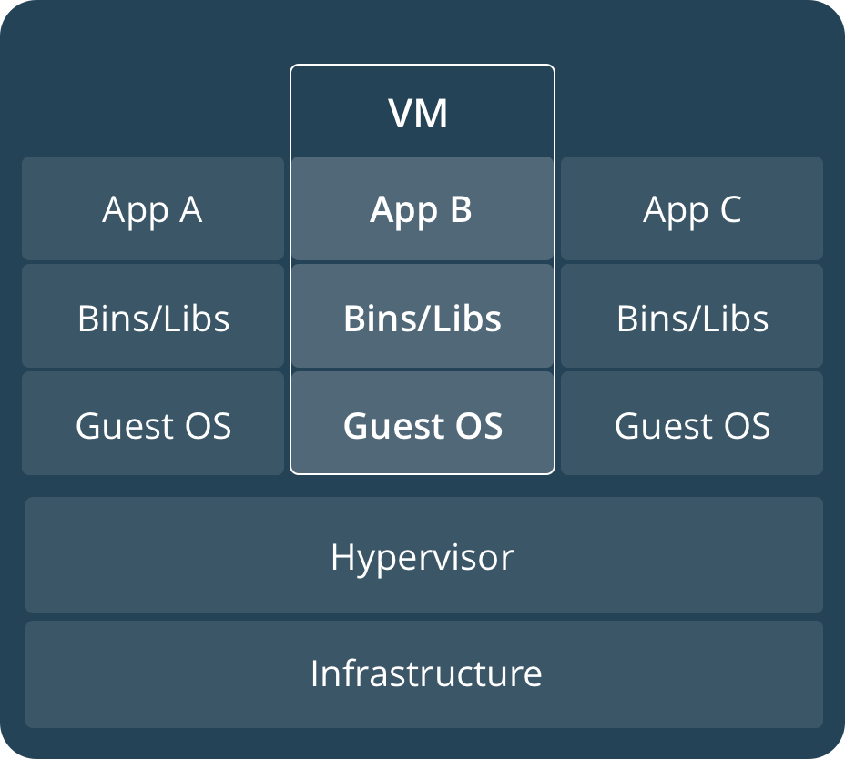
Containers and virtual machines

Slide 11
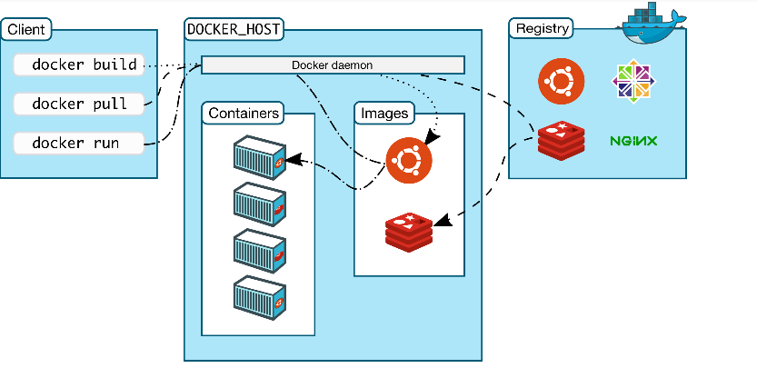
Docker concepts

Slide 12
Introduction to Docker
Namespaces
Rami Rosen
https://www.andrew.cmu.edu/course/14-712-s20/applications/ln/Namespaces_Cgroups_Conatiners.pdf

Slide 13
Namespaces and cgroups are the basis of lightweight process virtualization.
As such, they form the basis of Linux containers.
They can also be used for setting easily a testing/debugging environment or a resource separation environment and for resource accounting/logging.

Slide 14
Namespaces and cgroups are orthogonal.
We will talk mainly about the kernel implementation with some userspace usage examples.
What is lightweight process virtualization ?
A process that gives the user an illusion that he runs a linux operating system. You can run many such processes on a machine, and all such processes in fact share a single Linux kernel which runs on the machine.
This is opposed to hypervisor-based solutions, like Xen or KVM, where you run another instance of the kernel.
The idea is not revolutionary - we have Solaris Zones and BSD jails already several years ago.
A Linux container is in fact a process.

Slide 15
Containers versus Hypervisor-based VMs
It seems that Hypervisor-based VMs like KVM are here to stay (at least for the next several years). There is an ecosystem of cloud infrastructure around solutions like KVMs.
Advantages of Hypervisor-based VMs (like KVM) :
You can create VMs of other operating systems (windows, BSDs).
Security (Though there were cases of security vulnerabilities which were found and required patches to handle them, like VENOM).
Containers – advantages:
Lightweight: occupies less resources (like memory) significantly then hypervisor.
Density – you can install many more containers on a given host than KVM-based VMs.

Slide 16
elasticity - start time and shutdown time is much shorter, almost instantaneous. Creation of a container has the overhead of creating a Linux process, which can be of the order of milliseconds, while creating a vm based on XEN/KVM can take seconds.
The lightness of the containers in fact provides their density and their elasticity.
There is a single Linux kernel infrastructure for containers (namespaces and cgroups) while for Xen and KVM we have two different implementations without any common code.

Slide 17
Namespaces
Development took over a decade: Namespaces implementation started in about 2002; the last one, true for today, (user namespaces) was completed in February 2013, in kernel 3.18.
There are currently 6 namespaces in Linux:
mnt (mount points, filesystems)
pid (processes)
net (network stack)
ipc (System V IPC)
uts (hostname)
user (UIDs)
In the past there were talks on adding more namespaces – device namespaces (LPC 2013), and other (OLS 2006, Eric W. Biederman).

Slide 18
Namespaces - contd
A process can be created in Linux by the fork(), clone() or vclone()
system calls.
In order to support namespaces, 6 flags (CLONE_NEW*) were added: (include/linux/sched.h)
These flags (or a combination of them) can be used in clone() or
unshare() system calls to create a namespace.

Slide 19
Namespaces clone flags
Clone flag | Kernel Version | Required capability
CLONE_NEWNS | 2.4.19 | CAP_SYS_ADMIN
CLONE_NEWUTS | 2.6.19 | CAP_SYS_ADMIN
CLONE_NEWIPC | 2.6.19 | CAP_SYS_ADMIN
CLONE_NEWPID | 2.6.24 | CAP_SYS_ADMIN
CLONE_NEWNET | 2.6.29 | CAP_SYS_ADMIN
CLONE_NEWUSER | 3.8 | No capability is required

Slide 20
Namespaces system calls
Namespaces API consists of these 3 system calls:
clone() - creates a new process and a new namespace; the newly created process is attached to the new namespace.
– The process creation and process termination methods, fork() and
exit(), were patched to handle the new namespace CLONE_NEW* flags.
unshare() – gets only a single parameter, flags. Does not create a new process; creates a new namespace and attaches the calling process to it.
– unshare() was added in 2005.
see “new system call, unshare” : http://lwn.net/Articles/135266
setns() - a new system call, for joining the calling process to an existing namespace; prototype: int setns(int fd, int nstype);

Slide 21
Each namespace is assigned a unique inode number when it is created.
ls -al /proc/<pid>/ns
lrwxrwxrwx 1 root root 0 Apr 24 17:29 ipc -> ipc:[4026531839]
lrwxrwxrwx 1 root root 0 Apr 24 17:29 mnt -> mnt:[4026531840]
lrwxrwxrwx 1 root root 0 Apr 24 17:29 net -> net:[4026531956]
lrwxrwxrwx 1 root root 0 Apr 24 17:29 pid -> pid:[4026531836]
lrwxrwxrwx 1 root root 0 Apr 24 17:29 user -> user:[4026531837]
lrwxrwxrwx 1 root root 0 Apr 24 17:29 uts -> uts:[4026531838]
A namespace is terminated when all its processes are terminated and when its inode is not held (the inode can be held, for example, by bind mount).

Slide 22
Userspace support for namesapces
Apart from kernel, there were also some user space additions:
IPROUTE package:
●
Some additions like ip netns add/ip netns del and more commands (starting with ip netns …)
●
We will see some examples later.
util-linux package:
unshare util with support for all the 6 namespaces.
nsenter – a wrapper around setns().
●
●
See: man 1 unshare and man 1 nsenter.

Slide 23
UTS namespace
UTS namespace provides a way to get information about the system with commands like uname or hostname.
UTS namespace was the most simple one to implement. There is a member in the process descriptor called nsproxy.
A member named uts_ns (uts_namespace object) was added to it.
The uts_ns object includes an object (new_utsname struct ) with 6 members:
sysname nodename release version machine domainname

Slide 24
Former implementation of
gethostname():
The former implementation of gethostname():
asmlinkage long sys_gethostname(char user *name, int len)
{
..
if (copy_to_user(name, system_utsname.nodename, i))
... errno = -EFAULT;
}
(system_utsname is a global) kernel/sys.c, Kernel v2.6.11.5

Slide 25
New implementation of
gethostname():
A Method called utsname() was added:
static inline struct new_utsname *utsname(void)
{
return &current->nsproxy->uts_ns->name;
}
The new implementation of gethostname(): SYSCALL_DEFINE2(gethostname, char user *, name, int, len)
{
struct new_utsname *u;
...
u = utsname();
if (copy_to_user(name, u->nodename, i)) errno = -EFAULT;
.
}

Slide 26
Similar approach was taken in uname() and sethostname() syscalls.
For IPC namespaces, the same principle as in UTS namespace was held, nothing special, just more code.
Added a member named ipc_ns (ipc_namespace object) to the nsproxy object.

Slide 27
Network Namespaces
A network namespace is logically another copy of the network stack, with its own routing tables, firewall rules, and network devices.
The network namespace is represented by a huge struct net. (defined in
include/net/net_namespace.h)
struct net includes all network stack ingredients, like:
Loopback device.
SNMP stats. (netns_mib)
All network tables:routing, neighboring, etc.
All sockets
/procfs and /sysfs entries.

Slide 28
At a given moment -
A network device belongs to exactly one network namespace.
A socket belongs to exactly one network namespace.
The default initial network namespace, init_net (instance of struct net), includes the loopback device and all physical devices, the networking tables, etc.
Each newly created network namespace includes only the loopback device.

Slide 29
Example
Create two namespaces, called "myns1" and "myns2":
ip netns add myns1
ip netns add myns2
This triggers:
Creation of /var/run/netns/myns1,/var/run/netns/myns2 empty
folders.
Invoking the unshare() system call with CLONE_NEWNET.
– unshare() does not trigger cloning of a process; it does create a new namespace (a network namespace, because of the CLONE_NEWNET flag).

Slide 30
you delete a namespace by:
ip netns del myns1
– This unmounts and removes /var/run/netns/myns1
You can list the network namespaces (which were added via “ip netns add”) by:
ip netns list
You can monitor addition/removal of network namespaces by:
ip netns monitor
This prints one line for each addition/removal event it sees.

Slide 31
You can move a network interface (eth0) to myns1 network namespace by:
ip link set eth0 netns myns1
You can start a bash shell in a new namespace by:
ip netns exec myns1 bash
Recent additions – add “all” parameter to exec to allow exec on each netns; for example:
ip -all netns exec ip link
Show link info on all net namespaces. A nice feature:
Applications which usually look for configuration files under /etc (like /etc/hosts or /etc/resolv.conf), will first look under /etc/netns/NAME/, and only if nothing is available there, will look under /etc.

Slide 32
PID namespaces
Added a member named pid_ns (pid_namespace object) to the nsproxy.
Processes in different PID namespaces can have the same process ID.
When creating the first process in a new namespace, its PID is 1.
Behavior like the “init” process:
When a process dies, all its orphaned children will now have the process with PID 1 as their parent (child reaping).
Sending SIGKILL signal does not kill process 1, regardless of in which namespace the command was issued (initial namespace or other pid namespace).
pid namespaces can be nested, up to 32 nesting levels. (MAX_PID_NS_LEVEL).
See: multi_pidns.c, Michael Kerrisk, from http://lwn.net/Articles/532745 /.

Slide 33
The CRIU project
PID use case
The CRIU project - Checkpoint-Restore In Userspace
The Checkpoint-Restore feature is stopping a process and saving its state to the filesystem and later on starting it on the same machine or on a different machine. This feature is required in HPC mostly for load balancing and maintenance.
Previous attempts from OpenVZ folks to implement the same in the kernel in 2005 were rejected by the community as they were too intrusive. (A patch series of 17,000 lines, touching the most sensitive linux kernel subsystems).
When restarting a process in a different machine, you can have a collision in PID numbers of that process and the threads within it with other processes in the new machine.
Creating the process which has its own PID namespace avoids this collision.

Slide 34
Mount namespaces
Added a member named mnt_ns
(mnt_namespace object) to the nsproxy.
In the new mount namespace, all previous mounts will be visible; and from now on, mounts/unmounts in that mount namespace are invisible to the rest of the system.
mounts/unmounts in the global namespace are visible in that namespace.
More info about the low level details can be found in “Shared subtrees”by Jonathan Corbet, http://lwn.net/Articles/159077

Slide 35
User Namespaces
Added a member named user_ns (user_namespace object) to the credentials object (struct cred). Notice that this is different than the other 5 namespace pointers, which were added to the nsproxy object.
Each process will have a distinct set of UIDs, GIDs and capabilities.
User namespace enables a non root user to create a process in which it will be root (this is the basis for unprivileged containers)
Soon after this feature was mainlined, a security vulnerability was found in it and fixed; see:
“Anatomy of a user namespaces vulnerability”
By Michael Kerrisk, March 2013; an article about CVE 2013-1858, exploitable security Vulnerability:
http://lwn.net/Articles/543273/

Slide 36
cgroups
The cgroups (control groups) subsystem is a Resource Management and Resource Accounting/Tracking solution, providing a generic process- grouping framework.
It handles resources such as memory, cpu, network, and more.
This work was started by engineers at Google (primarily Paul Menage and Rohit Seth) in 2006 under the name "process containers”; shortly after, in 2007, it was renamed to “Control Groups”.
Merged into kernel 2.6.24 (2008).
Based on an OpenVZ solution called “bean counters”.
Maintainers: Li Zefan (Huawei) and Tejun Heo (Red Hat).
The memory controller (memcg) is maintained separately (4 maintainers)
●
The memory controller is the most complex.

Slide 37
cgroups implementation
No new system call was needed in order to support cgroups.
A new file system (VFS), "cgroup“ (also referred sometimes as cgroupfs).
The implementation of the cgroups subsystem required a few, simple hooks into the rest of the kernel, none in performance-critical paths:
In boot phase (init/main.c) to perform various initializations.
In process creation and destruction methods, fork() and exit().
Process descriptor additions (struct task_struct)
Add procfs entries:
For each process: /proc/pid/cgroup.
System-wide: /proc/cgroups

Slide 38
cgroups VFS
Cgroups uses a Virtual File System (VFS)
– All entries created in it are not persistent and are deleted after reboot.
All cgroups actions are performed via filesystem actions (create/remove/rename directories, reading/writing to files in it, mounting/mount options/unmounting).
For example:
cgroup inode_operations for cgroup mkdir/rmdir.
cgroup file_system_type for cgroup mount/unmount.
cgroup file_operations for reading/writing to control files.

Slide 39
Mounting cgroups
In order to use the cgroups filesystem (browse it/attach tasks to cgroups, etc) it must be mounted, as any other filesystem. The cgroup filesystem can be mounted on any path on the filesystem. Systemd uses /sys/fs/cgroup.
When mounting, we can specify with mount options (-o) which cgroup controllers we want to use.
There are 11 cgroup subsystems (controllers); two can be built as modules.
Example: mounting net_prio
mount -t cgroup -onet_prio none /sys/fs/cgroup/net_prio

Slide 40
Fedora 23 cgroup controllers
list of cgroup controllers - obtained by ls -a /sys/fs/cgroups,
dr-xr-xr-x 2 root root 0 Feb 6 14:40 blkio
lrwxrwxrwx 1 root root 11 Feb 6 14:40 cpu -> cpu,cpuacct
lrwxrwxrwx 1 root root 11 Feb 6 14:40 cpuacct -> cpu,cpuacct
dr-xr-xr-x 2 root root 0 Feb 6 14:40 cpu,cpuacct
dr-xr-xr-x 2 root root 0 Feb 6 14:40 cpuset
dr-xr-xr-x 4 root root 0 Feb 6 14:40 devices
dr-xr-xr-x 2 root root 0 Feb 6 14:40 freezer
dr-xr-xr-x 2 root root 0 Feb 6 14:40 hugetlb
dr-xr-xr-x 2 root root 0 Feb 6 14:40 memory
lrwxrwxrwx 1 root root 16 Feb 6 14:40 net_cls -> net_cls,net_prio
dr-xr-xr-x 2 root root 0 Feb 6 14:40 net_cls,net_prio
lrwxrwxrwx 1 root root 16 Feb 6 14:40 net_prio -> net_cls,net_prio
dr-xr-xr-x 2 root root 0 Feb 6 14:40 perf_event
dr-xr-xr-x 4 root root 0 Feb 6 14:40 systemd

Slide 41
Memory controller control files
cgroup.clone_children cgroup.event_control cgroup.procs cgroup.sane_behavior memory.failcnt memory.force_empty memory.kmem.failcnt memory.kmem.limit_in_bytes
memory.kmem.max_usage_in_bytes memory.kmem.slabinfo
memory.kmem.tcp.failcnt memory.kmem.tcp.limit_in_bytes
memory.kmem.tcp.max_usage_in_bytes
memory.kmem.tcp.usage_in_bytes memory.kmem.usage_in_bytes memory.limit_in_bytes
memory.memsw.failcnt memory.memsw.limit_in_bytes memory.memsw.max_usage_in_bytes memory.memsw.usage_in_bytes memory.move_charge_at_immigrate memory.numa_stat memory.oom_control memory.pressure_level memory.soft_limit_in_bytes memory.stat
memory.swappiness memory.usage_in_bytes memory.use_hierarchy notify_on_release release_agent
tasks

Slide 42
Example 1: memcg (memory control
groups)
mkdir /sys/fs/cgroup/memory/group0
The tasks entry that is created under group0 is empty (processes are called tasks in cgroup terminology).
echo $$ > /sys/fs/cgroup/memory/group0/tasks
The $$ pid (current bash shell process) is moved from the memory controller in which it resides into group0 memory controller.

Slide 43
memcg (memory control groups) - contd
echo 10M >
/sys/fs/cgroup/memory/group0/memory.limit_in_bytes
The implementation (and usage) of memory baloonning in Xen/KVM is much more complex, not to mention KSM (Kernel Same Page Merging).
You can disable the out of memory killer with memcg:
echo 1 > /sys/fs/cgroup/memory/group0/memory.oom_control
This disables the oom killer.
cat /sys/fs/cgroup/memory/group0/memory.oom_control
oom_kill_disable 1
under_oom 0

Slide 44
Now run some memory hogging process in this cgroup, which is known to be killed with oom killer in the default namespace.
This process will not be killed.
After some time, the value of under_oom will change to 1
After enabling the OOM killer again:
echo 0 > /sys/fs/cgroup/memory/group0/memory.oom_control
You will get soon the OOM “Killed” message.
Use case: keep critical processes from being destroyed by OOM. For example, disable sshd from being killed by OOM – this will allow you to be sure to be able to ssh into a machine which runs low on memory.

Slide 45
Example 2: release_agent in memcg
The release agent mechanism is invoked when the last process of a cgroup terminates.
The cgroup sysfs notify_on_release entry should be set so that
release_agent will be invoked.
Prepare a short script, for example, /work/dev/t/date.sh:
#!/bin/sh
date >> /root/log.txt
Assign the release_agent of the memory controller to be date.sh: echo /work/dev/t/date.sh > /sys/fs/cgroup/memory/release_agent Run a simple process, which simply sleeps forever; let's say it's PID is
pidSleepingProcess.
echo 1 > /sys/fs/cgroup/memory/notify_on_release

Slide 46
release_agent example (contd)
mkdir /sys/fs/cgroup/memory/0/
echo pidSleepingProcess > /sys/fs/cgroup/memory/0/tasks kill -9 pidSleepingProcess
This activates the release_agent; so we will see that the current time and date was written to /root/log.txt.
The release_agent can be set also via a mount option; systemd, for example, use this mechanism. For example in Fedora 23, mount shows:
cgroup on /sys/fs/cgroup/systemd type cgroup (rw,nosuid,nodev,noexec,relatime,xattr,release_agent=/usr/lib/systemd/systemd- cgroups-agent,name=systemd)
The release_agnet mechanism is quite heavy; see: “The past, present, and future of control groups”, https://lwn.net/Articles/574317/

Slide 47
Example 3: devices control group
Also referred to as : devcg (devices control group)
devices cgroup provides enforcing restrictions on reading, writing and creating (mknod) operations on device files.
3 control files: devices.allow, devices.deny, devices.list.
devices.allow can be considered as devices whitelist
devices.deny can be considered as devices blacklist.
devices.list available devices.
Each entry in these files consist of 4 fields:
– type: can be a (all), c (char device), or b (block device).
All means all types of devices, and all major and minor numbers.
Major number.
Minor number.
Access: composition of 'r' (read), 'w' (write) and 'm' (mknod).

Slide 48
devices control group – example (contd)
/dev/null major number is 1 and minor number is 3 (see
Documentation/devices.txt)
mkdir /sys/fs/cgroup/devices/group0
By default, for a new group, you have full permissions:
cat /sys/fs/cgroup/devices/group0/devices.list
a *:* rwm
echo 'c 1:3 rmw' > /sys/fs/cgroup/devices/group0/devices.deny
This denies rmw access from /dev/null device.
echo $$ > /sys/fs/cgroup/devices/group0/tasks #Runs the current shell in group0
echo "test" > /dev/null
bash: /dev/null: Operation not permitted

Slide 49
devices control group – example (contd)
echo a > /sys/fs/cgroup/devices/group0/devices.allow
This adds the 'a *:* rwm' entry to the whitelist.
echo "test" > /dev/null
Now there is no error.

Slide 50
Cgroups Userspace tools
There is a cgroups management package called libcgroup-tools.
Running the cgconfig (control group config) service (a systemd service) :
systemctl start cgconfig.service / systemctl stop cgconfig.service
Create a group:
cgcreate -g memory:group1
Creates: /sys/fs/cgroup/memory/group1/
Delete a group:
cgdelete -g memory:group1
Adds a process to a group:
cgclassify -g memory:group1 <pidNum>
Adds a process whose pid is pidNum to group1 of the memory controller.

Slide 51
Userspace tools - contd
cgexec -g memory:group0 sleepingProcess
Runs sleepingProcess in group0 (the same as if you wrote the pid of that process into group/tasks of the memory controller).
lssubsys – shows the list of mounted cgroup controllers.
There is a configuration file, /etc/cgconfig.conf. You can define groups which will be created when the service is started; thus, you can provide persistent configuration across reboots.
group group1 { memory {
memory.limit_in_bytes = 3.5G;
}
}

Slide 52
cgmanager
Problem: there can be many userspace daemons which set cgroups sysfs entries (like systemd, libvirt, lxc, docker, and others)
How can we guarantee that one will not override entries written by the other? Solution – cgmanager: A cgroup manager daemon
Currently under development (no rpm for Fedora/RHEL, for example).
A userspace daemon based on DBUS messages.
Developer: Serge Hallyn (Canonical)
- One of the LXC maintainers. https://linuxcontainers.org/cgmanager/introduction/ CVE found in cgmanager on 6 of January, 2015: http://www.securityfocus.com/bid/71896

Slide 53
groups and docker cpuset – example:
Configuring docker containers is in fact mostly setting cgroups and namespaces entries; for example, limiting cores in a docker container to be 0, 2 can be done by:
docker run -i --cpuset=0,2 -t fedora /bin/bash
This is in fact writing into the corresponding cgroups entry, so after running this command, we will have:
cat /sys/fs/cgroup/cpuset/system.slice/docker-64bit_ID.scope/cpuset.cpus
0,2
In Docker and in LXC, you can configure cgroup/namespaces via config files.

Slide 54
Building docker images
Dockerfile

Slide 55
Writing Dockerfiles
A Docker image consists of read-only layers each of which represents a Dockerfile instruction. The layers are stacked and each one is a delta of the changes from the previous layer. Consider this Dockerfile:
Each instruction creates one layer:
FROM creates a layer from the ubuntu:18.04 Docker image.
COPY adds files from your Docker client’s current directory.
RUN builds your application with make.
CMD specifies what command to run within the container.

Slide 56
Pipe Dockerfile through stdin
Docker has the ability to build images by piping Dockerfile through stdin with a local or remote build context. Piping a Dockerfile through stdin can be useful to perform one-off builds without writing a Dockerfile to disk, or in situations where the Dockerfile is generated, and should not persist afterwards.
The following commands are equivalent:
echo -e 'FROM busybox\nRUN echo "hello world"' | docker build -
docker build -<<EOF
FROM busybox
RUN echo "hello world"
EOF

Slide 57
Exclude with .dockerignore
To exclude files not relevant to the build (without restructuring your source repository) use a .dockerignore file. This file supports exclusion patterns similar to .gitignore files. For information on creating one, see the .dockerignore file.
# comment
*/temp*
*/*/temp*
temp?
*.md
!README.md

Slide 58
Understand how ARG and FROM interact
FROM instructions support variables that are declared by any ARG instructions that occur before the first FROM.
ARG CODE_VERSION=latest
FROM base:${CODE_VERSION}
CMD /code/run-app
FROM extras:${CODE_VERSION}
CMD /code/run-extras

Slide 59
Understand how ARG and FROM interact
An ARG declared before a FROM is outside of a build stage, so it can’t be used in any instruction after a FROM. To use the default value of an ARG declared before the first FROM use an ARG instruction without a value inside of a build stage:
ARG VERSION=latest
FROM busybox:$VERSION
ARG VERSION
RUN echo $VERSION > image_version

Slide 60
EXPOSE Usage
The EXPOSE instruction informs Docker that the container listens on the specified network ports at runtime. You can specify whether the port listens on TCP or UDP, and the default is TCP if the protocol is not specified.
EXPOSE 80/tcp
By default, EXPOSE assumes TCP. You can also specify UDP:
EXPOSE 80/udp

Slide 61
Exec form ENTRYPOINT
The following Dockerfile shows using the ENTRYPOINT to run Apache in the foreground (i.e., as PID 1):
FROM debian:stable
RUN apt-get update && apt-get install -y --force-yes apache2
EXPOSE 80 443
VOLUME ["/var/www", "/var/log/apache2", "/etc/apache2"]
ENTRYPOINT ["/usr/sbin/apache2ctl", "-D", "FOREGROUND"]

Slide 62
ENV Usage
The ENV instruction sets the environment variable <key> to the value <value>. This value will be in the environment for all subsequent instructions in the build stage and can be replaced inline in many as well.
Allows for multiple variables to be set at one time
ENV myName="John Doe" myDog=Rex\ The\ Dog myCat=fluffy
Set single variable to a value
ENV myName John Doe
ENV myDog Rex The Dog
ENV myCat fluffy

Slide 63
ADD Usage
The ADD instruction copies new files, directories or remote file URLs from <src> and adds them to the filesystem of the image at the path <dest>.
ADD hom* /mydir/
ADD hom?.txt /mydir/
ADD --chown=55:mygroup files* /somedir/
ADD --chown=bin files* /somedir/

Slide 64
ADD vs COPY
ADD lets you do that too, but it also supports 2 other sources. First, you can use a URL instead of a local file / directory. Secondly, you can extract a tar file from the source directly into the destination.

Slide 65
WORKDIR Usage
The WORKDIR instruction sets the working directory for any RUN, CMD, ENTRYPOINT, COPY and ADD instructions that follow it in the Dockerfile. If the WORKDIR doesn’t exist, it will be created even if it’s not used in any subsequent Dockerfile instruction.
The WORKDIR instruction can be used multiple times in a Dockerfile. If a relative path is provided, it will be relative to the path of the previous WORKDIR instruction.
WORKDIR /a
WORKDIR b
WORKDIR c
RUN pwd

Slide 66
SHELL Usage
The SHELL instruction allows the default shell used for the shell form of commands to be overridden. The default shell on Linux is ["/bin/sh", "-c"], and on Windows is ["cmd", "/S", "/C"]. The SHELL instruction must be written in JSON form in a Dockerfile.
# Executed as cmd /S /C echo default
RUN echo default
# Executed as cmd /S /C powershell -command Write-Host default
RUN powershell -command Write-Host default
# Executed as powershell -command Write-Host hello
SHELL ["powershell", "-command"]
RUN Write-Host hello
# Executed as cmd /S /C echo hello
SHELL ["cmd", "/S", "/C"]
RUN echo hello

Slide 67
Build from scratch
While scratch appears in Docker’s repository on the hub, you can’t pull it, run it, or tag any image with the name scratch.
Instead, you can refer to it in your Dockerfile.
For example, to create a minimal container using scratch:
FROM scratch
ADD hello /
CMD ["/hello"]

Slide 68
Multiple service images
If you need to run more than one service within a container, you can accomplish this in a few different ways.
Put all of your commands in a wrapper script, complete with testing and debugging information. Run the wrapper script as your CMD. This is a very naive example. First, the wrapper script:
./my_first_process -D
status=$?
if [ $status -ne 0 ]; then
echo "Failed to start my_first_process: $status"
exit $status
fi

Slide 69
Multiple service images
Next, the Dockerfile:
FROM ubuntu:latest
COPY my_first_process my_first_process
COPY my_second_process my_second_process
COPY my_wrapper_script.sh my_wrapper_script.sh
CMD ./my_wrapper_script.sh

Slide 70
Multiple service images
Use a process manager like supervisord. This is a moderately heavy-weight approach that requires you to package supervisord and its configuration in your image (or base your image on one that includes supervisord), along with the different applications it manages.
FROM ubuntu:latest
RUN apt-get update && apt-get install -y supervisor
RUN mkdir -p /var/log/supervisor
COPY supervisord.conf /etc/supervisor/conf.d/supervisord.conf
COPY my_first_process my_first_process
COPY my_second_process my_second_process
CMD ["/usr/bin/supervisord"]

Slide 71
Build docker
Create docker image
docker build --tag=friendlyhello .

Slide 72
Building docker images
Multi-stage builds

Slide 73
Use multi-stage builds
Multi-stage builds are a new feature requiring Docker 17.05 or higher on the daemon and client.
Multistage builds are useful to anyone who has struggled to optimize Dockerfiles while keeping them easy to read and maintain.
It was actually very common to have one Dockerfile to use for development (which contained everything needed to build your application), and a slimmed-down one to use for production, which only contained your application and exactly what was needed to run it.
This has been referred to as the “builder pattern”. Maintaining two Dockerfiles is not ideal.

Slide 74
Without multi-stage builds
#!/bin/sh
echo Building alexellis2/href-counter:build. Stage 1
docker build -t alexellis2/href-counter:build . -f Dockerfile.build
docker container create --name extract alexellis2/href-counter:build
docker container cp extract:/go/src/github.com/alexellis/href-counter/app ./app
docker container rm -f extract
echo Building alexellis2/href-counter:latest. Stage 2
docker build --no-cache -t alexellis2/href-counter:latest .
rm ./app

Slide 75
With multi-stage builds
FROM golang:latest AS builder
WORKDIR /go/src/github.com/alexellis/href-counter/
RUN go get -d -v golang.org/x/net/html
COPY app.go .
RUN CGO_ENABLED=0 GOOS=linux go build -a -installsuffix cgo -o app .
FROM alpine:latest
RUN apk --no-cache add ca-certificates
WORKDIR /root/
COPY --from=builder /go/src/github.com/alexellis/href-counter/app .
CMD ["./app"]

Slide 76
Using standard images
When using multi-stage builds, you are not limited to copying from stages you created earlier in your Dockerfile.
You can use the COPY --from instruction to copy from a separate image, either using the local image name, a tag available locally or on a Docker registry, or a tag ID.
The Docker client pulls the image if necessary and copies the artifact from there. The syntax is:
COPY --from=nginx:latest /etc/nginx/nginx.conf /nginx.conf

Slide 77
Stop building process
When you build your image, you don’t necessarily need to build the entire Dockerfile including every stage.
You can specify a target build stage.
The following command assumes you are using the previous Dockerfile but stops at the stage named builder:
docker build --target builder -t alexellis2/href-counter:latest .

Slide 78
With multi-stage builds
You can pick up where a previous stage left off by referring to it when using the FROM directive
FROM alpine:latest as builder
RUN apk --no-cache add build-base
FROM builder as build1
COPY source1.cpp source.cpp
RUN g++ -o /binary source.cpp
FROM builder as build2
COPY source2.cpp source.cpp
RUN g++ -o /binary source.cpp

Slide 79
Run application in production
Docker run examples

Slide 80
PID settings (--pid)
By default, all containers have the PID namespace enabled.
PID namespace provides separation of processes. The PID Namespace removes the view of the system processes, and allows process ids to be reused including pid 1.
You want to use some tools when debugging processes within the container.
Joining another container’s pid namespace can be used for debugging that container.
docker run -it --rm --pid=host myhtop

Slide 81
IPC settings (--ipc)
The following values are accepted:
”” Use daemon’s default.
“none” Own private IPC namespace, with /dev/shm not mounted.
“private” Own private IPC namespace.
“shareable” Own private IPC namespace, with a possibility to share it with other containers.
“container: <_name-or-ID_>" Join another (“shareable”) container’s IPC namespace.
“host” Use the host system’s IPC namespace.

Slide 82
Network settings
With the network set to container a container will share the network stack of another container.
The other container’s name must be provided in the format of --network container:<name|id>.
Note that --add-host --hostname --dns --dns-search --dns-option and --mac-address are invalid in container netmode, and --publish --publish-all --expose are also invalid in container netmode.
docker run --rm -it --network container:redis \
example/redis-cli -h 127.0.0.1

Slide 83
Clean up (--rm)
By default a container’s file system persists even after the container exits. This makes debugging a lot easier (since you can inspect the final state) and you retain all your data by default. But if you are running short-term foreground processes, these container file systems can really pile up.
If instead you’d like Docker to automatically clean up the container and remove the file system when the container exits, you can add the --rm flag:
--rm=false: Automatically remove the container when it exits

Slide 84
Overriding Dockerfile image defaults
Four of the Dockerfile commands cannot be overridden at runtime: FROM, MAINTAINER, RUN, and ADD.
Everything else has a corresponding override in docker run. We’ll go through what the developer might have set in each Dockerfile instruction and how the operator can override that setting.
  CMD (Default Command or Options)
  ENTRYPOINT (Default Command to Execute at Runtime)
  EXPOSE (Incoming Ports)
  ENV (Environment Variables)
  HEALTHCHECK
  VOLUME (Shared Filesystems)
  USER
  WORKDIR

Slide 85
Overriding Dockerfile image defaults
Here is an example of how to run a shell in a container that has been set up to automatically run something else (like /usr/bin/redis-server):
docker run -it --entrypoint /bin/bash example/redis
or two examples of how to pass more parameters to that ENTRYPOINT:
docker run -it --entrypoint /bin/bash example/redis -c ls -l
You can reset a containers entrypoint by passing an empty string, for example:
docker run -it --entrypoint="" mysql bash

Slide 86
Overriding Dockerfile image defaults
Here is an example of how to run a shell in a container that has been set up to automatically run something else (like /usr/bin/redis-server):
docker run -it --entrypoint /bin/bash example/redis
or two examples of how to pass more parameters to that ENTRYPOINT:
docker run -it --entrypoint /bin/bash example/redis -c ls -l
You can reset a containers entrypoint by passing an empty string, for example:
docker run -it --entrypoint="" mysql bash

Slide 87
Run application in production
Resource Management

Slide 88
Runtime constraints on resources
User memory constraints.
There is no memory limit for the container. The container can use as much memory as needed
-m, --memory="" Memory limit (format: <number>[<unit>]). Number is a positive integer. Unit can be one of b, k, m, or g. Minimum is 4M.
--memory-swap="" Total memory limit (memory + swap, format: <number>[<unit>]). Number is a positive integer. Unit can be one of b, k, m, or g.
--memory-reservation="" Memory soft limit (format: <number>[<unit>]). Number is a positive integer. Unit can be one of b, k, m, or g.

Slide 89
Runtime constraints on resources
We set memory limit only, this means the processes in the container can use 300M memory and 300M swap memory, by default, the total virtual memory size (--memory-swap) will be set as double of memory, in this case, memory + swap would be 2*300M, so processes can use 300M swap memory as well.
docker run -it -m 300M ubuntu:14.04 /bin/bash
We set both memory and swap memory, so the processes in the container can use 300M memory and 700M swap memory.
docker run -it -m 300M --memory-swap 1G ubuntu:14.04 /bin/bash

Slide 90
Runtime constraints on resources
Memory reservation is a kind of memory soft limit that allows for greater sharing of memory. Under normal circumstances, containers can use as much of the memory as needed and are constrained only by the hard limits set with the -m/--memory option.
When memory reservation is set, Docker detects memory contention or low memory and forces containers to restrict their consumption to a reservation limit.
docker run -it -m 500M --memory-reservation 200M \
ubuntu:14.04 /bin/bash

Slide 91
CPU share constraint
CPU period constraint
If there is 1 CPU, this means the container can get 50% CPU worth of run-time every 50ms.
docker run -it --cpu-period=50000 --cpu-quota=25000 \
ubuntu:14.04 /bin/bash
cpu-period=50000 (50ms)
cpu-quota=25000 (50% : 25000 of 50000 )

Slide 92
CPU share constraint
Cpuset constraint
This means processes in container can be executed on cpu 1 and cpu 3.
docker run -it --cpuset-cpus="1,3" ubuntu:14.04 /bin/bash
This means processes in container can be executed on cpu 0, cpu 1 and cpu 2.
docker run -it --cpuset-cpus="0-2" ubuntu:14.04 /bin/bash

Slide 93
Block IO bandwidth (Blkio) constraint
By default, all containers get the same proportion of block IO bandwidth (blkio). This proportion is 500. To modify this proportion, change the container’s blkio weight relative to the weighting of all other running containers using the --blkio-weight flag.
The --blkio-weight flag can set the weighting to a value between 10 to 1000. For example, the commands below create two containers with different blkio weight:
docker run -it --name c1 --blkio-weight 300 ubuntu:14.04 /bin/bash
docker run -it --name c2 --blkio-weight 600 ubuntu:14.04 /bin/bash

Slide 94
Block IO bandwidth (Blkio) constraint
The --blkio-weight-device="DEVICE_NAME:WEIGHT" flag sets a specific device weight.
The DEVICE_NAME:WEIGHT is a string containing a colon-separated device name and weight.
For example, to set /dev/sda device weight to 200:
docker run -it --blkio-weight-device "/dev/sda:200" Ubuntu
If you specify both the --blkio-weight and --blkio-weight-device, Docker uses the --blkio-weight as the default weight and uses --blkio-weight-device to override this default with a new value on a specific device.

Slide 95
Block IO bandwidth (Blkio) constraint
The --device-read-bps flag limits the read rate (bytes per second) from a device. For example, this command creates a container and limits the read rate to 1mb per second from /dev/sda:
docker run -it --device-read-bps /dev/sda:1mb ubuntu
The --device-write-bps flag limits the write rate (bytes per second) to a device. For example, this command creates a container and limits the write rate to 1mb per second for /dev/sda:
docker run -it --device-write-bps /dev/sda:1mb ubuntu

Slide 96
Block IO bandwidth (Blkio) constraint
The --device-read-iops flag limits read rate (IO per second) from a device. For example, this command creates a container and limits the read rate to 1000 IO per second from /dev/sda:
docker run -ti --device-read-iops /dev/sda:1000 ubuntu
The --device-write-iops flag limits write rate (IO per second) to a device. For example, this command creates a container and limits the write rate to 1000 IO per second to /dev/sda:
docker run -ti --device-write-iops /dev/sda:1000 ubuntu

Slide 97
Run application in production
Swarm

Slide 98
Swarm Feature highlights
Cluster management integrated with Docker Engine
Decentralized design
Declarative service model
Scaling
Desired state reconciliation
Multi-host networking
Service discovery
Load balancing
Secure by default
Rolling updates

Slide 99
Swarm mode key concepts
A swarm consists of multiple Docker hosts which run in swarm mode and act as managers (to manage membership and delegation) and workers (which run swarm services).
A node is an instance of the Docker engine participating in the swarm. You can also think of this as a Docker node.
A service is the definition of the tasks to execute on the manager or worker nodes. It is the central structure of the swarm system and the primary root of user interaction with the swarm.
The swarm manager uses ingress load balancing to expose the services you want to make available externally to the swarm.

Slide 100
Create a swarm
Open a terminal and ssh into the machine where you want to run your manager node.
This tutorial uses a machine named manager1.
Run the following command to create a new swarm:
docker swarm init --advertise-addr <MANAGER-IP>

Slide 101
Create a swarm
Run the following command to create a new swarm (10.0.0.1 – ip address of the manager):
docker swarm init --advertise-addr 10.0.0.1
To add a worker to this swarm, run the following command on the another node:
docker swarm join
--token SWMTKN-1-49nj1cmql0jkz5s954yi3oex3nedyz0fb0xx14ie39trti4wxv-8vxv8rssmk743ojnwacrr2e7c 10.0.0.1:2377

Slide 102
Create a swarm
Open a terminal and ssh into the machine where the manager node runs and run the docker node ls command to see the worker nodes:
docker node ls
ID HOSTNAME STATUS AVAILABILITY MANAGER STATUS
03g1y59jwfg7cf99w4lt0f662 worker2 Ready Active
9j68exjopxe7wfl6yuxml7a7j worker1 Ready Active
dxn1zf6l61qsb1josjja83ngz * manager1 Ready Active Leader

Slide 103
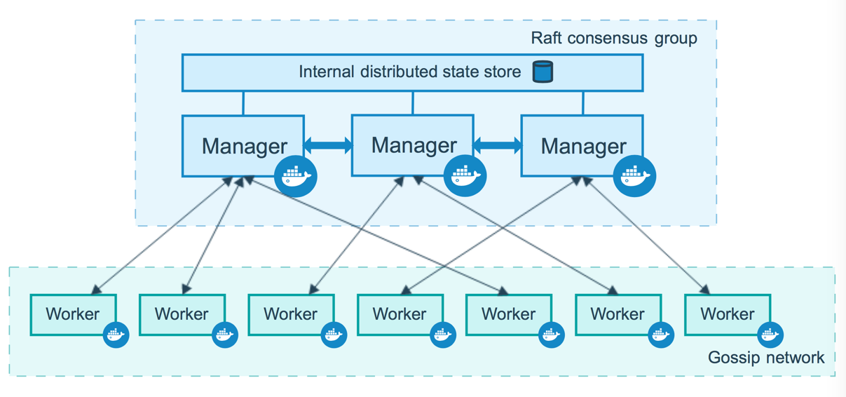
Create a fault tolerant swarm

Slide 104
Create a swarm: Change roles
You can promote a worker node to be a manager by running docker node promote. For example, you may want to promote a worker node when you take a manager node offline for maintenance.
docker node promote <node name>
You can also demote a manager node to a worker node.
docker node demote <node name>

Slide 105
Run application in production
Services

Slide 106
About services
In a distributed application, different pieces of the app are called “services”.
Services are really just “containers in production.”
A service only runs one image, but it codifies the way that image runs—what ports it should use, how many replicas of the container should run so the service has the capacity it needs, and so on.
Scaling a service changes the number of container instances running that piece of software, assigning more computing resources to the service in the process.

Slide 107
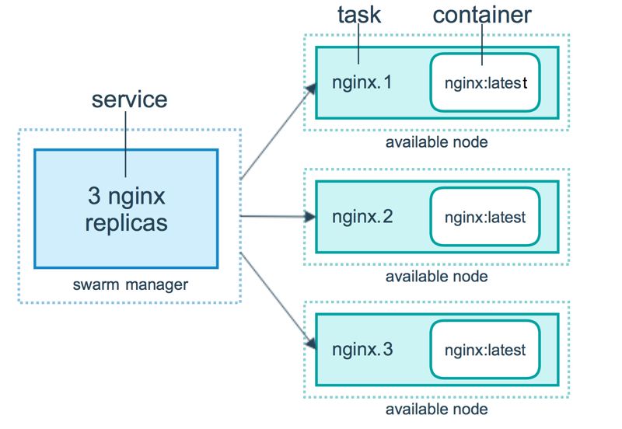
About services

Slide 108
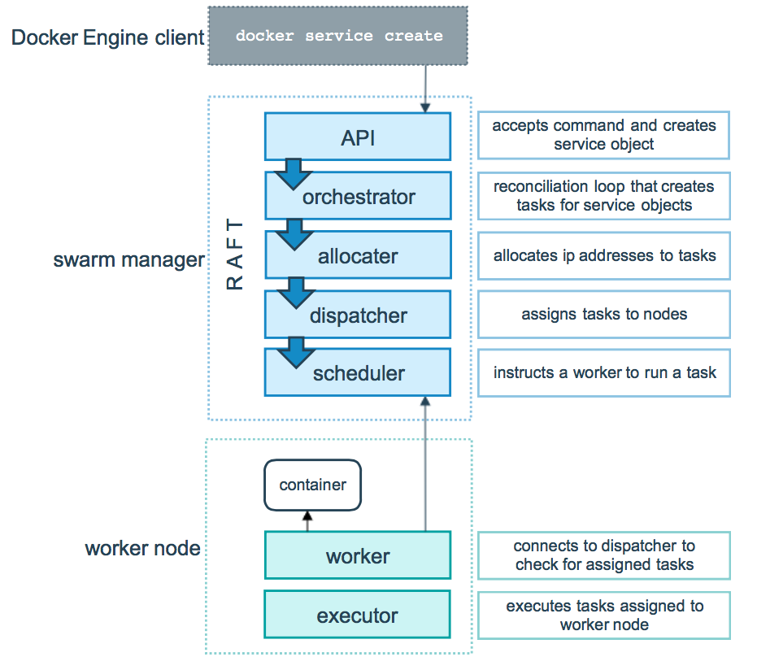
Start service

Slide 109
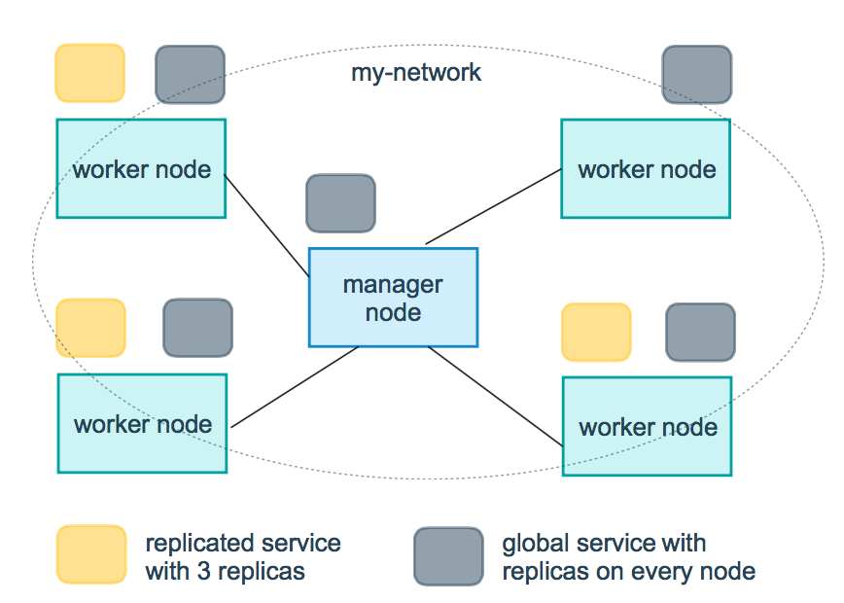
Replicated and global services

Slide 110
Create a service
Run the following command:
docker service create --replicas 1 \
--name helloworld alpine ping docker.com
The --name flag names the service helloworld.
The --replicas flag specifies the desired state of 1 running instance.
The arguments alpine ping docker.com define the service as an Alpine Linux container that executes the command ping docker.com.

Slide 111
Create a service
Run docker service ls to see the list of running services:
docker service ls
ID NAME SCALE IMAGE COMMAND
9uk4639qpg7n helloworld 1/1 alpine ping docker.com

Slide 112
Inspect and remove a service
Run docker service inspect --pretty <SERVICE-ID> to display the details about a service in an easily readable format.
docker service inspect --pretty helloworld
Run docker service rm helloworld to remove the helloworld service.
docker service rm helloworld
helloworld

Slide 113
Scale the service in the swarm
Run the following command to change the desired state of the service running in the swarm:
docker service scale helloworld=5
helloworld scaled to 5
docker service ps helloworld
NAME IMAGE NODE DESIRED STATE CURRENT STATE
helloworld.1.8p1vev3fq5zm0mi8g0as41w35 alpine worker2 Running Running 7 minutes
helloworld.2.c7a7tcdq5s0uk3qr88mf8xco6 alpine worker1 Running Running 24 seconds
helloworld.3.6crl09vdcalvtfehfh69ogfb1 alpine worker1 Running Running 24 seconds
helloworld.4.auky6trawmdlcne8ad8phb0f1 alpine manager1 Running Running 24 seconds
helloworld.5.ba19kca06l18zujfwxyc5lkyn alpine worker2 Running Running 24 seconds

Slide 114
Drain a node on the swarm
Sometimes, such as planned maintenance times, you need to set a node to DRAIN availability. DRAIN availability prevents a node from receiving new tasks from the swarm manager. It also means the manager stops tasks running on the node and launches replica tasks on a node with ACTIVE availability.
Change docker node availability availability state:
docker node update --availability drain worker1
docker node update --availability active worker1

Slide 115
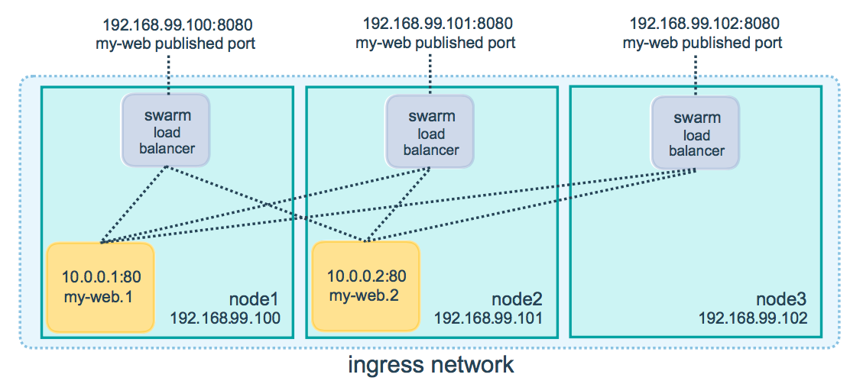
Publish a port for a service

Slide 116
Drain a node on the swarm
The following command publishes port 80 in the nginx container to port 8080 for any node in the swarm:
docker service create --name my-web \
--publish published=8080,target=80 --replicas 2 nginx
You can publish a port for an existing service using the following command:
docker service update \
--publish-add published=8080,target=80

Slide 117
Run application in production
Stacks

Slide 118
Using stacks
A stack is a group of interrelated services that share dependencies, and can be orchestrated and scaled together.
A single stack is capable of defining and coordinating the functionality of an entire application (though very complex applications may want to use multiple stacks).

Slide 119
Define service docker-compose.yml
version: "3"
services:
web:
image: username/repo:tag
deploy:
replicas: 5
resources:
limits:
cpus: "0.1"
memory: 50M
restart_policy:
condition: on-failure
ports:
- "4000:80"
networks:
- webnet
networks:
webnet:

Slide 120
Create or update the stacked service
Re-run the docker stack deploy command on the manager, and whatever services need updating are updated:
docker stack deploy -c docker-compose.yml getstartedlab
Updating service getstartedlab_web (id: angi1bf5e4to03qu9f93trnxm)
Creating service getstartedlab_visualizer (id: l9mnwkeq2jiononb5ihz9u7a4)

Slide 121
Docker-compose
Create a new Dockerfile .
FROM nginx:latest
EXPOSE 80

Slide 122
Docker-compose
Create docker-compose.yml .
version: "3.3"
services:
web:
build: .
ports:
- "8088:80"

Slide 123
Docker-compose
Build and run your app with Compose
From your project directory, start up your application by running docker-compose up.
docker-compose up

Slide 124
Questions?
andry.cheredarchuk@gmail.com

