Slide 1

K8S Administration
Introduction to Ansible

Slide 2
Ansible
Understanding YAML

Slide 3
Understanding YAML
YAML uses simple key-value pair to represent the data. The dictionary is represented in key: value pair.
Note − There should be space between : and value.
Example: A student record
--- #Optional YAML start syntax
james:
name: james john
rollNo: 34
div: B
sex: male

Slide 4
Understanding YAML
Abbreviation
You can also use abbreviation to represent dictionaries.
Example
James: {name: james john, rollNo: 34, div: B, sex: male}

Slide 5
Understanding YAML
We can also represent List in YAML. Every element(member) of list should be written in a new line with same indentation starting with “- “ (- and space).
Example
---
countries:
- America
- China
- Canada
- Iceland
…

Slide 6
Understanding YAML
Abbreviation
You can also use abbreviation to represent lists.
Example
Countries: [‘America’, ‘China’, ‘Canada’, ‘Iceland’]

Slide 7
Understanding YAML
List inside Dictionaries
We can use list inside dictionaries, i.e., value of key is list.
Example
---
james:
name: james john
rollNo: 34
div: B
sex: male
likes:
- maths
- physics
- english

Slide 8
Understanding YAML
List inside Dictionaries
We can use list inside dictionaries, i.e., value of key is list.
Example
---
james:
name: james john
rollNo: 34
div: B
sex: male
likes:
- maths
- physics
- english

Slide 9
Ansible
Usage

Slide 10
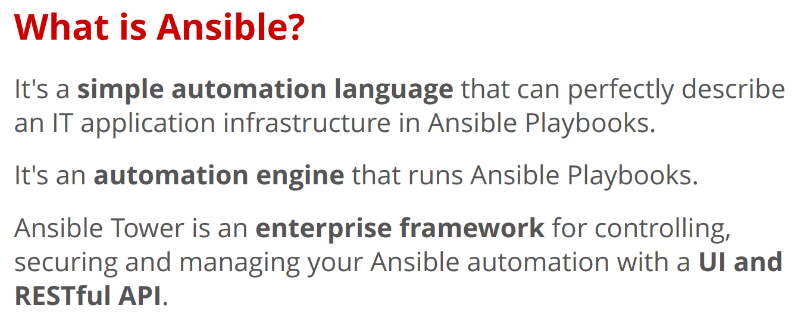

Slide 11
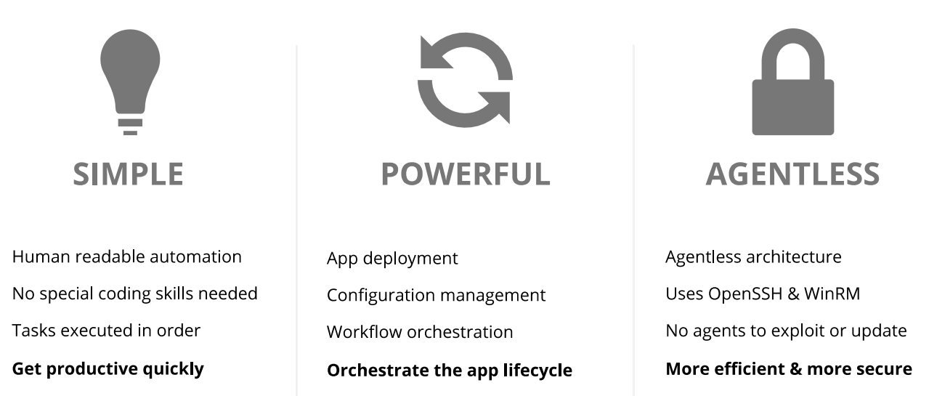

Slide 12
Terms
Some common words related to Ansible.
Service/Server − A process on the machine that provides the service.
Machine − A physical server, vm(virtual machine) or a container.
Target machine − A machine we are about to configure with Ansible.
Task − An action(run this, delete that) etc managed by Ansible.
Playbook − The yml file where Ansible commands are written and yml is executed on a machine.

Slide 13
Installation
Mainly, there are two types of machines when we talk about deployment −
Control machine − Machine from where we can manage other machines.
Remote machine − Machines which are handled/controlled by control machine.

Slide 14
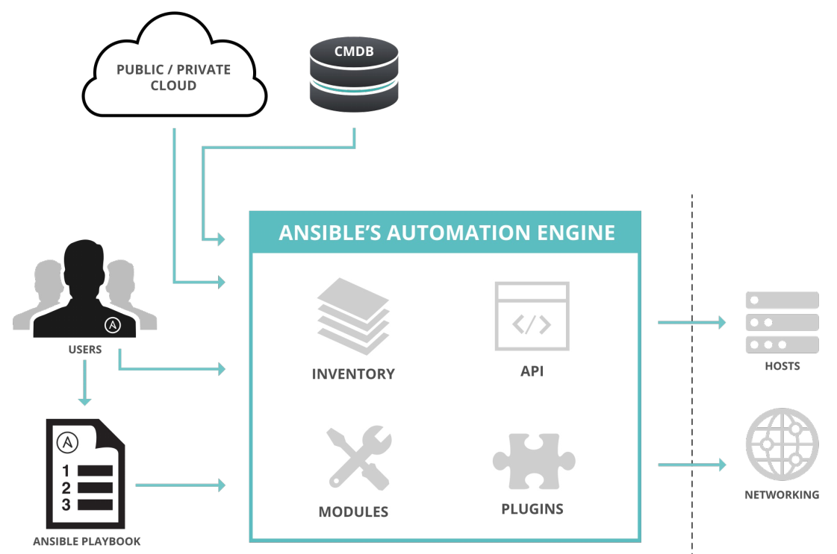

Slide 15
Modules
Modules are bits of code transferred to the target system and executed to satisfy the task declaration. Ansible ships with several hundred today!
apt/yum
copy
file
get_url
git
ping
debug
service
synchronize
template

Slide 16
Modules Documentation
# List out all modules installed
ansible-doc -l
copy
cron
...
# Read documentation for installed module
ansible-doc copy
> COPY
The [copy] module copies a file on the local box to remote locations. Use the [fetch] module to copy files from remote locations to the local box. If you need variable interpolation in copied files, use the [template] module.
* note: This module has a corresponding action plugin.
Options (= is mandatory):

Slide 17
Modules: Run Commands
If Ansible doesn’t have a module that suits your needs there are the “run command” modules:
command: Takes the command and executes it on the host. The most secure and predictable.
shell: Executes through a shell like /bin/sh so you can use pipes etc. Be careful.
script: Runs a local script on a remote node after transferring it.
raw: Executes a command without going through the Ansible module subsystem.
NOTE: Unlike standard modules, run commands have no concept of desired state and should only be used as a last resort

Slide 18
Inventory
Inventory is a collection of hosts (nodes) with associated data and groupings that Ansible can connect and manage.
Hosts (nodes)
Groups
Inventory-specific data (variables)
Static or dynamic sources

Slide 19
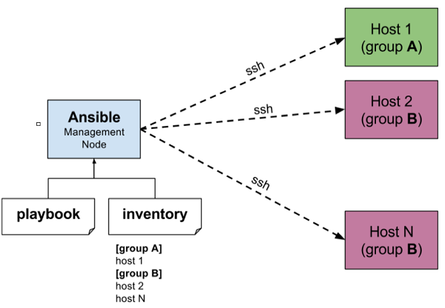
Inventory

Slide 20
Static Inventory Example
10.42.0.2
10.42.0.6
10.42.0.7
10.42.0.8
10.42.0.100
host.example.com

Slide 21
Static Inventory Example with group
[control]
control ansible_host=10.42.0.2
[web]
node-[1:3] ansible_host=10.42.0.[6:8]
[haproxy]
haproxy ansible_host=10.42.0.100
[all:vars]
ansible_user=vagrant
ansible_ssh_private_key_file=~/.vagrant.d/insecure_private_key

Slide 22
Ad-Hoc Commands
An ad-hoc command is a single Ansible task to perform quickly, but don’t want to save for later.
# check all my inventory hosts are ready to be managed by Ansible
ansible all -m ping
# collect and display the discovered facts for the localhost
ansible localhost -m setup
# run the uptime command on all hosts in the web group
ansible web -m command -a "uptime"

Slide 23
Ad-Hoc Commands
An ad-hoc command is a single Ansible task to perform quickly, but don’t want to save for later.
# To run reboot for all your company servers in a group, 'abc', in 12 parallel forks −
ansible abc –m command -a "/sbin/reboot" -f 12
# Transferring file to many servers/machines
ansible abc -m copy -a "src = /etc/yum.conf dest = /tmp/yum.conf"
# The following command checks if yum package is installed or not, but does not update it.
ansible abc -m yum -a "name = demo-tomcat-1 state = present"

Slide 24
Sidebar: Discovered Facts
Facts are bits of information derived from examining a host systems that are stored as variables for later use in a play.
ansible localhost -m setup
localhost | success >> {
"ansible_facts": {
"ansible_default_ipv4": {
"address": "192.168.1.37",
"alias": "wlan0",
"gateway": "192.168.1.1",
"interface": "wlan0",
"macaddress": "c4:85:08:3b:a9:16",
"mtu": 1500,
"netmask": "255.255.255.0",
"network": "192.168.1.0",
"type": "ether"
},

Slide 25
Variables
Ansible can work with metadata from various sources and manage their context in the form of variables.
Command line parameters
Plays and tasks
Files
Inventory
Discovered facts
Roles

Slide 26
Defining and Using Variables
You can define a simple variable using standard YAML syntax.
remote_install_path: /opt/my_app_config
After you define a variable, use Jinja2 syntax to reference it. Jinja2 variables use double curly braces. For example, the expression My amp goes to {{ max_amp_value }} demonstrates the most basic form of variable substitution. You can use Jinja2 syntax in playbooks. For example:
ansible.builtin.template:
src: foo.cfg.j2
dest: '{{ remote_install_path }}/foo.cfg'

Slide 27
Defining and Using Variables
You can define variables with multiple values using YAML lists. For example:
region:
- northeast
- southeast
- midwest
When you use variables defined as a list (also called an array), you can use individual, specific fields from that list. The first item in a list is item 0, the second item is item 1. For example:
region: "{{ region[0] }}"

Slide 28
Referencing nested variables
Many registered variables (and facts) are nested YAML or JSON data structures. You cannot access values from these nested data structures with the simple {{ foo }} syntax. You must use either bracket notation or dot notation. For example, to reference an IP address from your facts using the bracket notation:
{{ ansible_facts["eth0"]["ipv4"]["address"] }}
To reference an IP address from your facts using the dot notation:
{{ ansible_facts.eth0.ipv4.address }}

Slide 29
Using variables: inventory
host or group variables can be defined within inventory file
/etc/ansible/host_vars/hostname/*.yaml
/etc/ansible/group_vars/group_name/*.yaml

Slide 30
Variables
block:
- name: Install Tomcat artifacts
action:
yum name = "demo-tomcat-1" state = present
register: Output
always:
- debug:
msg:
- "Install Tomcat artifacts task ended with message: {{Output}}"
- "Installed Tomcat artifacts - {{Output.changed}}"

Slide 31
Tasks
Tasks are the application of a module to perform a specific unit of work.
file: A directory should exist
yum: A package should be installed
service: A service should be running
template: Render a configuration file from a template
get_url: Fetch an archive file from a URL
git: Clone a source code repository

Slide 32
Example Tasks in a Play
tasks:
- name: httpd package is present
yum:
name: httpd
state: latest
- name: latest index.html file is present
copy:
src: files/index.html
dest: /var/www/html/
- name: restart httpd
service:
name: httpd
state: restarted

Slide 33
Handler Tasks
Handlers are special tasks that run at the end of a play if notified by another task when a change occurs.
If a configuration file gets changed notify a service restart task that it needs to run tasks:

Slide 34
Example Handler Task in a Play
tasks:
- name: httpd package is present
yum:
name: httpd
state: latest
notify: restart httpd
- name: latest index.html file is present
copy:
src: files/index.html
dest: /var/www/html/
handlers:
- name: restart httpd
service:
name: httpd
state: restarted

Slide 35
Plays & Playbooks
Plays are ordered sets of tasks to execute against host selections from your inventory.
A playbook is a file containing one or more plays.

Slide 36
Playbook Example
---
- name: install and start apache
hosts: web
become: yes
vars:
http_port: 80
tasks:
- name: httpd package is present
yum:
name: httpd
state: latest
- name: latest index.html file is present
copy:
src: files/index.html
dest: /var/www/html/

Slide 37
Doing More with Playbooks
Here are some more essential playbook features that you can apply:
Templates
Loops
Conditionals
Tags
Blocks

Slide 38
Templates
Ansible embeds the that can be used to dynamically:
Set and modify play variables
Conditional logic
Generate files such as configurations from variables

Slide 39
Templates
Templates allow you to create new files on the nodes using predefined models based on the Jinja2 templating system.
Ansible templates are typically saved as .tpl files and support the use of variables, loops, and conditional expressions.
Templates are commonly used to configure services based on variable values that can be set up on the playbook itself, in included variable files, or obtained via facts.
This enables you to create more versatile setups that adapt behavior based on dynamic information.

Slide 40
Templates
General purpose template language
Python library
Delimiters
{% expression %} → logic
{{ expression }} → output results
{# expression #} → comment

Slide 41
Template example
<!doctype html>
<html lang="en">
<head>
<meta charset="utf-8">
<title>{{ page_title }}</title>
<meta name="description" content="Created with Ansible">
</head>
<body>
<h1>{{ page_title }}</h1>
<p>{{ page_description }}</p>
</body>
</html>

Slide 42
Template usage
This template uses two variables that must be provided whenever the template is applied in a playbook: page_title and page_description.
The following playbook sets up the required variables, installs Nginx, and then applies the specified template to replace the existing, default Nginx landing page located at /var/www/html/index.nginx-debian.html.
The last task uses the ufw module to enable tcp access on port 80, in case you have your firewall enabled as recommended in our initial server setup guide.

Slide 43
Template usage
---
- hosts: all
become: yes
vars:
page_title: My Landing Page
page_description: This is my landing page description.
tasks:
- name: Install Nginx
apt:
name: nginx
state: latest
- name: Apply Page Template
template:
src: files/landing-page.html.j2
dest: /var/www/html/index.nginx-debian.html
- name: Allow all access to tcp port 80
ufw:
rule: allow
port: '80'
proto: tcp

Slide 44
Loops
Loops can do one task on multiple things, such as create a lot of users, install a lot of packages, or repeat a polling step until a certain result is reached.
- yum:
name: "{{ item }}"
state: latest
with_items:
- httpd
- mod_wsgi

Slide 45
Loops
Avoid loops where possible
When module supports lists as input parameter
package, dnf, apt, apk, etc . . .
Standard loops over a list → with_items
Loop over a nested list → with_nested
Loop over a dictionary → with_dict
with_file → over contents of file list
with_fileglob → over matched file list
with_sequence → over number sequence

Slide 46
Loops
Loops can do one task on multiple things, such as create a lot of users, install a lot of packages, or repeat a polling step until a certain result is reached.
tasks:
- name: Install Apache
shell: "ls *.war"
register: output
args:
chdir: /opt/ansible/tomcat/demo/webapps
- file:
src: '/opt/ansible/tomcat/demo/webapps/{{ item }}'
dest: '/users/demo/vivek/{{ item }}'
state: link
with_items: "{{output.stdout_lines}}"

Slide 47
Conditionals
when → only perform task if condition is true
when processed for each item in loop
Can be used with
import*, include*
roles
fail, and assert exit play based on conditions

Slide 48
Conditionals
When you add a conditional to an import statement, Ansible applies the condition to all tasks within the imported file. This behavior is the equivalent of Tag inheritance: adding tags to multiple tasks. Ansible applies the condition to every task and evaluates each task separately. For example, if you want to define and then display a variable that was not previously defined, you might have a playbook called main.yml and a tasks file called other_tasks.yml:
# all tasks within an imported file inherit the condition from the import statement
- hosts: all
tasks:
- import_tasks: other_tasks.yml # note "import"
when: x is not defined

Slide 49
Tags
Tags are useful to be able to run a subset of a playbook on-demand.
- yum:
name: "{{ item }}"
state: latest
with_items:
- httpd
- mod_wsgi
tags:
- packages
- template:
src: templates/httpd.conf.j2
dest: /etc/httpd/conf/httpd.conf
tags:
- configuration

Slide 50
Tags usage
The following command helps in using tags
ansible-playbook -i hosts <your yaml> --tags "install" -vvv

Slide 51
Exception Handling in Playbooks
tasks:
- name: Name of the task to be executed
block:
- debug: msg = 'Just a debug message , relevant for logging'
- command: <the command to execute>
rescue:
- debug: msg = 'There was an exception.. '
- command: <Rescue mechanism for the above exception occurred)
always:
- debug: msg = "this will execute in all scenarios. Always will get logged"

Slide 52
Roles
In Ansible, the role is the primary mechanism for breaking a playbook into multiple files. This simplifies writing complex playbooks, and it makes them easier to reuse. The breaking of playbook allows you to logically break the playbook into reusable components.
Roles are not playbooks. Roles are small functionality which can be independently used but have to be used within playbooks. There is no way to directly execute a role. Roles have no explicit setting for which host the role will apply to.
Top-level playbooks are the bridge holding the hosts from your inventory file to roles that should be applied to those hosts.

Slide 53
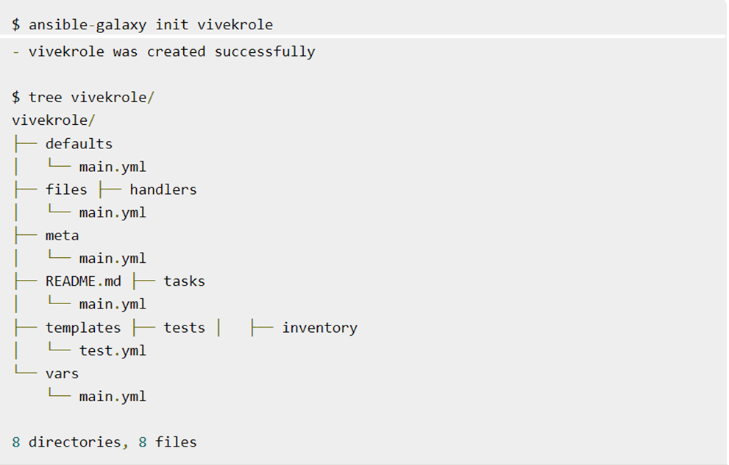

Slide 54
Utilizing Roles in Playbook
This is the code of the playbook we have written for demo purpose. This code is of the playbook vivek_orchestrate.yml. We have defined the hosts: tomcat-node and called the two roles – install-tomcat and start-tomcat.
The problem statement is that we have a war which we need to deploy on a machine via Ansible.
---
- hosts: tomcat-node
roles:
- {role: install-tomcat}
- {role: start-tomcat}

Slide 55
Configuring Ansible Vault
The ansible-vault encrypt_string command encrypts and formats any string you type (or copy or generate) into a format that can be included in a playbook, role, or variables file. To create a basic encrypted variable, pass three options to the ansible-vault encrypt_string command:
a source for the vault password (prompt, file, or script, with or without a vault ID)
the string to encrypt
the string name (the name of the variable)

Slide 56
Configuring Ansible Vault
ansible-vault
create → new encrypted file
encrypt_string → STDIN/STDOUT or argument
{en,de}crypt → file
view → decrypt to STDOUT
edit → decrypt, edit, encrypt
rekey → decrypt, encrypt with new password

Slide 57
Configuring Ansible Vault
The pattern looks like this:
For example, to encrypt the string ‘foobar’ using the only password stored in ‘a_password_file’ and name the variable ‘the_secret’:
ansible-vault encrypt_string --vault-password-file a_password_file 'foobar' --name 'the_secret'
The command above creates this content:
the_secret: !vault |
$ANSIBLE_VAULT;1.1;AES256
62313365396662343061393464336163383764373764613633653634306231386433626436623361
6134333665353966363534333632666535333761666131620a663537646436643839616531643561
63396265333966386166373632626539326166353965363262633030333630313338646335303630
3438626666666137650a353638643435666633633964366338633066623234616432373231333331
6564

Slide 58
Questions?
andry.cheredarchuk@gmail.com

