Slide 1
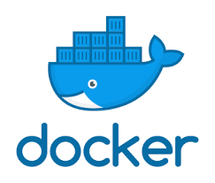
Linux Administration: Kubernetes
Main concepts

Slide 2
Kubernetes
About the platform

Slide 3
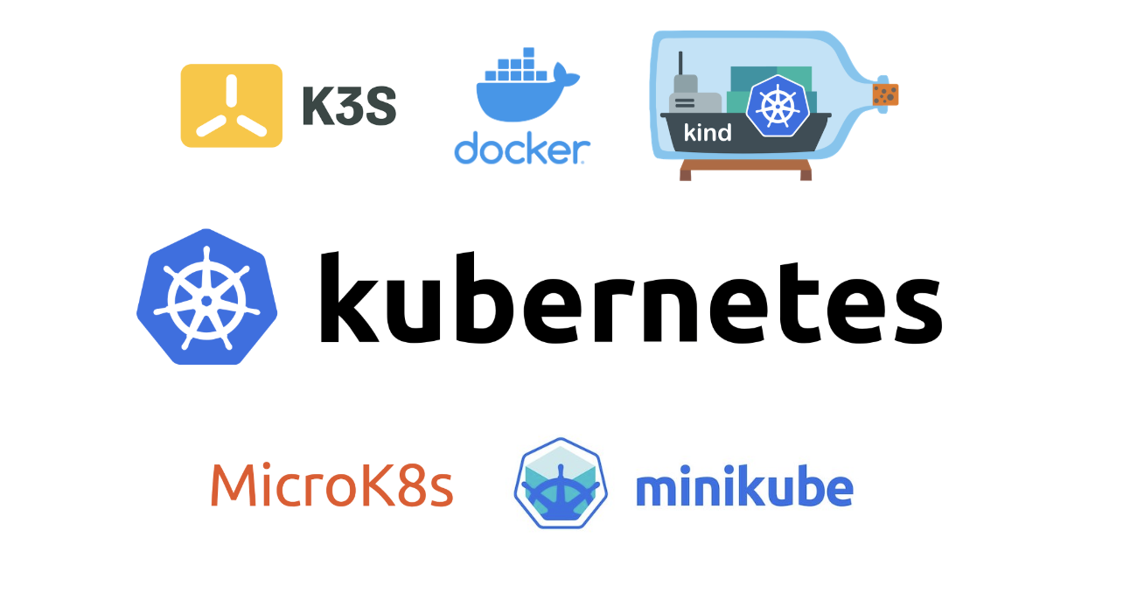
Kubernetes: Getting started

Slide 4
What Is Kubernetes?
According to the Kubernetes website,
"Kubernetes is an open-source system for automating deployment, scaling, and management of containerized applications."
Kubernetes comes from the Greek word κυβερνήτης, which means helmsman or ship pilot. With this analogy in mind, we can think of Kubernetes as the pilot on a ship of containers.
Kubernetes is also referred to as k8s (pronounced Kate's), as there are 8 characters between k and s.

Slide 5
Kubernetes: Concepts
To work with Kubernetes, you use Kubernetes API objects to describe your cluster’s desired state:
what applications or other workloads you want to run,
what container images they use, the number of replicas,
what network and disk resources you want to make available, and more.
You set your desired state by creating objects using the Kubernetes API, typically via the command-line interface, kubectl.
You can also use the Kubernetes API directly to interact with the cluster and set or modify your desired state.

Slide 6
Kubernetes: Cloud platform
Google Kubernetes Engine (GKE): Google's solution that manages production-ready Kubernetes clusters for you.
Amazon Elastic Kubernetes Service (EKS): Amazon's solution that manages production-ready Kubernetes clusters for you.
Azure Kubernetes Service (AKS): Azure's solution that provides you managed, production-ready Kubernetes clusters.
OpenShift Kubernetes: Red Hat's solution that handles Kubernetes clusters for you.

Slide 7
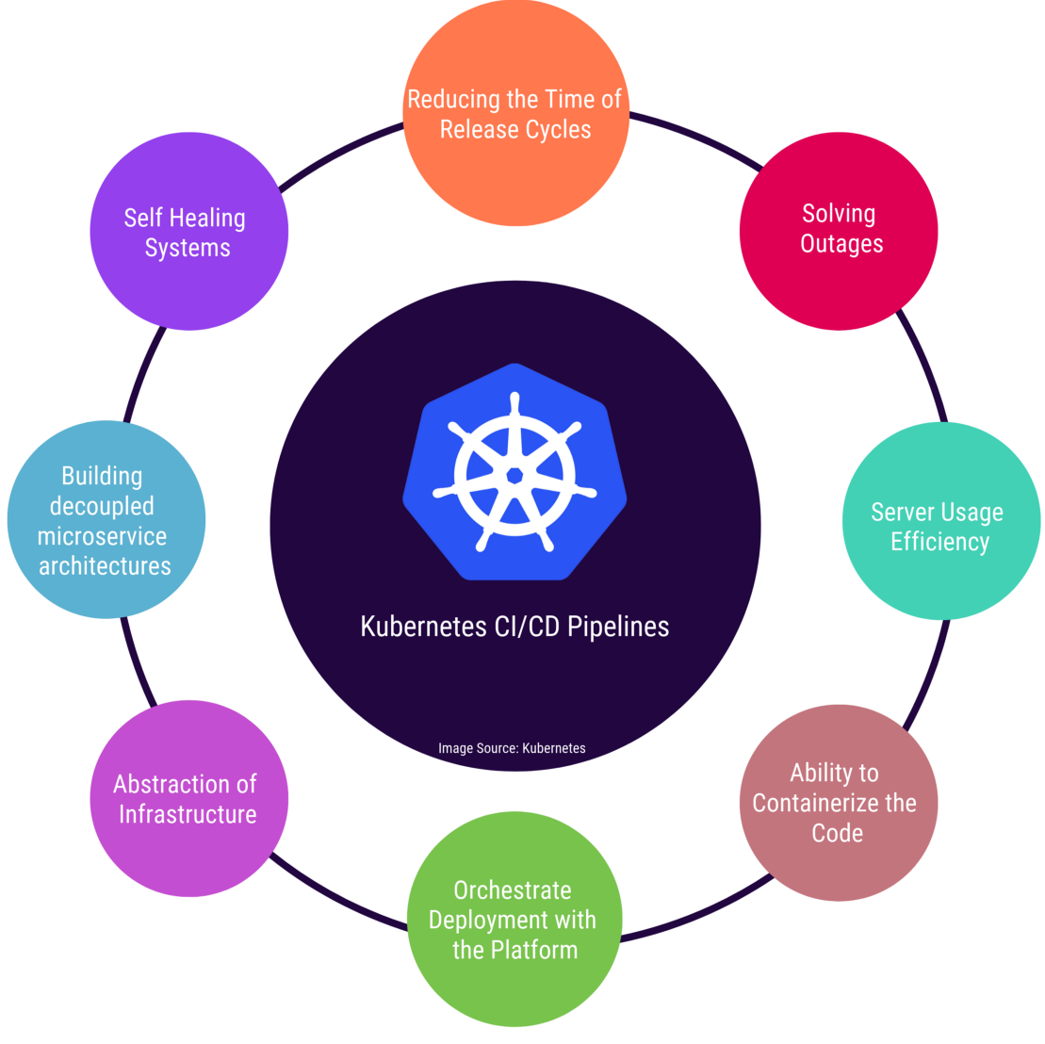
Kubernetes: Features

Slide 8
Kubernetes: Features
Kubernetes offers a very rich set of features for container orchestration. Some of its fully supported features are:
Automatic bin packing Kubernetes automatically schedules containers based on resource needs and constraints, to maximize utilization without sacrificing availability.
Self-healing Kubernetes automatically replaces and reschedules containers from failed nodes. It kills and restarts containers unresponsive to health checks, based on existing rules/policy. It also prevents traffic from being routed to unresponsive containers.
Horizontal scaling With Kubernetes applications are scaled manually or automatically based on CPU or custom metrics utilization.

Slide 9
Kubernetes: Features
Kubernetes offers a very rich set of features for container orchestration. Some of its fully supported features are:
Service discovery and Load balancing Containers receive their own IP addresses from Kubernetes, while it assigns a single Domain Name System (DNS) name to a set of containers to aid in load-balancing requests across the containers of the set.
Automated rollouts and rollbacks Kubernetes seamlessly rolls out and rolls back application updates and configuration changes, constantly monitoring the application's health to prevent any downtime.
Secret and configuration management Kubernetes manages sensitive data and configuration details for an application separately from the container image, in order to avoid a re-build of the respective image. Secrets consist of sensitive/confidential information passed to the application without revealing the sensitive content to the stack configuration, like on GitHub.

Slide 10
Kubernetes: Features
Kubernetes offers a very rich set of features for container orchestration. Some of its fully supported features are:
Storage orchestration Kubernetes automatically mounts software-defined storage (SDS) solutions to containers from local storage, external cloud providers, distributed storage, or network storage systems.
Batch execution Kubernetes supports batch execution, long-running jobs, and replaces failed containers.

Slide 11
Why Use Kubernetes?
In addition to its fully-supported features, Kubernetes is also portable and extensible. It can be deployed in many environments such as local or remote Virtual Machines, bare metal, or in public/private/hybrid/multi-cloud setups. It supports and it is supported by many 3rd party open source tools which enhance Kubernetes' capabilities and provide a feature-rich experience to its users.
Kubernetes' architecture is modular and pluggable. Not only that it orchestrates modular, decoupled microservices type applications, but also its architecture follows decoupled microservices patterns. Kubernetes' functionality can be extended by writing custom resources, operators, custom APIs, scheduling rules or plugins.

Slide 12
Kubernetes
Main concepts

Slide 13
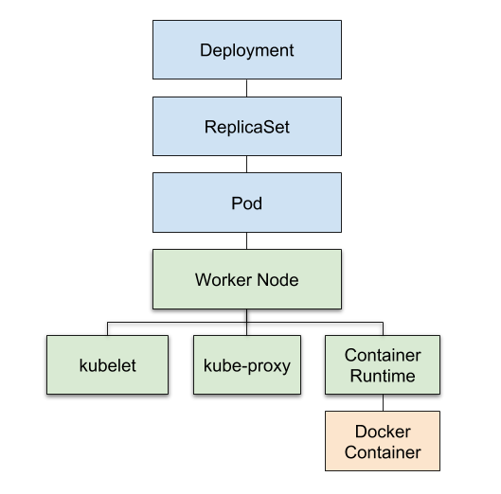
Kubernetes: Abstraction Level
Deployments create and manage ReplicaSets,
which create and manage Pods, which run on Nodes,
which have a container runtime,
which run the app code you put in your Docker image.
https://towardsdatascience.com/key-kubernetes-concepts-62939f4bc08e

Slide 14
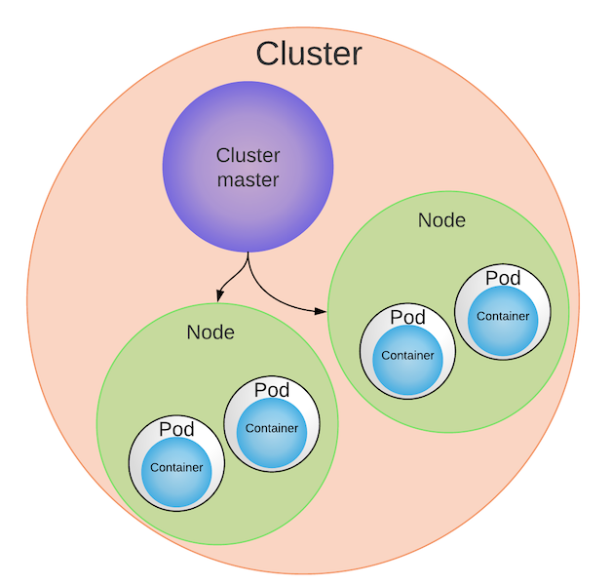
Kubernetes cluster
Masters make scheduling decisions, respond to events, implement changes, and monitor the Cluster.
Worker node is a computer server.
One or more Pods run on a single Worker Node.

Slide 15
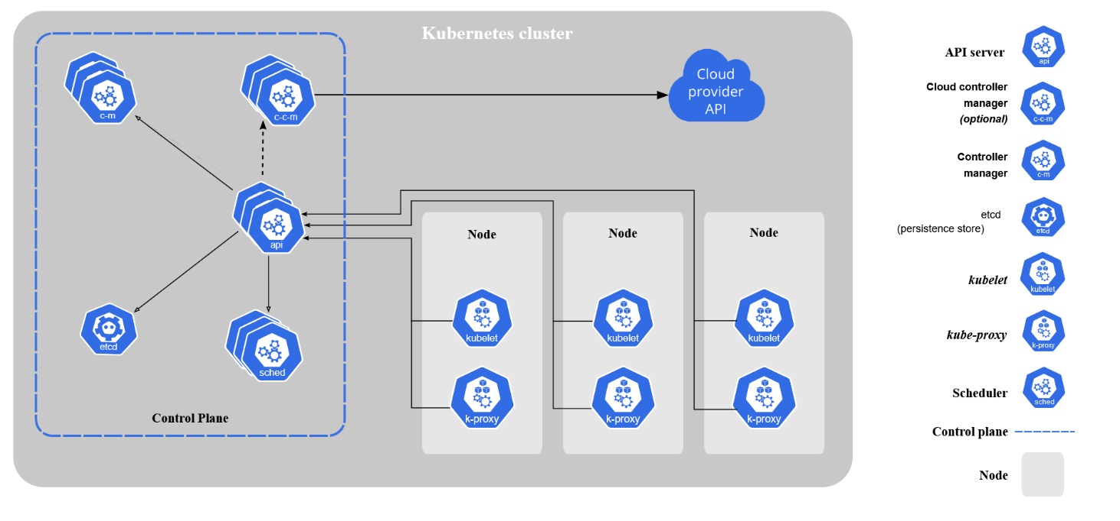
Kubernetes components

Slide 16
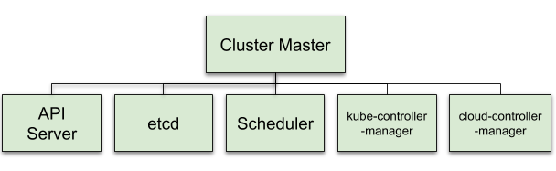
Kubernetes master
API Server — Exposes the K8s API. It’s the frontend for Kubernetes control. (aka. kube-apiserver) Think hub.
etcd — Distributed key-value store for Cluster state data. Think Cluster info.
Scheduler — Selects the Nodes for new Pods. Good guide here. (aka kube-scheduler) Think matcher.
kube-controller-manager —Process that runs controllers to handle Cluster background tasks. Think Cluster controller.
cloud-controller-manager — Runs controllers that interact with cloud providers. Think cloud interface.

Slide 17
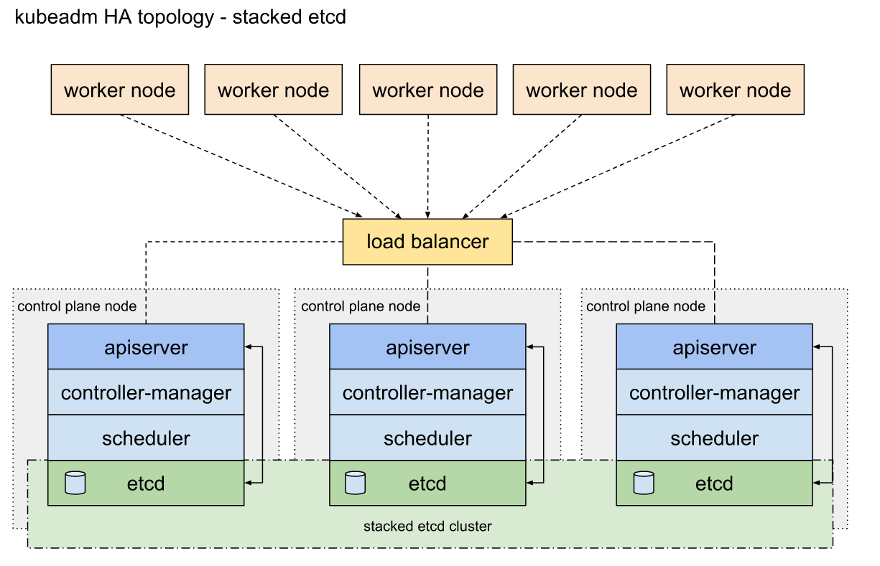

Slide 18
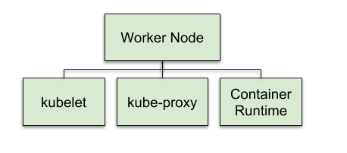
Kubernetes worker
kubelet — Responsible for everything on the Worker Node. It communicates with the Master’s API server. Think brain for Worker Node.
kube-proxy — Routes connections to the correct Pods. Also performs load balancing across Pods for a Service. Think traffic cop.
Container Runtime — Downloads images and runs containers. For example, Docker is a Container Runtime. Think Docker.

Slide 19
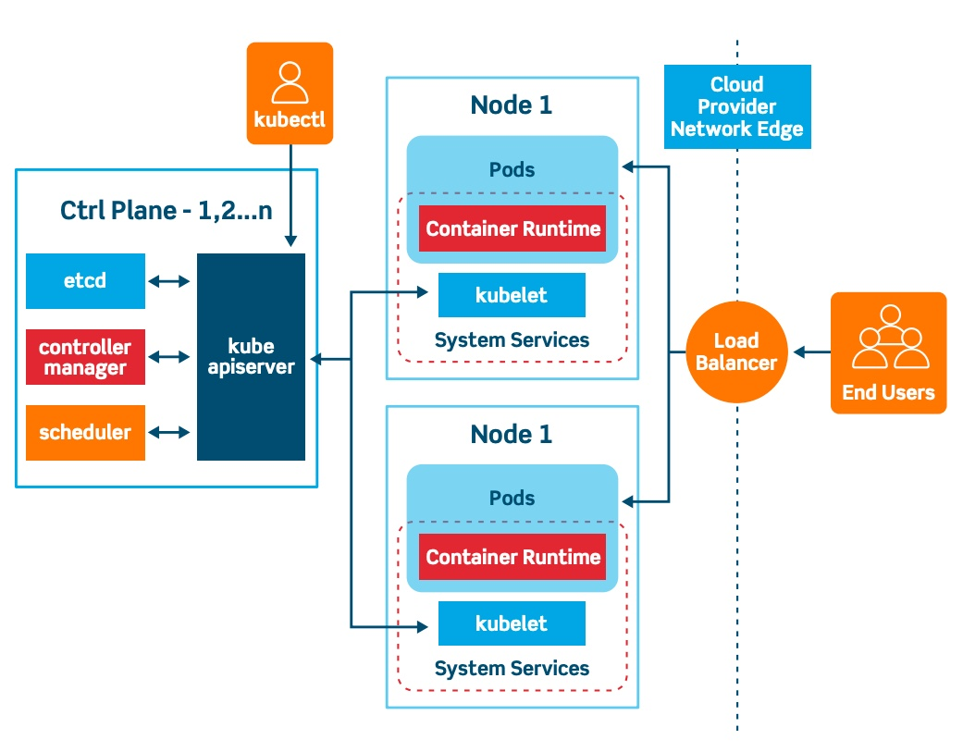
Kubernetes: Functional Level: - control plane - pods

Slide 20
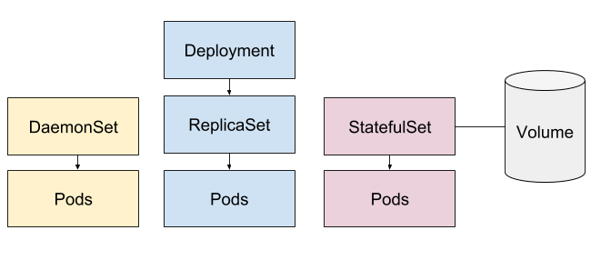
Kubernetes High-Level Controllers

Slide 21
Kubernetes
Main concepts

Slide 22
Kubernetes Object Model
Kubernetes has a very rich object model, representing different persistent entities in the Kubernetes cluster. Those entities describe:
What containerized applications we are running
The nodes where the containerized applications are deployed
Application resource consumption
Policies attached to applications, like restart/upgrade policies, fault tolerance, etc.
Examples of Kubernetes objects are Pods, ReplicaSets, Deployments, Namespaces, etc. We will explore them next.

Slide 23
Kubernetes High-Level Controllers

Slide 24
Kubernetes Pods
Usually you don't need to create Pods directly, even singleton Pods. Instead, create them using workload resources such as Deployment or Job. If your Pods need to track state, consider the StatefulSet resource.
Pods in a Kubernetes cluster are used in two main ways:
The "one-container-per-Pod" model is the most common Kubernetes use case; in this case, you can think of a Pod as a wrapper around a single container;
A Pod can encapsulate an application composed of multiple co-located containers that are tightly coupled and need to share resources. These co-located containers form a single cohesive unit of service—for example, one container serving data stored in a shared volume to the public, while a separate sidecar container refreshes or updates those files.

Slide 25
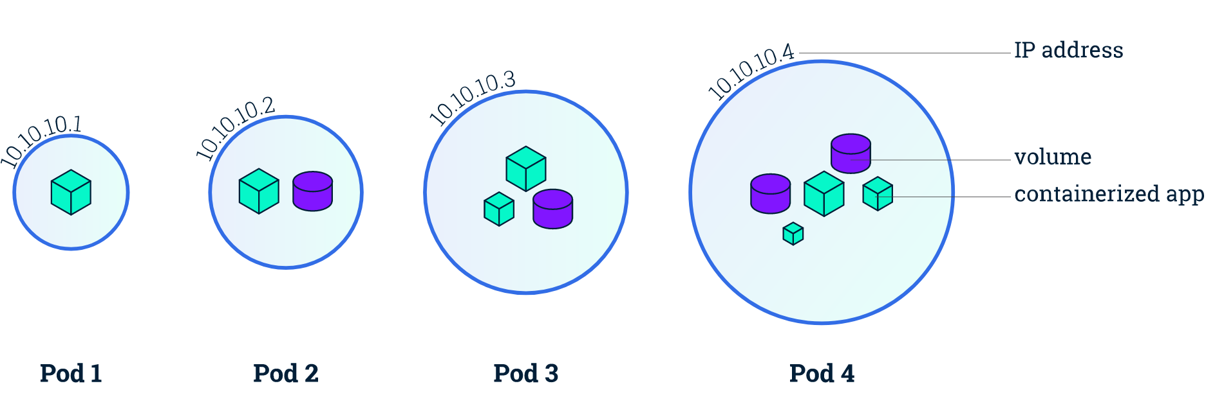
Kubernetes Pods

Slide 26
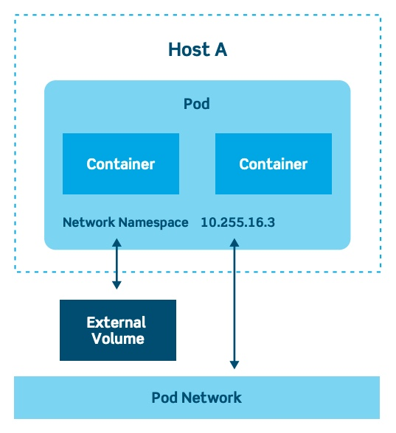
Kubernetes Pod
Pod
The Pod is the basic building block of Kubernetes. A Pod contains a group of one or more containers. Generally, each Pod has one container

Slide 27
Kubernetes Pod
apiVersion: v1
kind: Pod
metadata:
name: nginx-pod
labels:
app: nginx
spec:
containers:
- name: nginx
image: nginx:1.15.11
ports:
- containerPort: 80

Slide 28
Labels
Labels are key-value pairs attached to Kubernetes objects (e.g. Pods, ReplicaSets, Nodes, Namespaces, Persistent Volumes).
Labels are used to organize and select a subset of objects, based on the requirements in place.
Many objects can have the same Label(s).
Labels do not provide uniqueness to objects.
Controllers use Labels to logically group together decoupled objects, rather than using objects' names or IDs.

Slide 29
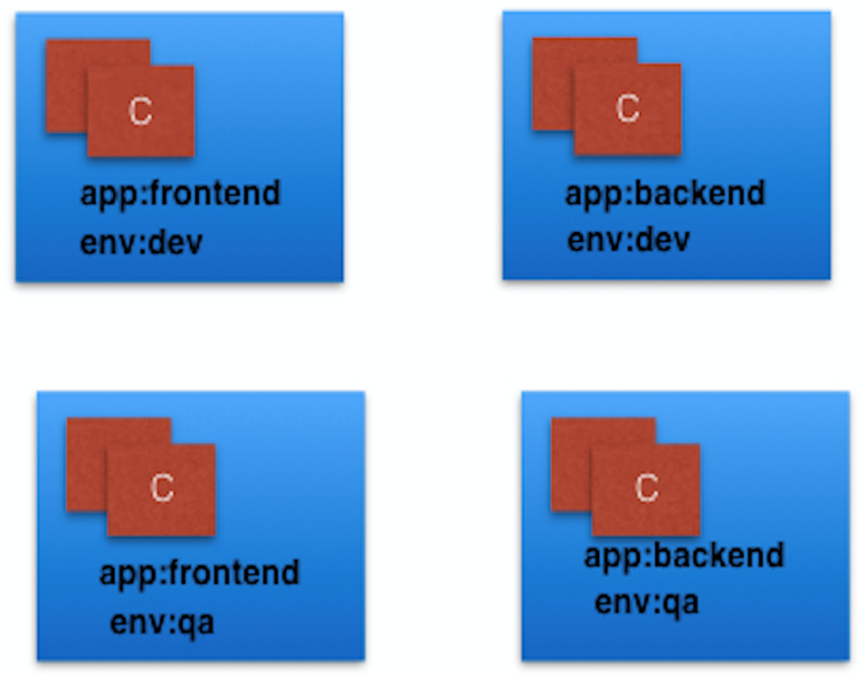
Labels

Slide 30
Kubernetes Label Selectors
o Equality-Based Selectors
Equality-Based Selectors allow filtering of objects based on Label keys and values. Matching is achieved using the =, == (equals, used interchangeably), or != (not equals) operators. For example, with env==dev or env=dev we are selecting the objects where the env Label key is set to value dev.
o Set-Based Selectors
Set-Based Selectors allow filtering of objects based on a set of values. We can use in, notin operators for Label values, and exist/does not exist operators for Label keys. For example, with env in (dev,qa) we are selecting objects where the env Label is set to either dev or qa; with !app we select objects with no Label key app.

Slide 31
Kubernetes Label
In the image above, we have used two Label keys: app and env.
Based on our requirements, we have given different values to our four Pods.
The Label env=dev logically selects and groups the top two Pods, while the Label app=frontend logically selects and groups the left two Pods.
We can select one of the four Pods - bottom left, by selecting two Labels: app=frontend AND env=qa.

Slide 32
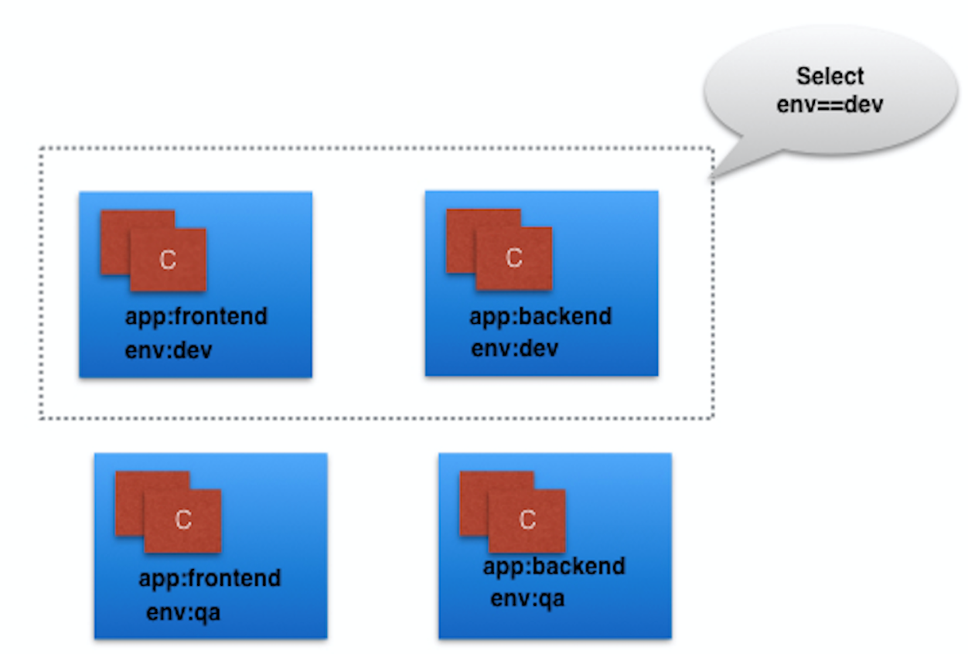
Label Selectors

Slide 33
Kubernetes ReplicaSets
A ReplicaSet’s purpose is to maintain a stable set of replica Pods running at any given time. As such, it is often used to guarantee the availability of a specified number of identical Pods.
A ReplicaSet is defined with fields, including a selector that specifies how to identify Pods it can acquire, a number of replicas indicating how many Pods it should be maintaining, and a pod template specifying the data of new Pods it should create to meet the number of replicas criteria.

Slide 34
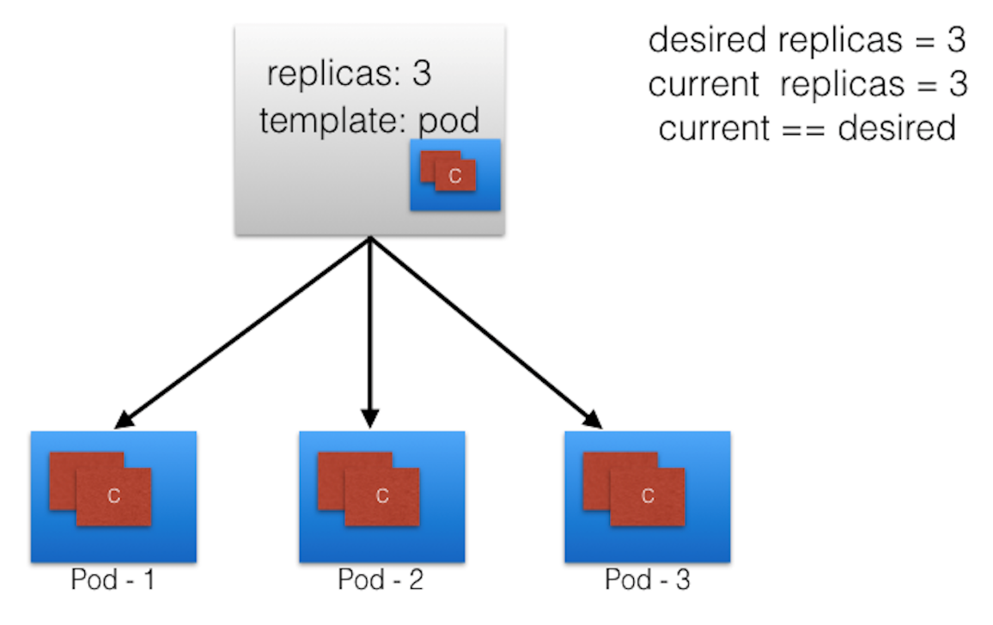
Replica Sets

Slide 35
Kubernetes ReplicaSets
apiVersion: apps/v1
kind: ReplicaSet
metadata:
name: frontend
labels:
app: guestbook
tier: frontend
spec:
# modify replicas according to your case
replicas: 3
selector:
matchLabels:
tier: frontend
template:
metadata:
labels:
tier: frontend
spec:
containers:
- name: php-redis
image: gcr.io/google_samples/gb-frontend:v3

Slide 36
Kubernetes ReplicaSets Autoscaling
apiVersion: autoscaling/v1
kind: HorizontalPodAutoscaler
metadata:
name: frontend-scaler
spec:
scaleTargetRef:
kind: ReplicaSet
name: frontend
minReplicas: 3
maxReplicas: 10
targetCPUUtilizationPercentage: 50

Slide 37
Kubernetes Namespaces
If multiple users and teams use the same Kubernetes cluster we can partition the cluster into virtual sub-clusters using Namespaces. The names of the resources/objects created inside a Namespace are unique, but not across Namespaces in the cluster.
To list all the Namespaces, we can run the following command:
kubectl get namespaces NAME STATUS AGE default Active 11h kube-node-lease Active 11h kube-public Active 11h kube-system Active 11h

Slide 38
Kubernetes High-Level Controllers
StatefulSet
Like a ReplicaSet, a StatefulSet manages deployment and scaling of a group of Pods based on a container spec.
Unlike a Deployment, a StatefulSet’s Pods are not interchangeable. Each Pod has a unique, persistent identifier that the controller maintains over any rescheduling.
StatefulSets for good for persistent, stateful backends like databases.

Slide 39
Kubernetes StatefulSet
apiVersion: apps/v1
kind: StatefulSet
metadata:
name: web
spec:
selector:
matchLabels:
app: nginx # has to match .spec.template.metadata.labels
serviceName: "nginx"
replicas: 3 # by default is 1

Slide 40
Kubernetes High-Level Controllers
DaemonSets are for continuous process.
They run one Pod per Node.
DaemonSets are useful for ongoing background tasks such as monitoring and log collection.
Each new Node added to the cluster automatically gets a Pod started by the DaemonSet.
As nodes are removed from the cluster, those Pods are garbage collected.
Deleting a DaemonSet will clean up the Pods it created

Slide 41
Kubernetes DaemonSet
apiVersion: apps/v1
kind: DaemonSet
metadata:
name: fluentd-elasticsearch
namespace: kube-system
labels:
k8s-app: fluentd-logging
spec:
…….

Slide 42
Kubernetes Deployments
A Deployment provides declarative updates for Pods and ReplicaSets.
You describe a desired state in a Deployment, and the Deployment Controller changes the actual state to the desired state at a controlled rate. You can define Deployments to create new ReplicaSets, or to remove existing Deployments and adopt all their resources with new Deployments.

Slide 43
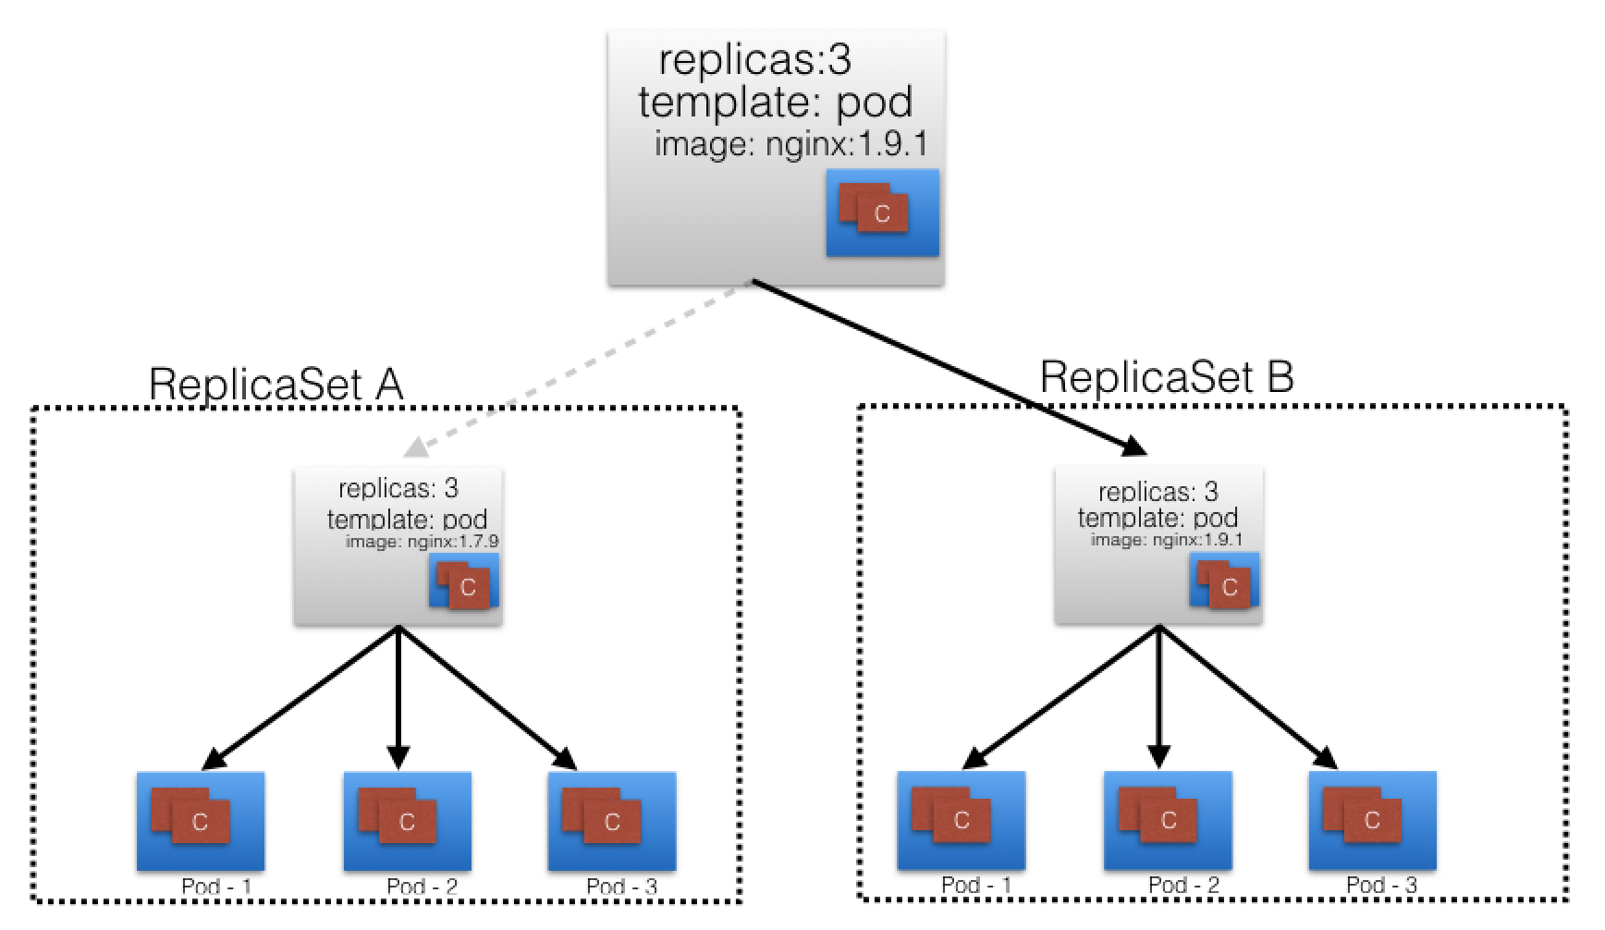
Deployments

Slide 44
Kubernetes Deployments
apiVersion: apps/v1
kind: Deployment
metadata:
name: nginx-deployment
labels:
app: nginx
spec:
replicas: 3
selector:
matchLabels:
app: nginx
template:
metadata:
labels:
app: nginx
spec:
containers:
- name: nginx
image: nginx:1.14.2
ports:
- containerPort: 80

Slide 45
Kubernetes Deployments Updating
Let’s update the nginx Pods to use the nginx:1.16.1 image instead of the nginx:1.14.2 image:
kubectl --record deployment.apps/nginx-deployment set \
image deployment.v1.apps/nginx-deployment nginx=nginx:1.16.1
kubectl set image deployment/nginx-deployment \
nginx=nginx:1.16.1 –record
kubectl edit deployment.v1.apps/nginx-deployment

Slide 46
Kubernetes Deployments
Run kubectl get rs to see that the Deployment updated the Pods by creating a new ReplicaSet and scaling it up to 3 replicas, as well as scaling down the old ReplicaSet to 0 replicas.
Running get pods should now show the Pods.

Slide 47
Kubernetes Deployments Scaling
You can scale a Deployment by using the following command:
kubectl scale deployment.v1.apps/nginx-deployment --replicas=10
Assuming horizontal Pod autoscaling is enabled in your cluster, you can setup an autoscaler for your Deployment and choose the minimum and maximum number of Pods you want to run based on the CPU utilization of your existing Pods.
kubectl autoscale deployment.v1.apps/nginx-deployment \
--min=10 --max=15 --cpu-percent=80

Slide 48
Kubernetes Job and CronJob
A Job creates one or more Pods and ensures that a specified number of them successfully terminate. As pods successfully complete, the Job tracks the successful completions. When a specified number of successful completions is reached, the task (ie, Job) is complete. Deleting a Job will clean up the Pods it created.
A CronJob creates Jobs on a repeating schedule. CronJobs are useful for creating periodic and recurring tasks, like running backups or sending emails. CronJobs can also schedule individual tasks for a specific time, such as scheduling a Job for when your cluster is likely to be idle.

Slide 49
Kubernetes High-Level Controllers
Job
A Job is a supervisor for Pods that run a batch process. A Job creates Pods and ensures they do a task by tracking the number of successful Pod completions. Unlike a ReplicaSet, once the process inside the container finishes successfully, the container is not restarted. Use a Job when you want to run a process once.

Slide 50
Kubernetes Job
apiVersion: batch/v1
kind: Job
metadata:
name: pi
spec:
template:
spec:
containers:
- name: pi
image: perl
command: ["perl", "-Mbignum=bpi", "-wle", "print bpi(2000)"]
restartPolicy: Never
backoffLimit: 4

Slide 51
Kubernetes High-Level Controllers
CronJob
If you want to run a Job at regular, specified times (e.g. hourly, daily, or monthly), create a CronJob. A CronJob is similar to a Job, but is scheduled to repeat at regular intervals or set times.

Slide 52
Kubernetes CronJob
apiVersion: batch/v1beta1
kind: CronJob
metadata:
name: hello
spec:
schedule: "*/1 * * * *"
jobTemplate:
spec:
template:
spec:
containers:
- name: hello
image: busybox
args:
- /bin/sh
- -c
- date; echo Hello from the Kubernetes cluster
restartPolicy: OnFailure

Slide 53
Kubernetes Volumes
A Volume is a directory that can hold data. A Volume is a component of a Pod, and is not independent of it. A Volume is created in the Pod specification. A Volume cannot be deleted on its own.
A Volume is made accessible to all the containers in a Pod. Each container that you want to access the Volume must mount it individually.
A K8s Volume outlives any individual containers, but when the enclosing Pod dies, the Volume dies, too. However, the files of some Volume types continue to exist in local or cloud storage, even after the Volume is gone.

Slide 54
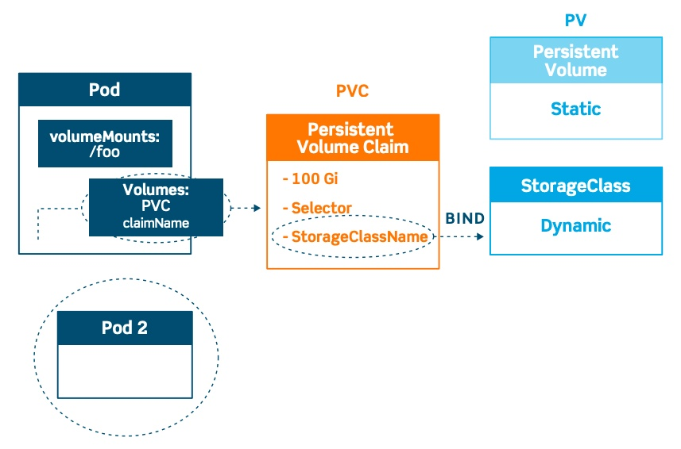
Kubernetes Volumes

Slide 55
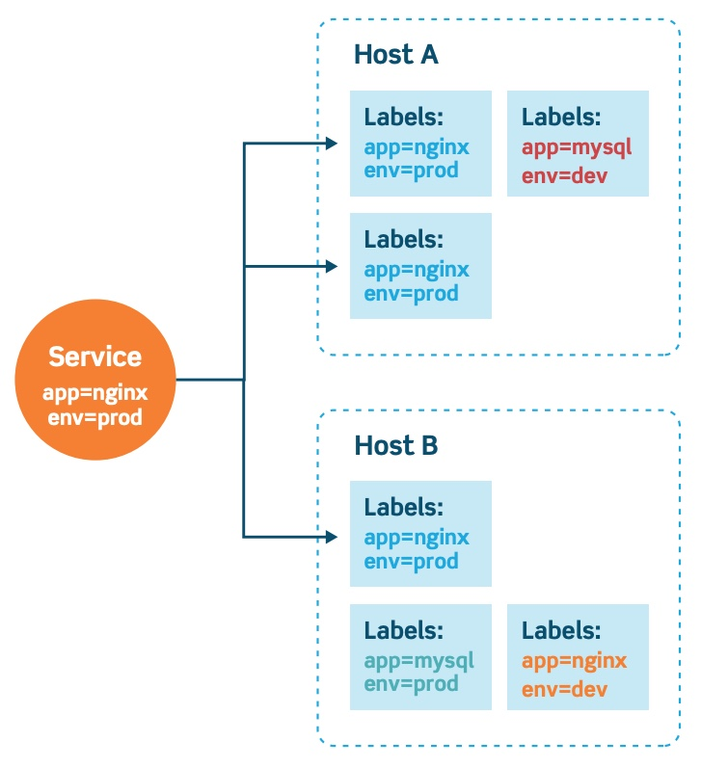
Kubernetes Service
Services are the Kubernetes way of configuring a proxy to forward traffic to a set of pods.

Slide 56
Kubernetes Service Types
ClusterIP exposes the service on an internal IP only. This makes the service reachable only from within the cluster. This is the default type.
NodePort exposes the service on each node’s IP at a specific port. This gives the developers the freedom to set up their own load balancers, for example, or configure environments not fully supported by Kubernetes.
LoadBalancer exposes the service externally using a cloud provider’s load balancer. This is often used when the cloud provider’s load balancer is supported by Kubernetes, as it automates their configuration.
ExternalName will just map a CNAME record in DNS. No proxying of any kind is established. This is commonly used to create a service within Kubernetes to represent an external datastore like a database that runs externally to Kubernetes.

Slide 57
Kubernetes
Environments

Slide 58
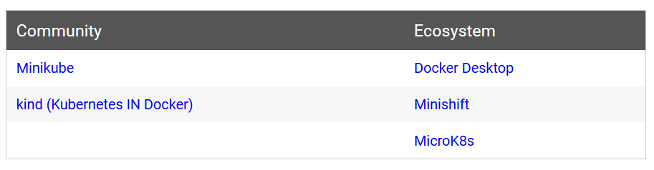
Kubernetes Environments
Learning environments

Slide 59
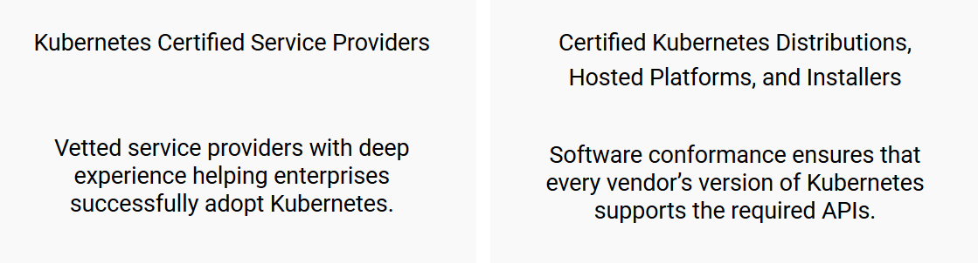
Kubernetes Environments
Production environments

Slide 60
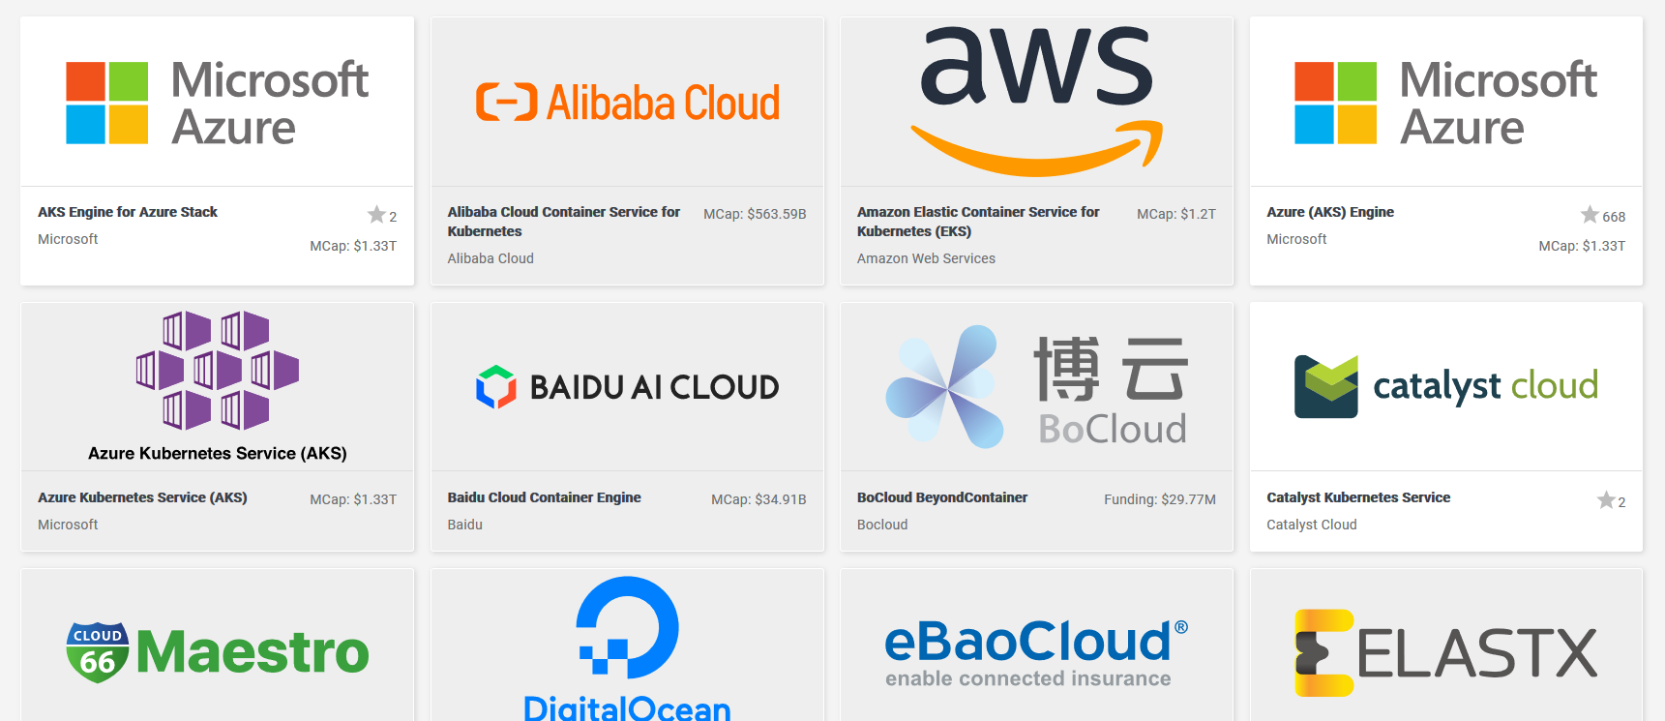
Kubernetes Environments
Production environments

Slide 61
Kubernetes
Minikube

Slide 62
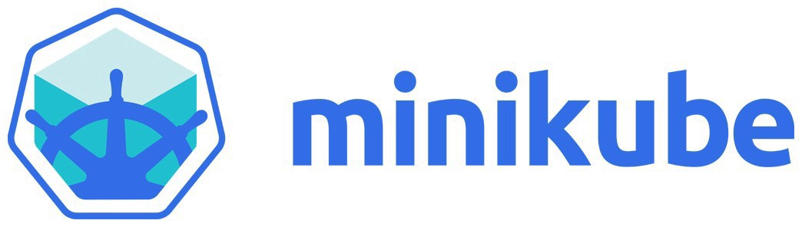
Minikube: Getting Started

Slide 63
Minikube: Getting Started
Start Minikube service
minikube start --driver=<driver_name>
Output:
Starting local Kubernetes cluster...
Running pre-create checks...
Creating machine...
Starting local Kubernetes cluster...

Slide 64
Minikube: Getting Started
Deploy application
kubectl create deployment hello-minikube \
--image=k8s.gcr.io/echoserver:1.10
Output:
deployment.apps/hello-minikube created

Slide 65
Minikube: Getting Started
Expose network port
kubectl expose deployment hello-minikube \
--type=NodePort --port=8080
Output:
service/hello-minikube exposed

Slide 66
Minikube: Getting Started
View pod information
kubectl get pod
Output:
NAME READY STATUS RESTARTS AGE
hello-minikube-3383150820-vctvh 0/1 ContainerCreating 0 3s

Slide 67
Minikube: Getting Started
Delete application
kubectl delete services hello-minikube
Output:
service "hello-minikube" deleted

Slide 68
Minikube: Getting Started
Delete deployment
kubectl delete deployment hello-minikube
Output:
deployment.extensions "hello-minikube" deleted

Slide 69
Kubernetes
Kubeadm

Slide 70

Kubeadm: Getting Started

Slide 71
Kubeadm: Getting Started
Create new deployment
kubeadm init
Output:
Your Kubernetes control-plane has initialized successfully!

Slide 72
Kubeadm: Getting Started
Add additional nodes
kubeadm join --token <token> \
<control-plane-host>:<control-plane-port> \
--discovery-token-ca-cert-hash sha256:<hash>

Slide 73
Kubeadm: Getting Started
Show tokens
kubeadm token list
Output:
TOKEN TTL EXPIRES USAGES DESCRIPTION EXTRA GROUPS
8ewj1p.9r9hcjoqgajrj4gi 23h 2018-06-12T02:51:28Z authentication, The default bootstrap system:
signing token generated by bootstrappers:
'kubeadm init'. kubeadm:
default-node-token

Slide 74
Kubeadm: Getting Started
Remove nodes (partially)
kubectl config delete-cluster
Remove nodes (more cleanly)
kubectl drain <node name> --delete-local-data \
--force --ignore-daemonsets
kubectl delete node <node name>

Slide 75
Kubernetes
Rancher

Slide 76
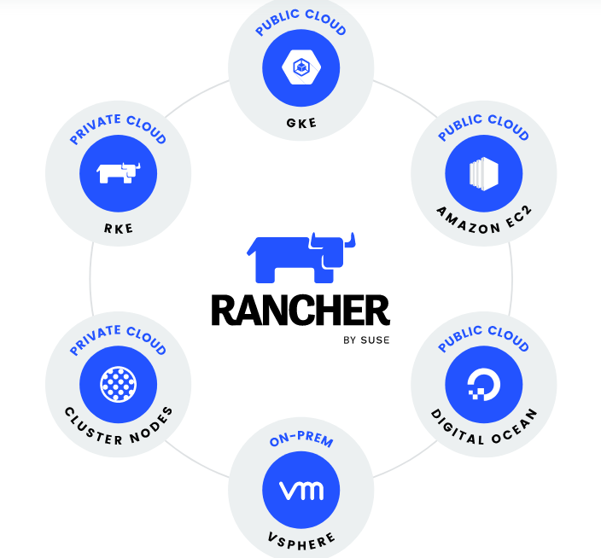
Rancher: Getting Started

Slide 77
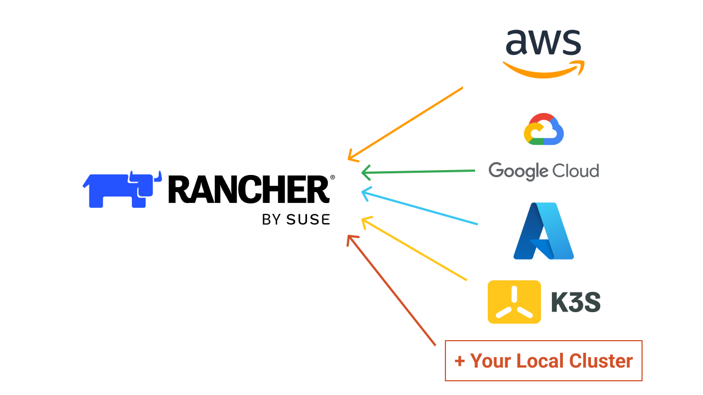
Rancher: Getting Started

Slide 78
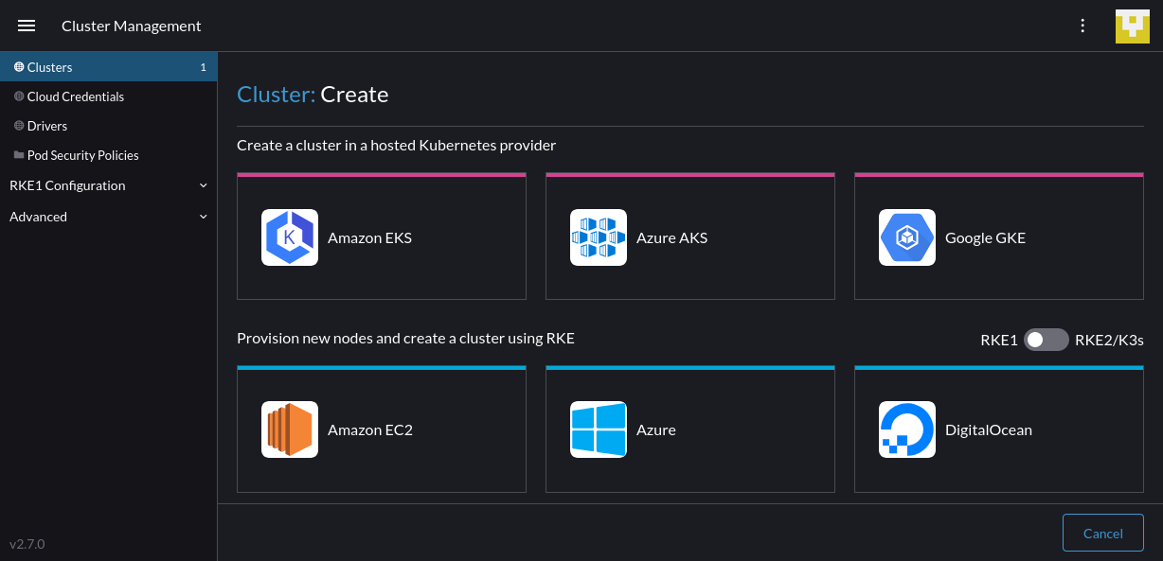
Rancher: Getting Started

Slide 79
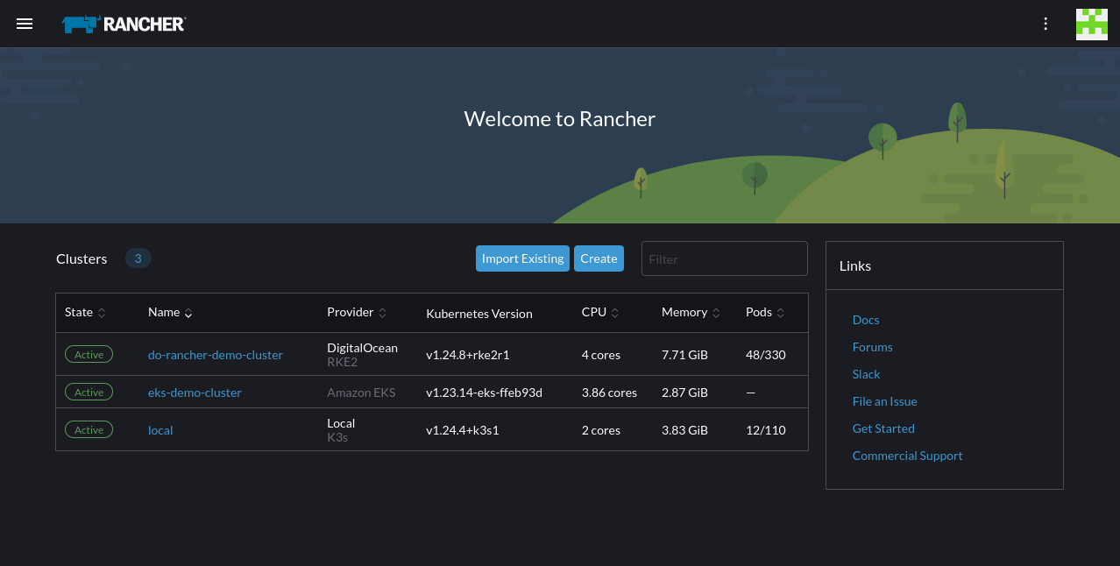
Rancher: Getting Started

Slide 80
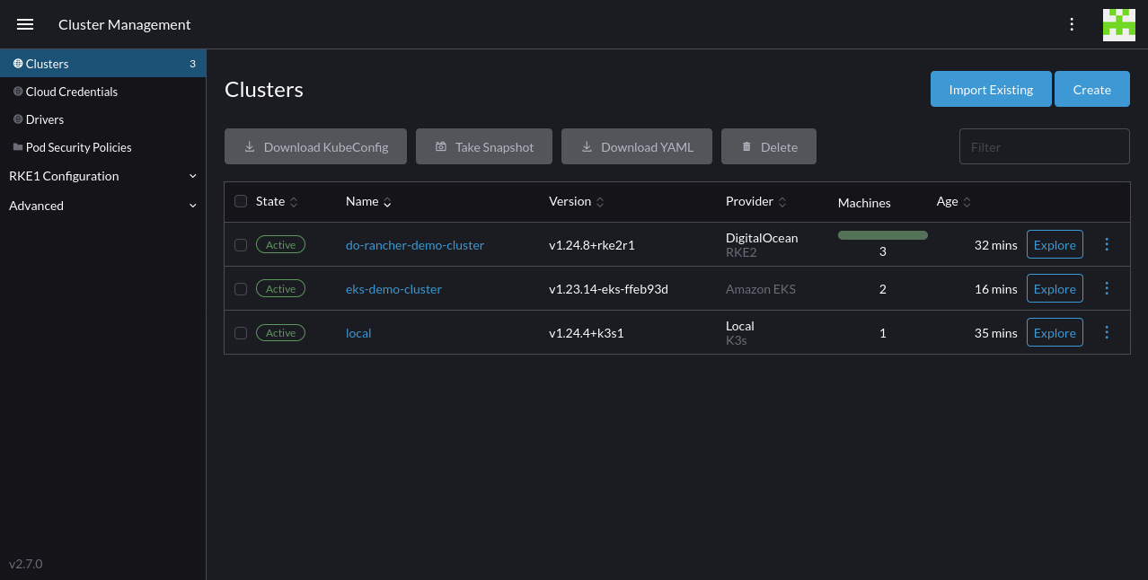
Rancher: Getting Started

Slide 81
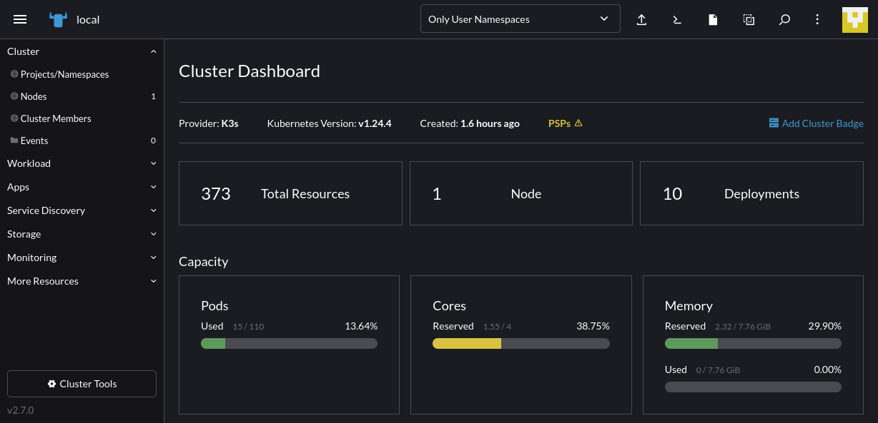
Rancher: Getting Started

Slide 82
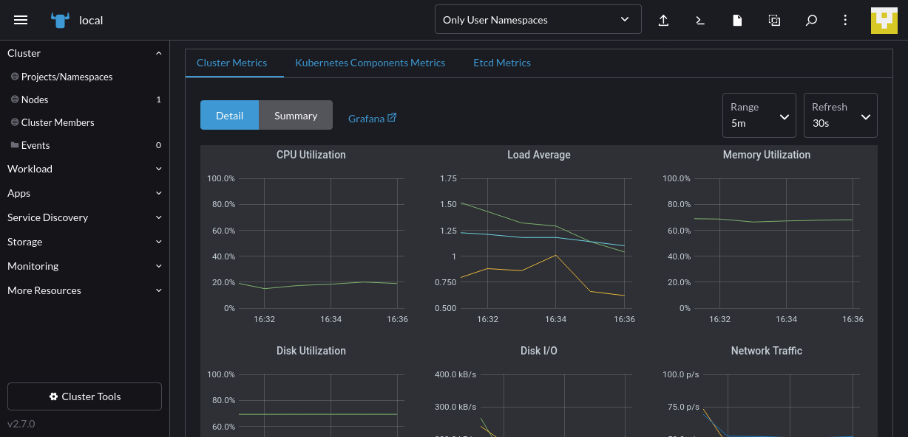
Rancher: Getting Started

Slide 83
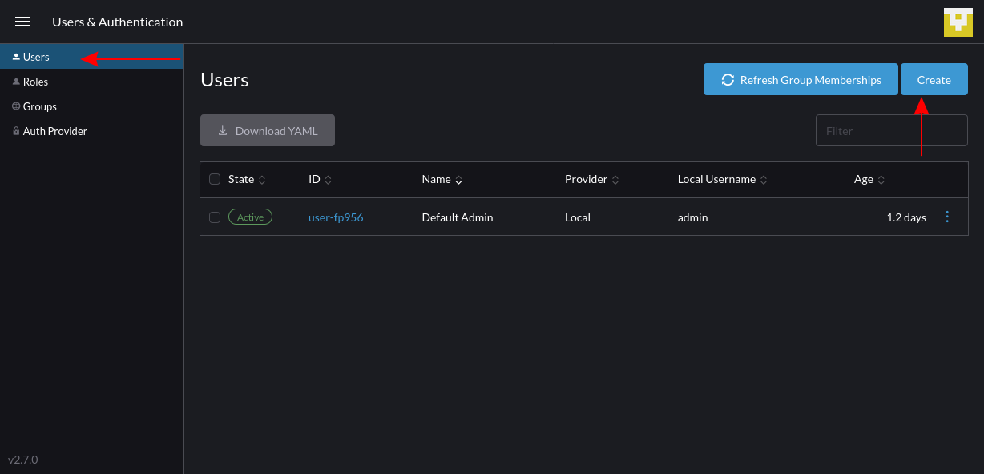
Rancher: Getting Started

Slide 84
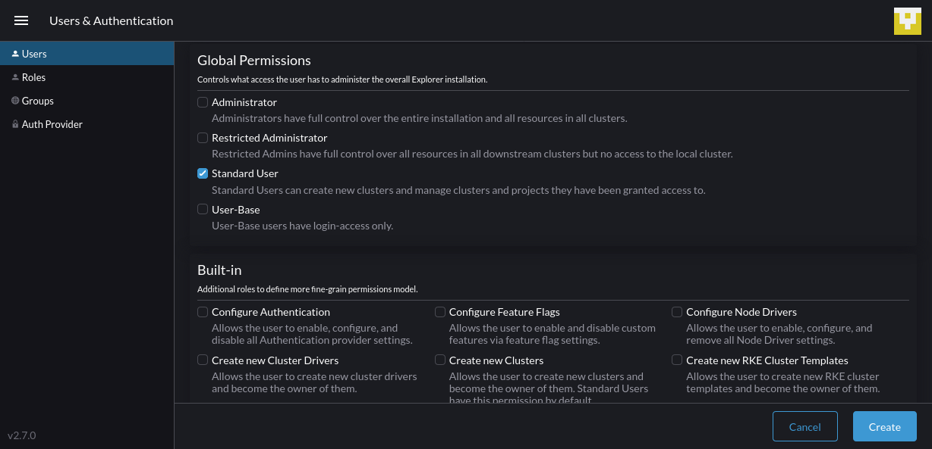
Rancher: Getting Started

Slide 85
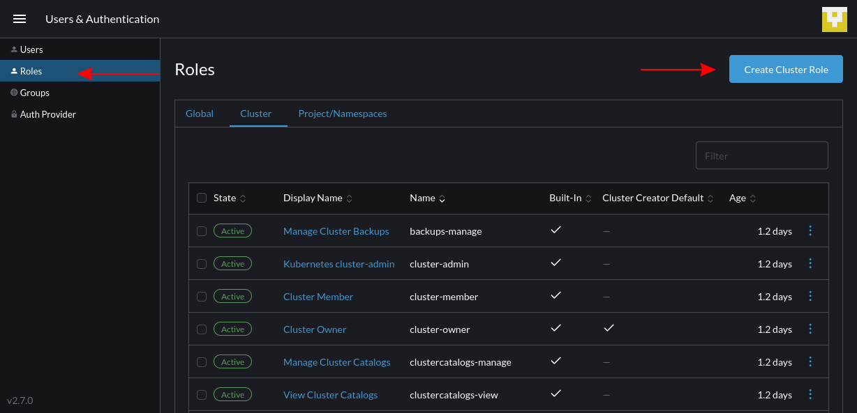
Rancher: Getting Started

Slide 86
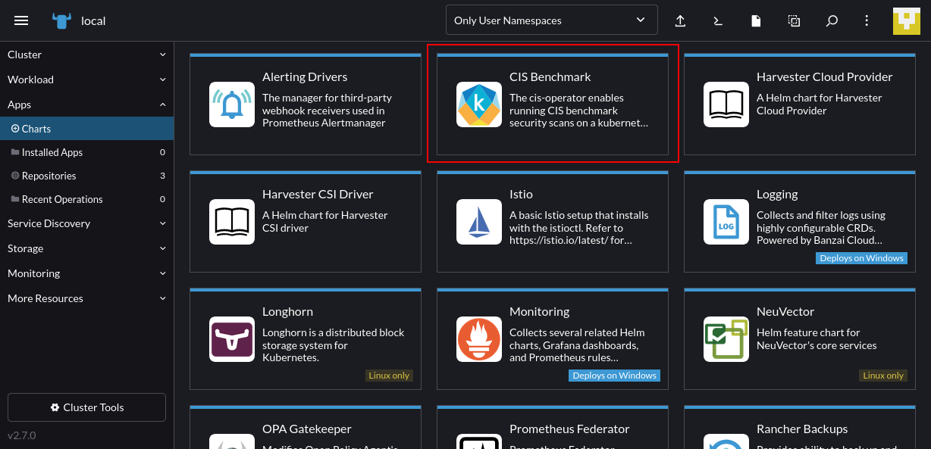
Rancher: Getting Started

Slide 87
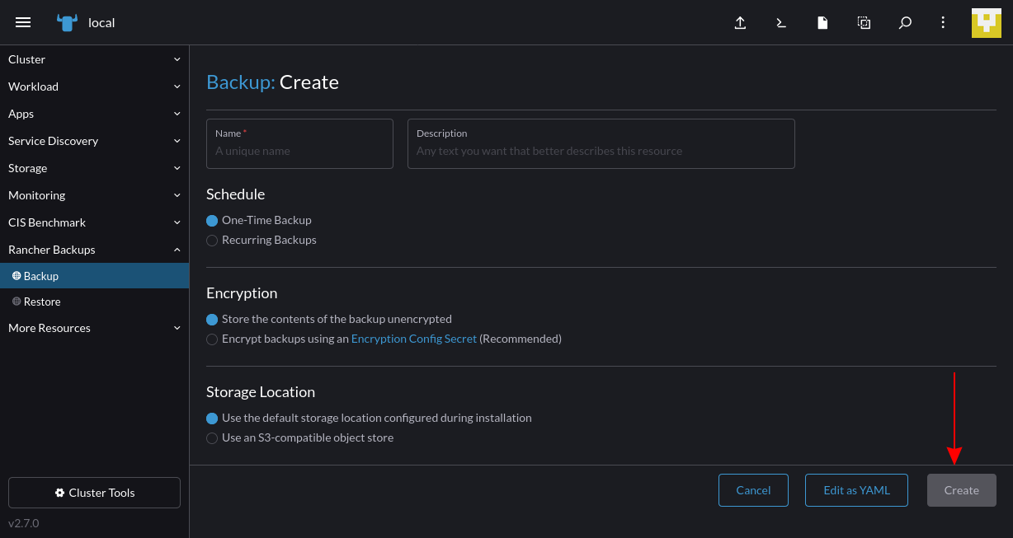
Rancher: Getting Started

Slide 88
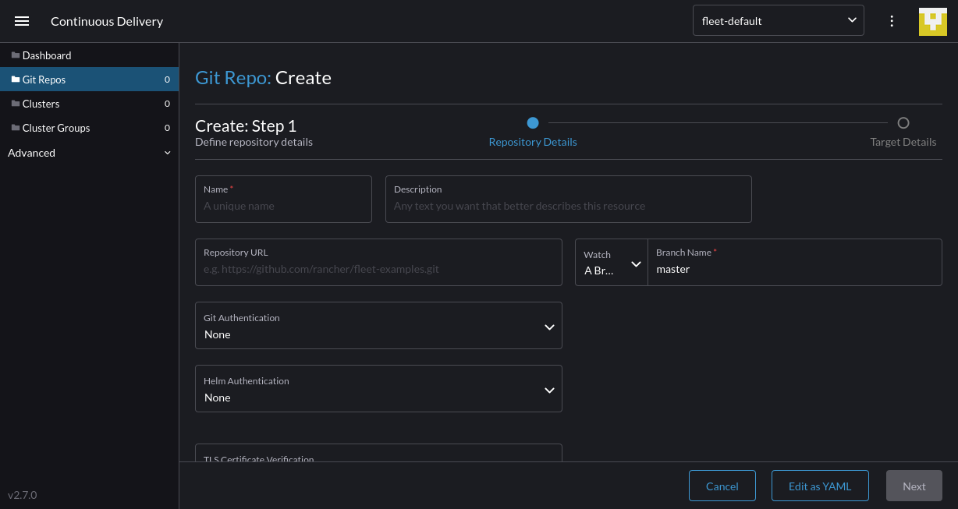
Rancher: Getting Started

Slide 89
Questions?
andry.cheredarchuk@gmail.com

