Slide 1
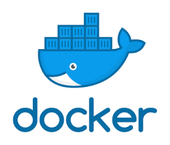
Docker
Networking

Slide 2
Docker Networking
Introduction to networking

Slide 3
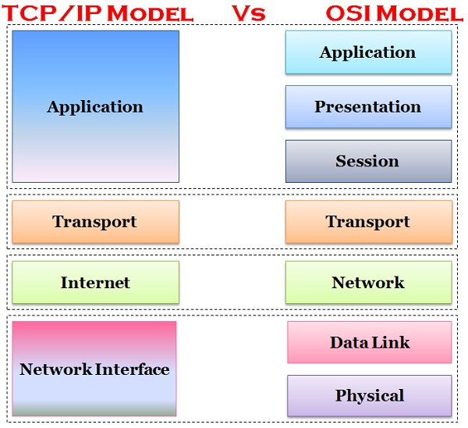
Networking layered models

Slide 4
Addressing
Protocol signature, Layer 7 – define the application protocol.
Source and destination ports, Layer 4 – define the process of the application.
Source and destination IPs , Layer 3 – define hosts.
Sorce and destination MACs , Layer 2 – define network interfaces.

Slide 5
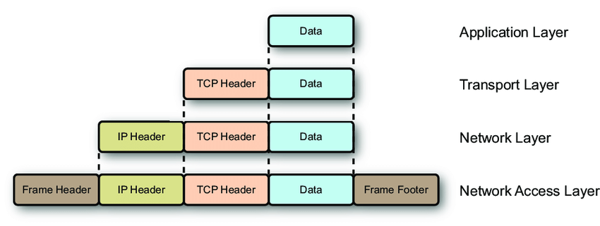
Encapsulation

Slide 6
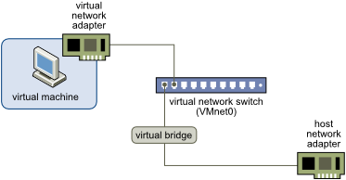
Bridging

Slide 7
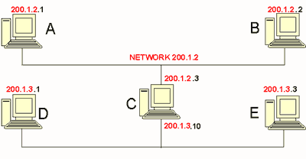
Routing

Slide 8
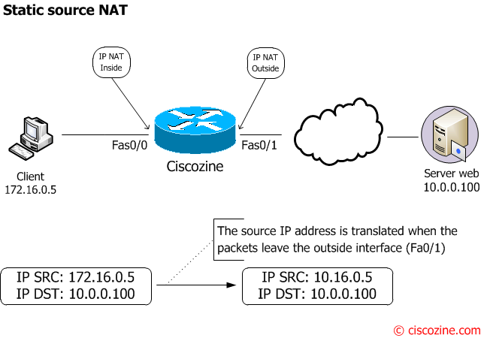
Network Address Translation

Slide 9
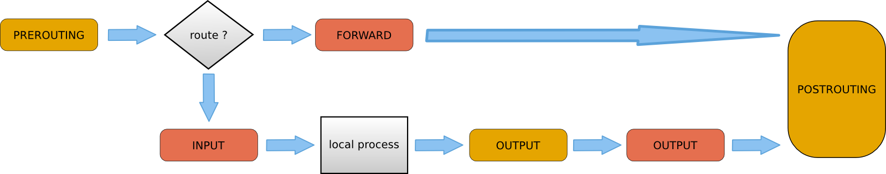
IP Filtering

Slide 10
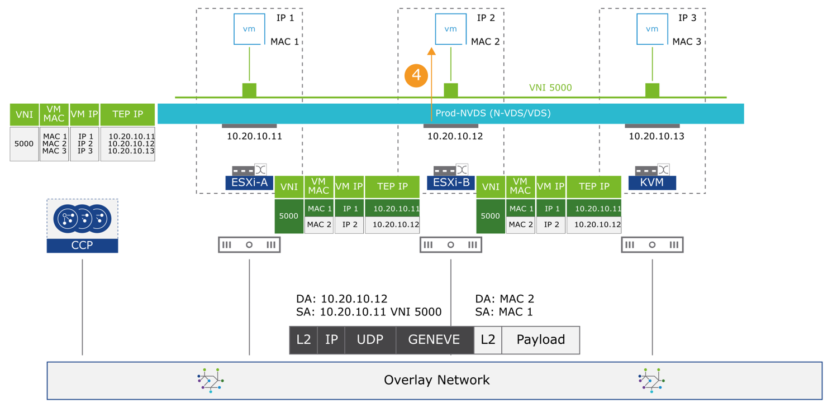
VXLan / Geneva

Slide 11
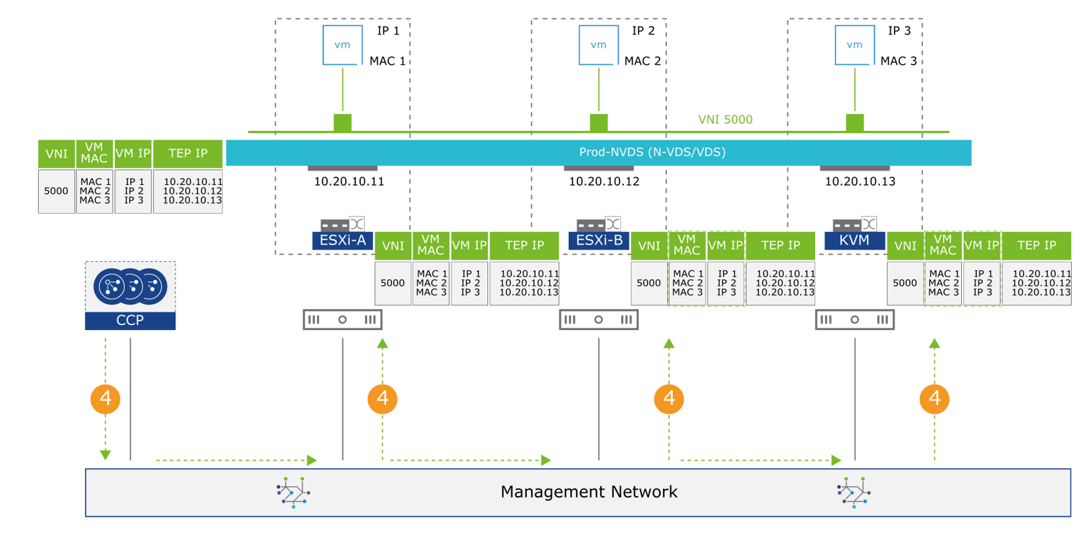
VXLan / Geneva

Slide 12
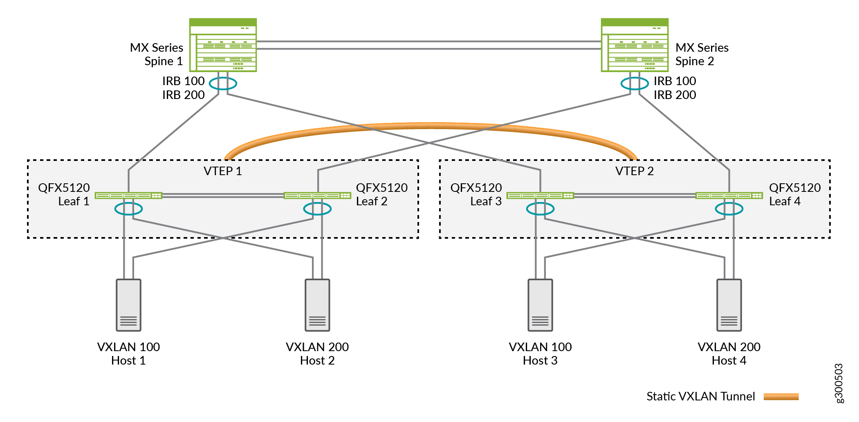
VXLan / Geneva

Slide 13
Docker Networking
Overview

Slide 14
Network driver summary
Portability
How do I guarantee maximum portability across diverse network environments while taking advantage of unique network characteristics?
Service Discovery
How do I know where services are living as they are scaled up and down?
Load Balancing
How do I share load across services as services themselves are brought up and scaled?
Security
How do I segment to prevent the wrong containers from accessing each other?
How do I guarantee that a container with application and cluster control traffic is secure?
Performance
How do I provide advanced network services while minimizing latency and maximizing bandwidth?
Scalability
How do I ensure that none of these characteristics are sacrificed when scaling applications across many hosts?

Slide 15
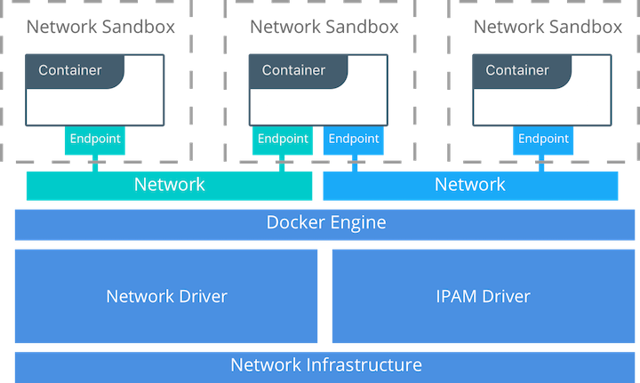
The Container Networking Model

Slide 16
CNM Constructs
There are several high-level constructs in the CNM. They are all OS and infrastructure agnostic so that applications can have a uniform experience no matter the infrastructure stack.
Sandbox — A Sandbox contains the configuration of a container's network stack. This includes management of the container's interfaces, routing table, and DNS settings. An implementation of a Sandbox could be a Linux Network Namespace, a FreeBSD Jail, or other similar concept. A Sandbox may contain many endpoints from multiple networks.
Endpoint — An Endpoint joins a Sandbox to a Network. The Endpoint construct exists so the actual connection to the network can be abstracted away from the application. This helps maintain portability so that a service can use different types of network drivers without being concerned with how it's connected to that network.
Network — The CNM does not specify a Network in terms of the OSI model. An implementation of a Network could be a Linux bridge, a VLAN, etc. A Network is a collection of endpoints that have connectivity between them. Endpoints that are not connected to a network do not have connectivity on a network.

Slide 17
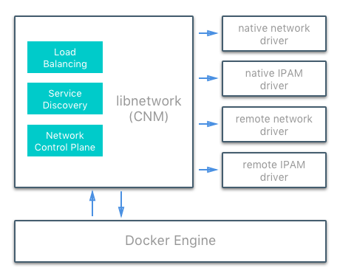
Network driver summary
The following network drivers exist:
Network Drivers
  Native Network Drivers
  Remote Network Drivers
IPAM Drivers

Slide 18
Network driver summary
User-defined bridge networks are best when you need multiple containers to communicate on the same Docker host.
Host networks are best when the network stack should not be isolated from the Docker host, but you want other aspects of the container to be isolated.
Overlay networks are best when you need containers running on different Docker hosts to communicate, or when multiple applications work together using swarm services.
Macvlan networks are best when you are migrating from a VM setup or need your containers to look like physical hosts on your network, each with a unique MAC address.
Third-party network plugins allow you to integrate Docker with specialized network stacks.

Slide 19
Docker EE networking features
The following two features are only possible when using Docker EE and managing your Docker services using Universal Control Plane (UCP):
The HTTP routing mesh allows you to share the same network IP address and port among multiple services. UCP routes the traffic to the appropriate service using the combination of hostname and port, as requested from the client.
Session stickiness allows you to specify information in the HTTP header which UCP uses to route subsequent requests to the same service task, for applications which require stateful sessions.

Slide 20
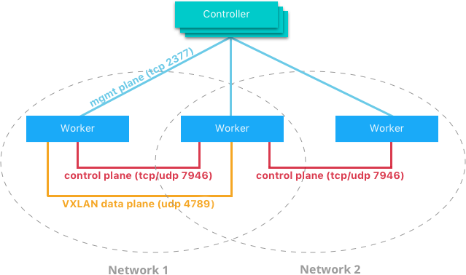
Docker Network Control Plane

Slide 21
Use the default bridge network
List current networks
docker network ls
NETWORK ID NAME DRIVER SCOPE
17e324f45964 bridge bridge local
6ed54d316334 host host local
7092879f2cc8 none null local
The default bridge network is listed, along with host and none.

Slide 22
Use the default bridge network
List current networks
docker network ls
NETWORK ID NAME DRIVER SCOPE
17e324f45964 bridge bridge local
6ed54d316334 host host local
7092879f2cc8 none null local
The default bridge network is listed, along with host and none.
Inspect the bridge network to see what containers are connected to it.
docker network inspect bridge

Slide 23
Virtual Ethernet Devices
A virtual ethernet device or veth is a Linux networking interface that acts as a connecting wire between two network namespaces.
A veth is a full duplex link that has a single interface in each namespace. Traffic in one interface is directed out the other interface.
Docker network drivers utilize veths to provide explicit connections between namespaces when Docker networks are created.
When a container is attached to a Docker network, one end of the veth is placed inside the container (usually seen as the ethX interface) while the other is attached to the Docker network.

Slide 24
Docker Networking
Bridge network

Slide 25
Bridge network
Containers connected to the same user-defined bridge network automatically expose all ports to each other, and no ports to the outside world. This allows containerized applications to communicate with each other easily, without accidentally opening access to the outside world.

Slide 26
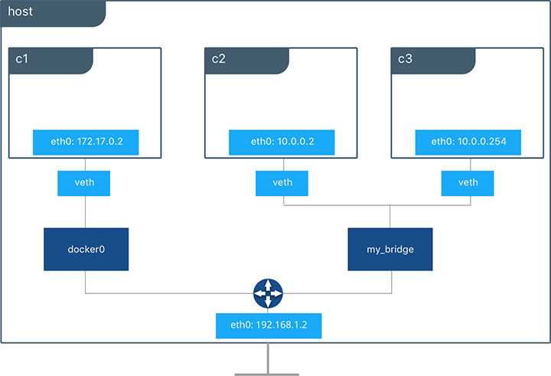
Bridge network

Slide 27
Bridge interface
Create interface
docker network create --driver bridge my-net
--driver bridge : default setting.
Remove interface
docker network rm my-net

Slide 28
Bridge network
Connect to bridge interface
docker create --name my-nginx \
--network my-net \
--publish 8080:80 \
nginx:latest

Slide 29
Bridge network
The tool brctl on the host shows the Linux bridges that exist in the host network namespace. It shows a single bridge called docker0. docker0 has one interface, vetha3788c4, which provides connectivity from the bridge to the eth0 interface inside container c1.
brctl show
bridge name bridge id STP enabled interfaces
docker0 8000.0242504b5200 no vethb64e8b8

Slide 30
Bridge network
You can only connect to one network during the docker run command, so you need to use
docker run -dit --name alpine1 --network alpine-net alpine ash
Connect ciontainer to the bridge network afterward
docker network connect bridge alpine4
Disconnect from network
docker network disconnect bridge alpine4

Slide 31
Bridge network
By default, traffic from containers connected to the default bridge network is not forwarded to the outside world. To enable forwarding, you need to change two settings.
Configure the Linux kernel to allow IP forwarding.
sysctl net.ipv4.conf.all.forwarding=1
Change the policy for the iptables FORWARD policy from DROP to ACCEPT.
iptables -P FORWARD ACCEPT

Slide 32
Configure the default bridge network
Configure the default bridge network (file daemon.json).
{
"bip": "192.168.1.5/24",
"fixed-cidr": "192.168.1.5/25",
"fixed-cidr-v6": "2001:db8::/64",
"mtu": 1500,
"default-gateway": "10.20.1.1",
"default-gateway-v6": "2001:db8:abcd::89",
"dns": ["10.20.1.2","10.20.1.3"]
}

Slide 33
Configure custom bridge network
Below a user-defined bridge network is created with two containers attached to it. A subnet is specified, and the network is named my_bridge. One container is not given IP parameters, so the IPAM driver assigns it the next available IP in the subnet. The other container has its IP specified.
docker network create -d bridge --subnet 10.0.0.0/24 my_bridge
docker run -itd --name c2 --net my_bridge busybox sh
docker run -itd --name c3 --net my_bridge --ip 10.0.0.254 busybox sh

Slide 34
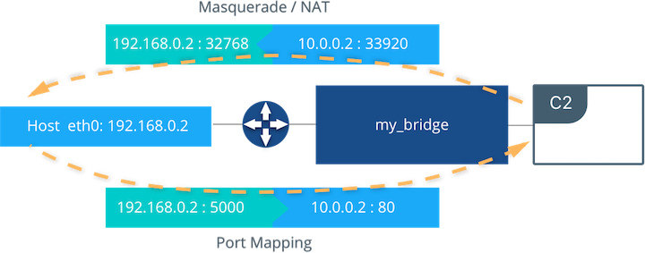
External Access for Standalone Containers

Slide 35
External Access for Standalone Containers
For most types of Docker networks (bridge and overlay included) external ingress access for applications must be explicitly granted.
This is done through internal port mapping. Docker publishes ports exposed on host interfaces to internal container interfaces.
The port can be set to listen on a specific (or all) host interfaces, and all traffic is mapped from this port to a port and interface inside the container.
docker run -d --name C2 --net my_bridge -p 5000:80 nginx

Slide 36
Docker Networking
Host network

Slide 37
Docker Host Network Driver
The host network driver is most familiar to those new to Docker because it's the same networking configuration that Linux uses without Docker.
--net=host effectively turns Docker networking off and containers use the host (or default) networking stack of the host operating system.
Typically with other networking drivers, each container is placed in its own network namespace (or sandbox) to provide complete network isolation from each other. With the host driver containers are all in the same host network namespace and use the network interfaces and IP stack of the host. All containers in the host network are able to communicate with each other on the host interfaces. From a networking standpoint this is equivalent to multiple processes running on a host without containers. Because they are using the same host interfaces, no two containers are able to bind to the same TCP port. This may cause port contention if multiple containers are being scheduled on the same host.

Slide 38
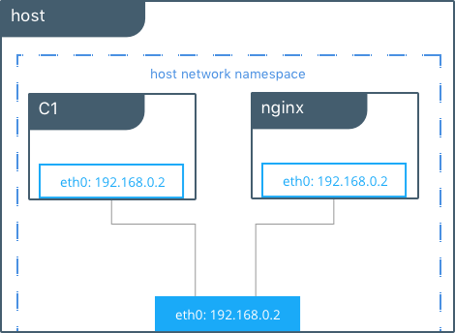
Host network

Slide 39
Docker Host Network Driver
#Create containers on the host network
docker run -itd --net host --name C1 alpine sh
docker run -itd --net host --name nginx
#Show host eth0
ip add | grep eth0
2: eth0: <BROADCAST,MULTICAST,UP,LOWER_UP> mtu 9001 qdisc mq state UP group default qlen 1000
inet 172.31.21.213/20 brd 172.31.31.255 scope global eth0
#Show eth0 from C1
docker run -it --net host --name C1 alpine ip add | grep eth0
2: eth0: <BROADCAST,MULTICAST,UP,LOWER_UP> mtu 9001 qdisc mq state UP qlen 1000
inet 172.31.21.213/20 brd 172.31.31.255 scope global eth0

Slide 40
Docker Networking
Overlay network

Slide 41
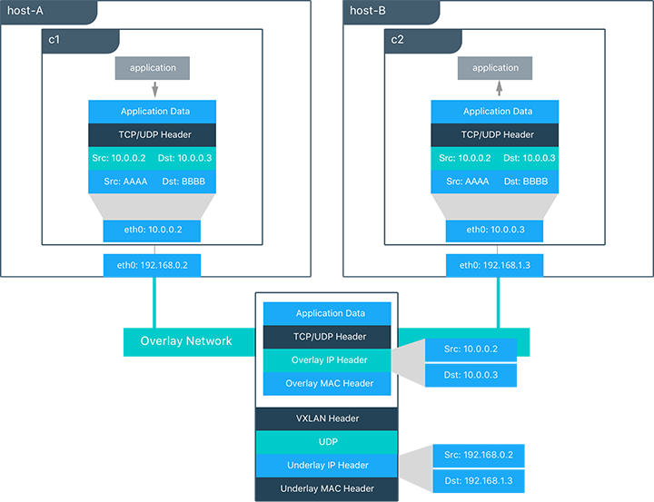
Overlay network

Slide 42
Overlay network
The overlay network driver creates a distributed network among multiple Docker daemon hosts. This network sits on top of (overlays) the host-specific networks, allowing containers connected to it (including swarm service containers) to communicate securely. Docker transparently handles routing of each packet to and from the correct Docker daemon host and the correct destination container.

Slide 43
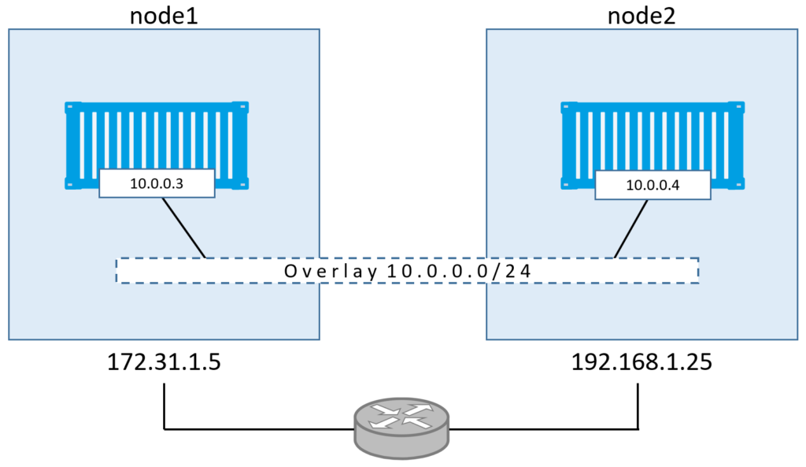
Overlay network

Slide 44
Overlay network
To create an overlay network for use with swarm services, use a command like the following:
docker network create -d overlay my-overlay
To create an overlay network which can be used by swarm services or standalone containers to communicate with other standalone containers running on other Docker daemons, add the --attachable flag:
docker network create -d overlay --attachable my-attachable-overlay

Slide 45
Overlay network
You can use the overlay network feature with both --opt encrypted –attachable, define custom ip range and gateway and attach unmanaged containers to that network:
docker network create --opt encrypted --driver overlay \
--attachable --subnet=10.11.0.0/16 \
--gateway=10.11.0.2 \
--opt com.docker.network.driver.mtu=1200 \
my-attachable-multi-host-network

Slide 46
Docker Networking
Macvlan

Slide 47
Macvlan network
Some applications, especially legacy applications or applications which monitor network traffic, expect to be directly connected to the physical network. In this type of situation, you can use the macvlan network driver to assign a MAC address to each container’s virtual network interface, making it appear to be a physical network interface directly connected to the physical network.

Slide 48
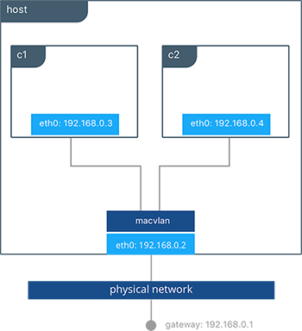
Macvlan network

Slide 49
Macvlan network
The macvlan driver is a new implementation of the tried and true network virtualization technique.
The Linux implementations are extremely lightweight because rather than using a Linux bridge for isolation, they are simply associated with a Linux Ethernet interface or sub-interface to enforce separation between networks and connectivity to the physical network.
MACVLAN use-cases may include:
  Very low-latency applications
  Network design that requires containers be on the same subnet as and using IPs as the external host network

Slide 50
Macvlan network
To create a Macvlan network which bridges with a given physical network interface
docker network create -d macvlan \
--subnet=172.16.86.0/24 --gateway=172.16.86.1 \
-o parent=eth0 pub_net

Slide 51
Macvlan network
To connect containers to the Macvlan network
docker run -itd --name c1 --net mvnet --ip 192.168.0.3 busybox sh
docker run -it --name c2 --net mvnet --ip 192.168.0.4 busybox sh

Slide 52
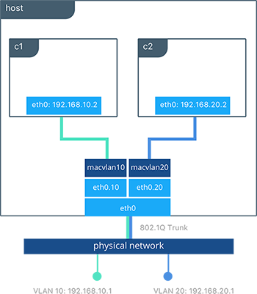
Macvlan network with vlans

Slide 53
Macvlan network with vlans
#Creation of macvlan10 network in VLAN 10
docker network create -d macvlan --subnet 192.168.10.0/24 \
--gateway 192.168.10.1 -o parent=eth0.10 macvlan10
#Creation of macvlan20 network in VLAN 20
docker network create -d macvlan --subnet 192.168.20.0/24 \
--gateway 192.168.20.1 -o parent=eth0.20 macvlan20
#Creation of containers on separate MACVLAN networks
docker run -itd --name c1--net macvlan10 --ip 192.168.10.2 busybox sh
docker run -it --name c2--net macvlan20 --ip 192.168.20.2 busybox sh

Slide 54
Kubernetes Networking
Basic concepts

Slide 55
Networking problems
Highly-coupled container-to-container communications: this is solved by pods and localhost communications.
Pod-to-Pod communications.
Pod-to-Service communications: this is covered by services.
External-to-Service communications: this is covered by services.

Slide 56
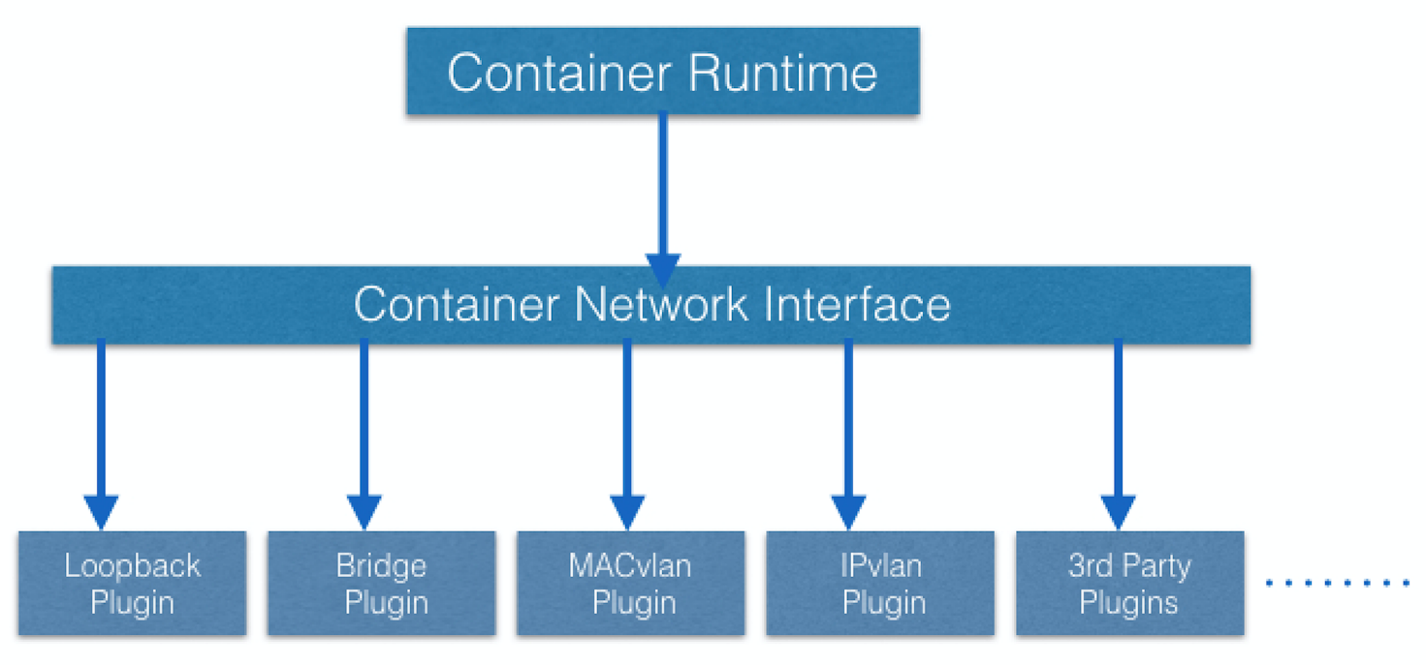
Kubernetes network core plugins

Slide 57
Kubernetes network model
Every Pod gets its own IP address.
This means you do not need to explicitly create links between Pods and you almost never need to deal with mapping container ports to host ports.
This creates a clean, backwards-compatible model where Pods can be treated much like VMs or physical hosts from the perspectives of port allocation, naming, service discovery, load balancing, application configuration, and migration.

Slide 58
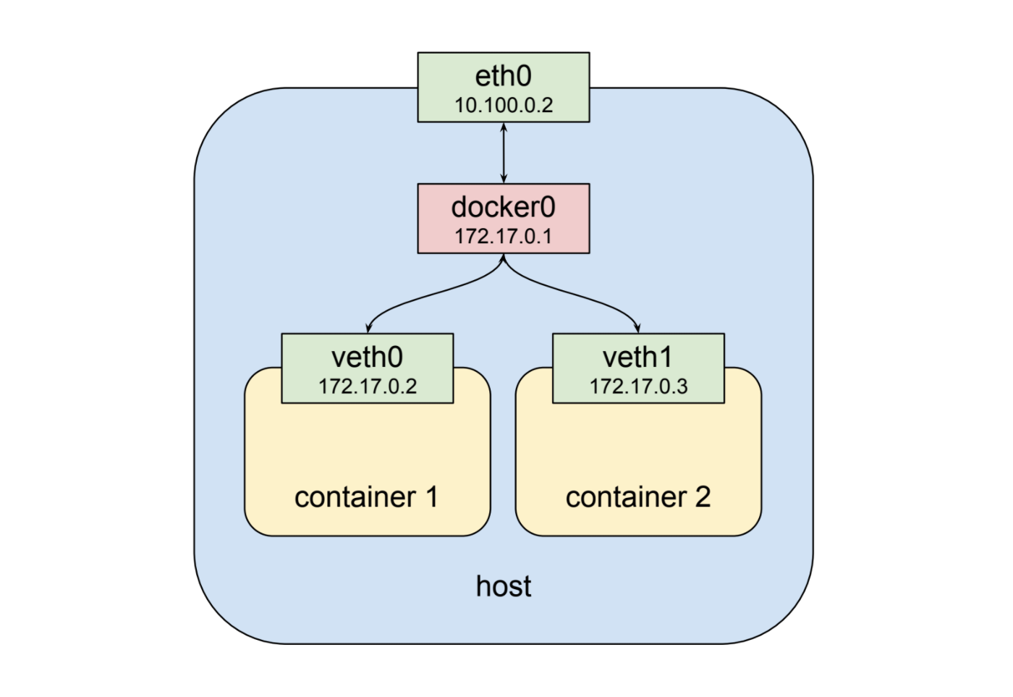
Kubernetes pod: networking

Slide 59
Pod networking
Every Pod gets its own IP address.
This means you do not need to explicitly create links between Pods and you almost never need to deal with mapping container ports to host ports.
This creates a clean, backwards-compatible model where Pods can be treated much like VMs or physical hosts from the perspectives of port allocation, naming, service discovery, load balancing, application configuration, and migration..

Slide 60
Pod networking
Kubernetes imposes the following fundamental requirements on any networking implementation (barring any intentional network segmentation policies):
  pods on a node can communicate with all pods on all nodes without NAT
  agents on a node (e.g. system daemons, kubelet) can communicate with all pods on that node

Slide 61
Network Model Implememtations
There are a number of ways that this network model can be implemented.
Azure CNI for Kubernetes
Google Compute Engine (GCE)
OpenVSwitch, k-vswitch (simple Kubernetes networking plugin based on Open vSwitch).
Project Calico.
Weave Net from Weaveworks.

Slide 62
Kubernetes Networking
Ingress network

Slide 63
Ingress
Ingress exposes HTTP and HTTPS routes from outside the cluster to services within the cluster. Traffic routing is controlled by rules defined on the Ingress resource.
An Ingress may be configured to give Services externally-reachable URLs, load balance traffic, terminate SSL / TLS, and offer name based virtual hosting.
An Ingress does not expose arbitrary ports or protocols. Exposing services other than HTTP and HTTPS to the internet typically uses a service of type Service.Type=NodePort or Service.Type=LoadBalancer.

Slide 64
Ingress Controller
You must have an ingress controller to satisfy an Ingress. Only creating an Ingress resource has no effect.
You may need to deploy an Ingress controller such as ingress-nginx. You can choose from a number of Ingress controllers.
Kubernetes as a project currently supports and maintains GCE and nginx controllers.

Slide 65
Ingress Resource
apiVersion: networking.k8s.io/v1beta1
kind: Ingress
metadata:
name: test-ingress
annotations:
nginx.ingress.kubernetes.io/rewrite-target: /
spec:
rules:
- http:
paths:
- path: /testpath
pathType: Prefix
backend:
serviceName: test
servicePort: 80

Slide 66
Ingress Class
apiVersion: networking.k8s.io/v1beta1
kind: IngressClass
metadata:
name: external-lb
spec:
controller: example.com/ingress-controller
parameters:
apiGroup: k8s.example.com/v1alpha
kind: IngressParameters
name: external-lb

Slide 67
Ingress Example
apiVersion: networking.k8s.io/v1beta1
kind: Ingress
metadata:
name: simple-fanout-example
annotations:
nginx.ingress.kubernetes.io/rewrite-target: /
spec:
rules:
- host: foo.bar.com
http:
paths:
- path: /foo
backend:
serviceName: service1
servicePort: 4200
- path: /bar
backend:
serviceName: service2
servicePort: 8080

Slide 68
Ingress Example
Name: simple-fanout-example
Namespace: default
Address: 178.91.123.132
Default backend: default-http-backend:80 (10.8.2.3:8080)
Rules:
Host Path Backends
---- ---- --------
foo.bar.com
/foo service1:4200 (10.8.0.90:4200)
/bar service2:8080 (10.8.0.91:8080)
Annotations:
nginx.ingress.kubernetes.io/rewrite-target: /
Events:
Type Reason Age From Message
---- ------ ---- ---- -------
Normal ADD 22s loadbalancer-controller default/test

Slide 69
Ingress TLS (1 od 2)
apiVersion: v1
kind: Secret
metadata:
name: testsecret-tls
namespace: default
data:
tls.crt: base64 encoded cert
tls.key: base64 encoded key
type: kubernetes.io/tls

Slide 70
Ingress TLS (2 od 2)
apiVersion: networking.k8s.io/v1beta1
kind: Ingress
metadata:
name: tls-example-ingress
spec:
tls:
- hosts:
- sslexample.foo.com
secretName: testsecret-tls
rules:
- host: sslexample.foo.com
http:
paths:
- path: /
backend:
serviceName: service1
servicePort: 80

Slide 71
Kubernetes Networking
Network Policy

Slide 72
Network Policy
A network policy is a specification of how groups of pods are allowed to communicate with each other and other network endpoints.
NetworkPolicy resources use labels to select pods and define rules which specify
By default, pods are non-isolated; they accept traffic from any source.what traffic is allowed to the selected pods.

Slide 73
Network Policy Terms
podSelector: Each NetworkPolicy includes a podSelector which selects the grouping of pods to which the policy applies. The example policy selects pods with the label “role=db”. An empty podSelector selects all pods in the namespace

Slide 74
Network Policy Terms
policyTypes: Each NetworkPolicy includes a policyTypes list which may include either Ingress, Egress, or both. The policyTypes field indicates whether or not the given policy applies to ingress traffic to selected pod, egress traffic from selected pods, or both. If no policyTypes are specified on a NetworkPolicy then by default Ingress will always be set and Egress will be set if the NetworkPolicy has any egress rules.

Slide 75
Network Policy Terms
ingress: Each NetworkPolicy may include a list of whitelist ingress rules. Each rule allows traffic which matches both the from and ports sections. The example policy contains a single rule, which matches traffic on a single port, from one of three sources, the first specified via an ipBlock, the second via a namespaceSelector and the third via a podSelector.
egress: Each NetworkPolicy may include a list of whitelist egress rules. Each rule allows traffic which matches both the to and ports sections. The example policy contains a single rule, which matches traffic on a single port to any destination in 10.0.0.0/24.

Slide 76
Network Policy
apiVersion: networking.k8s.io/v1
kind: NetworkPolicy
metadata:
name: test-network-policy
namespace: default
spec:
podSelector:
matchLabels:
role: db
policyTypes:
- Ingress
- Egress
ingress:
- from:
- ipBlock:
cidr: 172.17.0.0/16
except:
- 172.17.1.0/24
- namespaceSelector:
matchLabels:
project: myproject
- podSelector:
matchLabels:
role: frontend
ports:
- protocol: TCP
port: 6379
egress:
- to:
- ipBlock:
cidr: 10.0.0.0/24
ports:
- protocol: TCP
port: 5978

Slide 77
Questions?
andry.cheredarchuk@gmail.com

