Slide 1
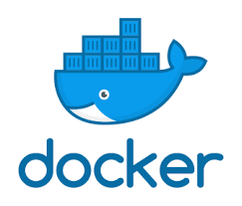
Linux Administration: Kubernetes
Services and Security

Slide 2
Run application in production
Resource Management

Slide 3
Runtime constraints on resources
User memory constraints.
There is no memory limit for the container. The container can use as much memory as needed
-m, --memory="" Memory limit (format: <number>[<unit>]). Number is a positive integer. Unit can be one of b, k, m, or g. Minimum is 4M.
--memory-swap="" Total memory limit (memory + swap, format: <number>[<unit>]). Number is a positive integer. Unit can be one of b, k, m, or g.
--memory-reservation="" Memory soft limit (format: <number>[<unit>]). Number is a positive integer. Unit can be one of b, k, m, or g.

Slide 4
Runtime constraints on resources
We set memory limit only, this means the processes in the container can use 300M memory and 300M swap memory, by default, the total virtual memory size (--memory-swap) will be set as double of memory, in this case, memory + swap would be 2*300M, so processes can use 300M swap memory as well.
docker run -it -m 300M ubuntu:14.04 /bin/bash
We set both memory and swap memory, so the processes in the container can use 300M memory and 700M swap memory.
docker run -it -m 300M --memory-swap 1G ubuntu:14.04 /bin/bash

Slide 5
Runtime constraints on resources
Memory reservation is a kind of memory soft limit that allows for greater sharing of memory. Under normal circumstances, containers can use as much of the memory as needed and are constrained only by the hard limits set with the -m/--memory option.
When memory reservation is set, Docker detects memory contention or low memory and forces containers to restrict their consumption to a reservation limit.
docker run -it -m 500M --memory-reservation 200M \
ubuntu:14.04 /bin/bash

Slide 6
CPU share constraint
CPU period constraint
If there is 1 CPU, this means the container can get 50% CPU worth of run-time every 50ms.
docker run -it --cpu-period=50000 --cpu-quota=25000 \
ubuntu:14.04 /bin/bash
cpu-period=50000 (50ms)
cpu-quota=25000 (50% : 25000 of 50000 )

Slide 7
CPU share constraint
Cpuset constraint
This means processes in container can be executed on cpu 1 and cpu 3.
docker run -it --cpuset-cpus="1,3" ubuntu:14.04 /bin/bash
This means processes in container can be executed on cpu 0, cpu 1 and cpu 2.
docker run -it --cpuset-cpus="0-2" ubuntu:14.04 /bin/bash

Slide 8
Block IO bandwidth (Blkio) constraint
By default, all containers get the same proportion of block IO bandwidth (blkio). This proportion is 500. To modify this proportion, change the container’s blkio weight relative to the weighting of all other running containers using the --blkio-weight flag.
The --blkio-weight flag can set the weighting to a value between 10 to 1000. For example, the commands below create two containers with different blkio weight:
docker run -it --name c1 --blkio-weight 300 ubuntu:14.04 /bin/bash
docker run -it --name c2 --blkio-weight 600 ubuntu:14.04 /bin/bash

Slide 9
Block IO bandwidth (Blkio) constraint
The --blkio-weight-device="DEVICE_NAME:WEIGHT" flag sets a specific device weight.
The DEVICE_NAME:WEIGHT is a string containing a colon-separated device name and weight.
For example, to set /dev/sda device weight to 200:
docker run -it --blkio-weight-device "/dev/sda:200" Ubuntu
If you specify both the --blkio-weight and --blkio-weight-device, Docker uses the --blkio-weight as the default weight and uses --blkio-weight-device to override this default with a new value on a specific device.

Slide 10
Block IO bandwidth (Blkio) constraint
The --device-read-bps flag limits the read rate (bytes per second) from a device. For example, this command creates a container and limits the read rate to 1mb per second from /dev/sda:
docker run -it --device-read-bps /dev/sda:1mb ubuntu
The --device-write-bps flag limits the write rate (bytes per second) to a device. For example, this command creates a container and limits the write rate to 1mb per second for /dev/sda:
docker run -it --device-write-bps /dev/sda:1mb ubuntu

Slide 11
Block IO bandwidth (Blkio) constraint
The --device-read-iops flag limits read rate (IO per second) from a device. For example, this command creates a container and limits the read rate to 1000 IO per second from /dev/sda:
docker run -ti --device-read-iops /dev/sda:1000 ubuntu
The --device-write-iops flag limits write rate (IO per second) to a device. For example, this command creates a container and limits the write rate to 1000 IO per second to /dev/sda:
docker run -ti --device-write-iops /dev/sda:1000 ubuntu

Slide 12
Kubernetes
Resource Quotas

Slide 13
Resource Quotas
A resource quota, defined by a ResourceQuota object, provides constraints that limit aggregate resource consumption per namespace. It can limit the quantity of objects that can be created in a namespace by type, as well as the total amount of compute resources that may be consumed by resources in that project.
Compute Resource Quota
Storage Resource Quota
Object Count Quota

Slide 14
Compute Resource Quotas
limits.cpu Across all pods in a non-terminal state, the sum of CPU limits cannot exceed this value.
limits.memory Across all pods in a non-terminal state, the sum of memory limits cannot exceed this value.
requests.cpu Across all pods in a non-terminal state, the sum of CPU requests cannot exceed this value.
requests.memory Across all pods in a non-terminal state, the sum of memory requests cannot exceed this value.

Slide 15
Storage Resource Quotas
requests.storage Across all persistent volume claims, the sum of storage requests cannot exceed this value.
persistentvolumeclaims The total number of persistent volume claims that can exist in the namespace.
<storage-class-name>.storageclass.storage.k8s.io/requests.storage Across all persistent volume claims associated with the storage-class-name, the sum of storage requests cannot exceed this value.
<storage-class-name>.storageclass.storage.k8s.io/persistentvolumeclaims Across all persistent volume claims associated with the storage-class-name, the total number of persistent volume claims that can exist in the namespace.

Slide 16
Object Count Quotas
Here is an example set of resources users may want to put under object count quota:
count/persistentvolumeclaims
count/services
count/secrets
count/configmaps
count/replicationcontrollers
count/deployments.apps
count/replicasets.apps
count/statefulsets.apps
count/jobs.batch
count/cronjobs.batch
count/deployments.extensions

Slide 17
Object Count Quotas
apiVersion: v1
kind: List
items:
- apiVersion: v1
kind: ResourceQuota
metadata:
name: pods-high
spec:
hard:
cpu: "1000"
memory: 200Gi
pods: "10"
scopeSelector:
matchExpressions:
- operator : In
scopeName: PriorityClass
values: ["high"]
- apiVersion: v1
kind: ResourceQuota
metadata:
name: pods-medium

Slide 18
Object Count Quotas
spec:
hard:
cpu: "10"
memory: 20Gi
pods: "10"
scopeSelector:
matchExpressions:
- operator : In
scopeName: PriorityClass
values: ["medium"]
- apiVersion: v1
kind: ResourceQuota
metadata:
name: pods-low
spec:
hard:
cpu: "5"
memory: 10Gi
pods: "10"
scopeSelector:
matchExpressions:
- operator : In
scopeName: PriorityClass
values: ["low"]

Slide 19
Run application in production
Swarm

Slide 20
Swarm Feature highlights
Cluster management integrated with Docker Engine
Decentralized design
Declarative service model
Scaling
Desired state reconciliation
Multi-host networking
Service discovery
Load balancing
Secure by default
Rolling updates

Slide 21
Swarm mode key concepts
A swarm consists of multiple Docker hosts which run in swarm mode and act as managers (to manage membership and delegation) and workers (which run swarm services).
A node is an instance of the Docker engine participating in the swarm. You can also think of this as a Docker node.
A service is the definition of the tasks to execute on the manager or worker nodes. It is the central structure of the swarm system and the primary root of user interaction with the swarm.
The swarm manager uses ingress load balancing to expose the services you want to make available externally to the swarm.

Slide 22
Create a swarm
Open a terminal and ssh into the machine where you want to run your manager node.
This tutorial uses a machine named manager1.
Run the following command to create a new swarm:
docker swarm init --advertise-addr <MANAGER-IP>

Slide 23
Create a swarm
Run the following command to create a new swarm (10.0.0.1 – ip address of the manager):
docker swarm init --advertise-addr 10.0.0.1
To add a worker to this swarm, run the following command on the another node:
docker swarm join
--token SWMTKN-1-49nj1cmql0jkz5s954yi3oex3nedyz0fb0xx14ie39trti4wxv-8vxv8rssmk743ojnwacrr2e7c 10.0.0.1:2377

Slide 24
Create a swarm
Open a terminal and ssh into the machine where the manager node runs and run the docker node ls command to see the worker nodes:
docker node ls
ID HOSTNAME STATUS AVAILABILITY MANAGER STATUS
03g1y59jwfg7cf99w4lt0f662 worker2 Ready Active
9j68exjopxe7wfl6yuxml7a7j worker1 Ready Active
dxn1zf6l61qsb1josjja83ngz * manager1 Ready Active Leader

Slide 25
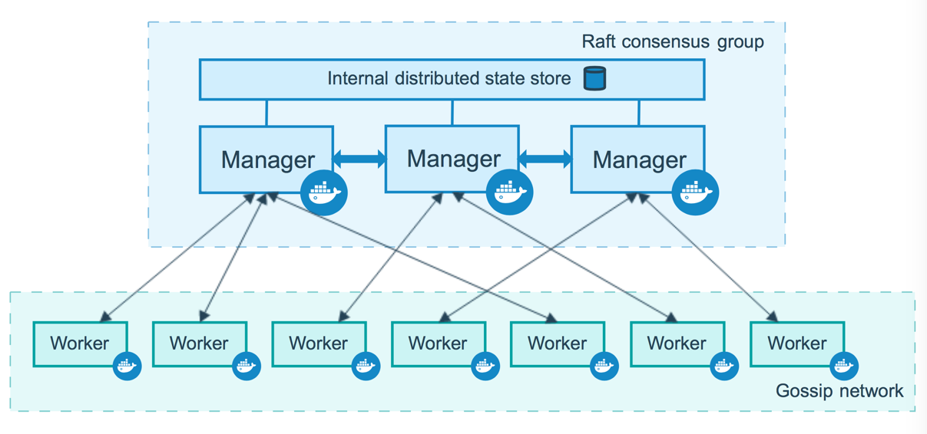
Create a fault tolerant swarm

Slide 26
Create a swarm: Change roles
You can promote a worker node to be a manager by running docker node promote. For example, you may want to promote a worker node when you take a manager node offline for maintenance.
docker node promote <node name>
You can also demote a manager node to a worker node.
docker node demote <node name>

Slide 27
Run application in production
Services

Slide 28
About services
In a distributed application, different pieces of the app are called “services”.
Services are really just “containers in production.”
A service only runs one image, but it codifies the way that image runs—what ports it should use, how many replicas of the container should run so the service has the capacity it needs, and so on.
Scaling a service changes the number of container instances running that piece of software, assigning more computing resources to the service in the process.

Slide 29
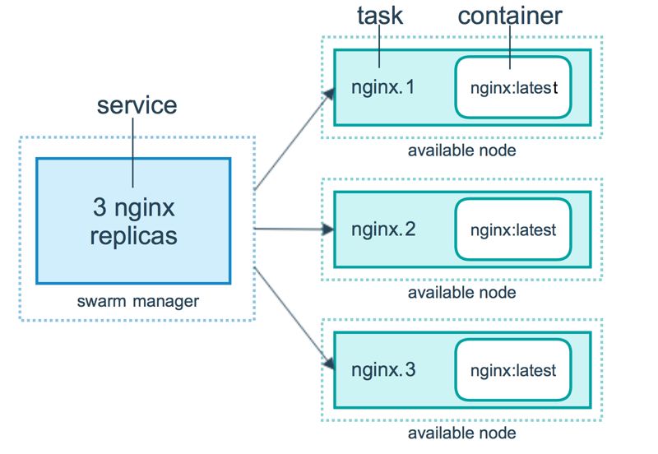
About services

Slide 30
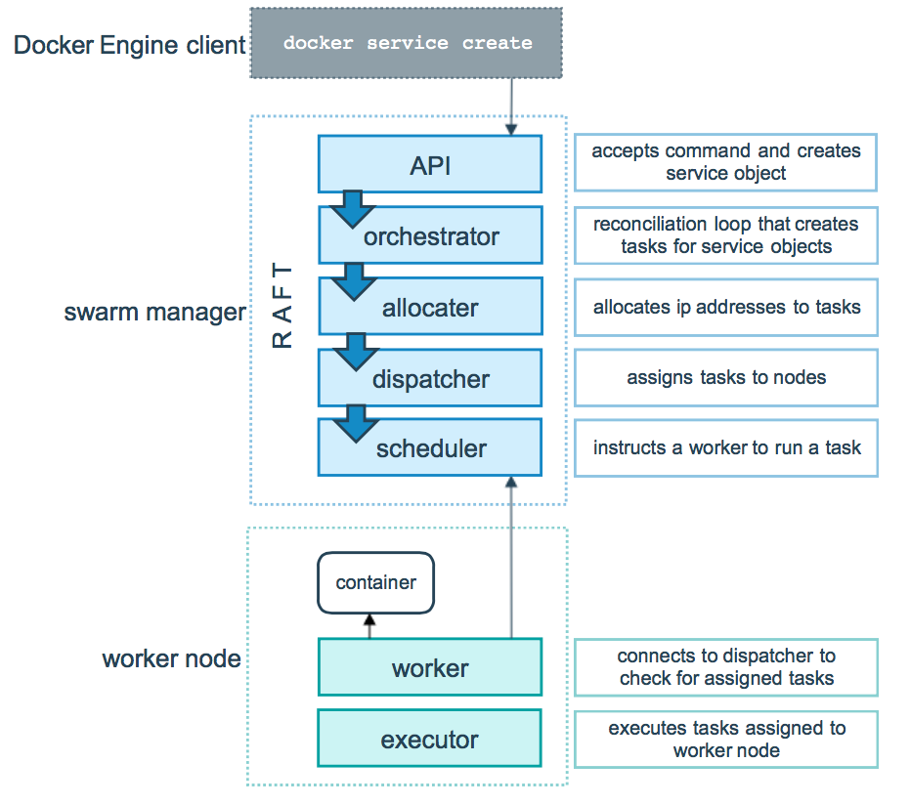
Start service

Slide 31
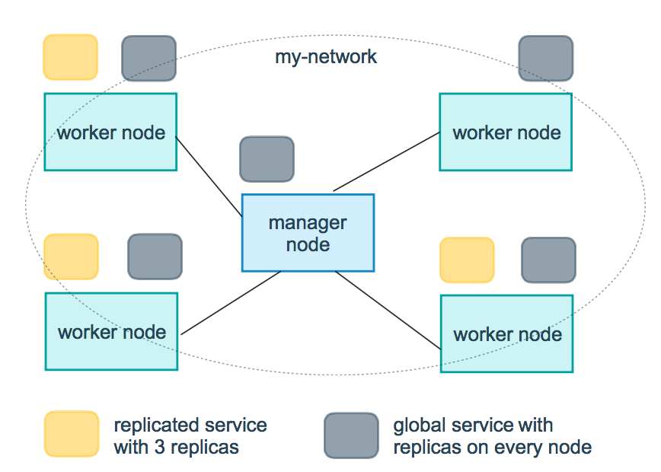
Replicated and global services

Slide 32
Create a service
Run the following command:
docker service create --replicas 1 \
--name helloworld alpine ping docker.com
The --name flag names the service helloworld.
The --replicas flag specifies the desired state of 1 running instance.
The arguments alpine ping docker.com define the service as an Alpine Linux container that executes the command ping docker.com.

Slide 33
Create a service
Run docker service ls to see the list of running services:
docker service ls
ID NAME SCALE IMAGE COMMAND
9uk4639qpg7n helloworld 1/1 alpine ping docker.com

Slide 34
Inspect and remove a service
Run docker service inspect --pretty <SERVICE-ID> to display the details about a service in an easily readable format.
docker service inspect --pretty helloworld
Run docker service rm helloworld to remove the helloworld service.
docker service rm helloworld
helloworld

Slide 35
Scale the service in the swarm
Run the following command to change the desired state of the service running in the swarm:
docker service scale helloworld=5
helloworld scaled to 5
docker service ps helloworld
NAME IMAGE NODE DESIRED STATE CURRENT STATE
helloworld.1.8p1vev3fq5zm0mi8g0as41w35 alpine worker2 Running Running 7 minutes
helloworld.2.c7a7tcdq5s0uk3qr88mf8xco6 alpine worker1 Running Running 24 seconds
helloworld.3.6crl09vdcalvtfehfh69ogfb1 alpine worker1 Running Running 24 seconds
helloworld.4.auky6trawmdlcne8ad8phb0f1 alpine manager1 Running Running 24 seconds
helloworld.5.ba19kca06l18zujfwxyc5lkyn alpine worker2 Running Running 24 seconds

Slide 36
Drain a node on the swarm
Sometimes, such as planned maintenance times, you need to set a node to DRAIN availability. DRAIN availability prevents a node from receiving new tasks from the swarm manager. It also means the manager stops tasks running on the node and launches replica tasks on a node with ACTIVE availability.
Change docker node availability availability state:
docker node update --availability drain worker1
docker node update --availability active worker1

Slide 37
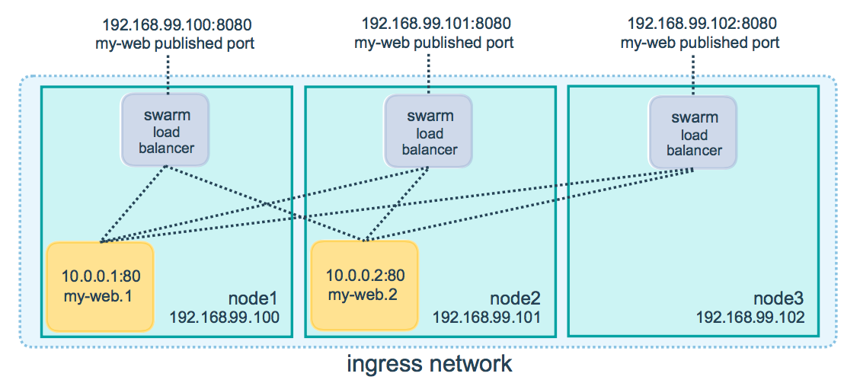
Publish a port for a service

Slide 38
Drain a node on the swarm
The following command publishes port 80 in the nginx container to port 8080 for any node in the swarm:
docker service create --name my-web \
--publish published=8080,target=80 --replicas 2 nginx
You can publish a port for an existing service using the following command:
docker service update \
--publish-add published=8080,target=80

Slide 39
Run application in production
Stacks

Slide 40
Using stacks
A stack is a group of interrelated services that share dependencies, and can be orchestrated and scaled together.
A single stack is capable of defining and coordinating the functionality of an entire application (though very complex applications may want to use multiple stacks).

Slide 41
Define service docker-compose.yml
version: "3"
services:
web:
image: username/repo:tag
deploy:
replicas: 5
resources:
limits:
cpus: "0.1"
memory: 50M
restart_policy:
condition: on-failure
ports:
- "4000:80"
networks:
- webnet
networks:
webnet:

Slide 42
Create or update the stacked service
Re-run the docker stack deploy command on the manager, and whatever services need updating are updated:
docker stack deploy -c docker-compose.yml getstartedlab
Updating service getstartedlab_web (id: angi1bf5e4to03qu9f93trnxm)
Creating service getstartedlab_visualizer (id: l9mnwkeq2jiononb5ihz9u7a4)

Slide 43
Docker-compose
Create a new Dockerfile .
FROM nginx:latest
EXPOSE 80

Slide 44
Docker-compose
Create docker-compose.yml .
version: "3.3"
services:
web:
build: .
ports:
- "8088:80"

Slide 45
Docker-compose
Build and run your app with Compose
From your project directory, start up your application by running docker-compose up.
docker-compose up

Slide 46
Kubernetes
Access Control

Slide 47
Namespaces
If multiple users and teams use the same Kubernetes cluster we can partition the cluster into virtual sub-clusters using Namespaces. The names of the resources/objects created inside a Namespace are unique, but not across Namespaces in the cluster.
To list all the Namespaces, we can run the following command:
kubectl get namespaces
Generally, Kubernetes creates four Namespaces out of the box: kube-system, kube-public, kube-node-lease, and default.

Slide 48
Authentication, Authorization, and Admission Control
To access and manage Kubernetes resources or objects in the cluster, we need to access a specific API endpoint on the API server. Each access request goes through the following access control stages:
Authentication : Logs in a user.
Authorization: Authorizes the API requests submitted by the authenticated user.
Admission Control : Software modules that validate and/or modify user requests based.

Slide 49
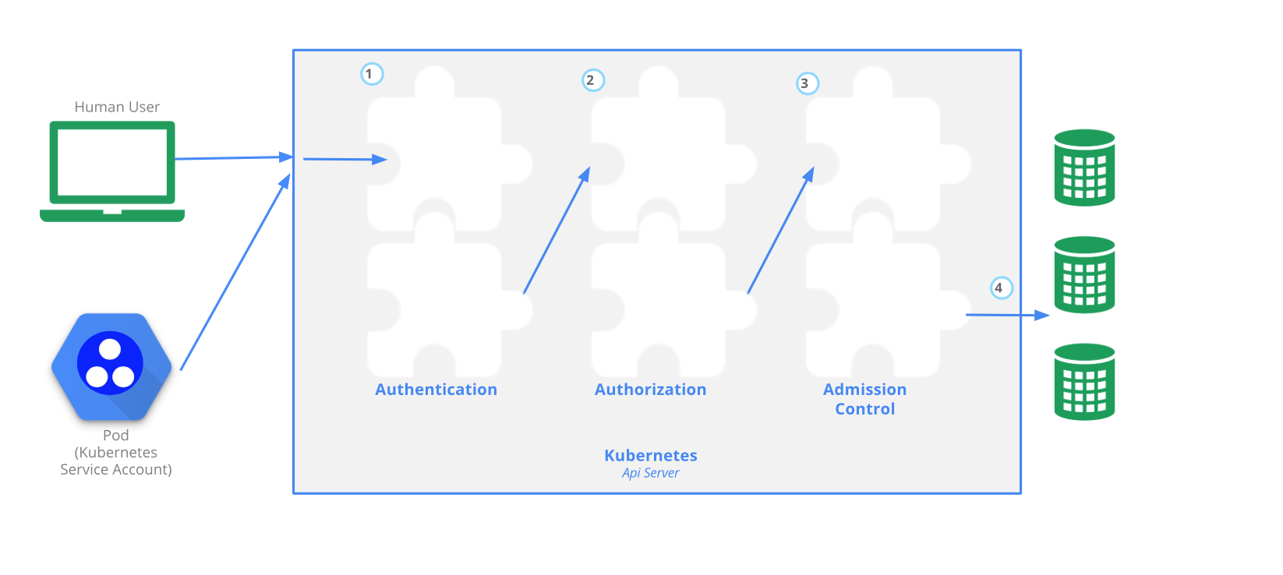
Authentication, Authorization, and Admission Control

Slide 50
Authentication
Kubernetes does not have an object called user, nor does it store usernames or other related details in its object store. However, even without that, Kubernetes can use usernames for the Authentication phase of the API access control, and to request logging as well.
Kubernetes supports two kinds of users:
Normal Users are managed outside of the Kubernetes cluster via independent services like User/Client Certificates, a file listing usernames/passwords, Google accounts, etc.
Service Accounts allow in-cluster processes to communicate with the API server to perform various operations. Most of the Service Accounts are created automatically via the API server, but they can also be created manually. The Service Accounts are tied to a particular Namespace and mount the respective credentials to communicate with the API server as Secrets.

Slide 51
Authentication
For authentication, Kubernetes uses a series of authentication modules:
X509 Client Certificates (passing the --client-ca-file=SOMEFILE option to the API server)
Static Token File (the --token-auth-file=SOMEFILE option to the API server)
Bootstrap Tokens
Service Account Tokens
OpenID Connect Tokens (to offload the authentication to external services)
Webhook Token Authentication (offload to a remote service)
Authenticating Proxy

Slide 52
Authorization
After a successful authentication, users can send the API requests to perform different operations.
Here, these API requests get authorized by Kubernetes using various authorization modules, that allow or deny the requests.
Some of the API request attributes that are reviewed by Kubernetes include user, group, extra, Resource, Namespace, or API group, to name a few. Next, these attributes are evaluated against policies. If the evaluation is successful, then the request is allowed, otherwise it is denied. Similar to the Authentication step, Authorization has multiple modules, or authorizers. More than one module can be configured for one Kubernetes cluster, and each module is checked in sequence. If any authorizer approves or denies a request, then that decision is returned immediately

Slide 53
Authorization
Authorization modes
Node authorization is a special-purpose authorization mode which specifically authorizes API requests made by kubelets. It authorizes the kubelet's read operations for services, endpoints, or nodes, and writes operations for nodes, pods, and events.
Attribute-Based Access Control (ABAC) With the ABAC authorizer, Kubernetes grants access to API requests, which combine policies with attributes.
In Webhook mode, Kubernetes can request authorization decisions to be made by third-party services, which would return true for successful authorization, and false for failure

Slide 54
Authorization : Role
Authorization modes
Role-Based Access Control (RBAC) regulates the access to resources based on the Roles of individual users. In Kubernetes, multiple Roles can be attached to subjects like users, service accounts, etc.
In RBAC, we can create two kinds of Roles:
A Role grants access to resources within a specific Namespace.
A ClusterRole grants the same permissions as Role does, but its scope is cluster-wide.

Slide 55
Authorization : Role
apiVersion: rbac.authorization.k8s.io/v1
kind: Role
metadata:
namespace: lfs158
name: pod-reader
rules:
- apiGroups: [""] # "" indicates the core API group
resources: ["pods"]
verbs: ["get", "watch", "list"]

Slide 56
Authorization : RoleBinding
Once the role is created, we can bind it to users with a RoleBinding object.
There are two kinds of RoleBindings:
RoleBinding It allows us to bind users to the same namespace as a Role. We could also refer a ClusterRole in RoleBinding, which would grant permissions to Namespace resources defined in the ClusterRole within the RoleBinding’s Namespace.
ClusterRoleBinding It allows us to grant access to resources at a cluster-level and to all Namespaces.

Slide 57
Authorization : RoleBinding
apiVersion: rbac.authorization.k8s.io/v1
kind: RoleBinding
metadata:
name: pod-read-access
namespace: lfs158
subjects:
- kind: User
name: student
apiGroup: rbac.authorization.k8s.io
roleRef:
kind: Role
name: pod-reader
apiGroup: rbac.authorization.k8s.io

Slide 58
Admission Control
Admission Controllers are used to specify granular access control policies, which include allowing privileged containers, checking on resource quota, etc.
We force these policies using different admission controllers, like ResourceQuota, DefaultStorageClass, AlwaysPullImages, etc.
They come into effect only after API requests are authenticated and authorized.

Slide 59
Admission Control
Admission Controllers are used to specify granular access control policies, which include allowing privileged containers, checking on resource quota, etc.
We force these policies using different admission controllers, like ResourceQuota, DefaultStorageClass, AlwaysPullImages, etc.
They come into effect only after API requests are authenticated and authorized.

Slide 60
Kubernetes API
The main component of the Kubernetes control plane is the API server, responsible for exposing the Kubernetes APIs.
The APIs allow operators and users to directly interact with the cluster. Using both CLI tools and the Dashboard UI, we can access the API server running on the master node to perform various operations to modify the cluster's state.
The API server is accessible through its endpoints by agents and users possessing the required credentials.

Slide 61
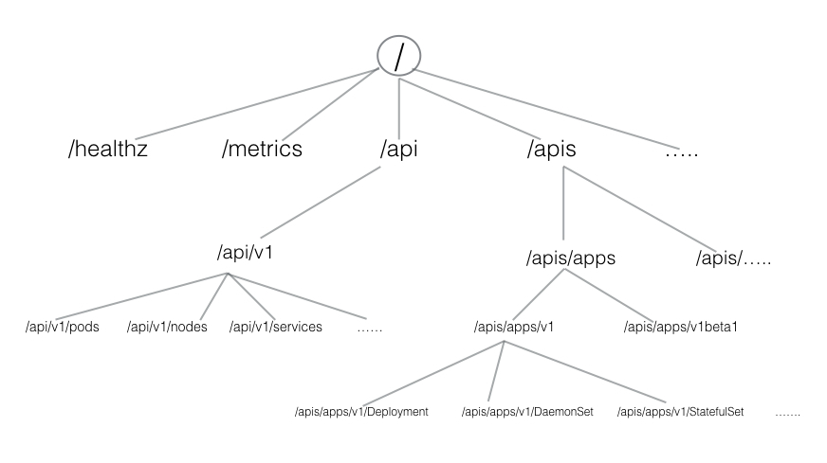
Kubernetes API

Slide 62
APIs with Authentication
When not using the kubectl proxy, we need to authenticate to the API server when sending API requests.
We can authenticate by providing a Bearer Token when issuing a curl, or by providing a set of keys and certificates.
A Bearer Token is an access token which is generated by the authentication server (the API server on the master node) and given back to the client. Using that token, the client can connect back to the Kubernetes API server without providing further authentication details, and then, access resources.

Slide 63
APIs with Authentication
Get the token
TOKEN=$(kubectl describe secret -n kube-system \
$(kubectl get secrets -n kube-system | grep default | cut -f1 -d ' ') \|
grep -E '^token' | cut -f2 -d':' | tr -d '\t' | tr -d " ")
Get the API server endpoint:
APISERVER=$(kubectl config view | grep https | cut -f 2- -d ":" | tr -d " ")

Slide 64
APIs with Authentication
Access the API server using the curl command, as shown below:
curl $APISERVER --header "Authorization: Bearer $TOKEN" --insecure
Instead of the access token, we can extract the client certificate, client key, and certificate authority data from the .kube/config file. Once extracted, they can be encoded and then passed with a curl command for authentication
curl $APISERVER --cert encoded-cert --key encoded-key --cacert encoded-ca

Slide 65
Kubernetes
ConfigMaps and Secret

Slide 66
Kubernetes ConfigMaps
Use a ConfigMap for setting configuration data separately from application code.
For example, imagine that you are developing an application that you can run on your own computer (for development) and in the cloud (to handle real traffic). You write the code to look in an environment variable named DATABASE_HOST. Locally, you set that variable to localhost. In the cloud, you set it to refer to a Kubernetes Service that exposes the database component to your cluster.

Slide 67
Kubernetes ConfigMaps
apiVersion: v1
kind: ConfigMap
metadata:
name: game-demo
data:
# property-like keys; each key maps to a simple value
player_initial_lives: 3
ui_properties_file_name: "user-interface.properties"
#
# file-like keys
game.properties: |
enemy.types=aliens,monsters
player.maximum-lives=5
user-interface.properties: |
color.good=purple
color.bad=yellow
allow.textmode=true

Slide 68
Using ConfigMaps
Defining a volume and mounting it inside the demo container as /config creates four files:
/config/player_initial_lives
/config/ui_properties_file_name
/config/game.properties
/config/user-interface.properties

Slide 69
Using ConfigMaps
Create a config map or use an existing one. Multiple Pods can reference the same config map.
Modify your Pod definition to add a volume under .spec.volumes[]. Name the volume anything, and have a .spec.volumes[].configmap.localObjectReference field set to reference your ConfigMap object.
Add a .spec.containers[].volumeMounts[] to each container that needs the config map. Specify .spec.containers[].volumeMounts[].readOnly = true and .spec.containers[].volumeMounts[].mountPath to an unused directory name where you would like the config map to appear.
Modify your image or command line so that the program looks for files in that directory. Each key in the config map data map becomes the filename under mountPath.

Slide 70
Kubernetes ConfigMaps
apiVersion: v1
kind: Pod
metadata:
name: mypod
spec:
containers:
- name: mypod
image: redis
volumeMounts:
- name: foo
mountPath: "/etc/foo"
readOnly: true
volumes:
- name: foo
configmap:
name: myconfigmap

Slide 71
Information Security
Secrets Management
https://kubernetes-security.info/#securing-your-container-images

Slide 72
Overview of Secrets
To use a Secret, a Pod needs to reference the Secret. A Secret can be used with a Pod in three ways:
As files in a volume mounted on one or more of its containers.
As container environment variable.
By the kubelet when pulling images for the Pod.

Slide 73
Types of Secret
When creating a Secret, you can specify its type using the type field of a Secret resource, or certain equivalent kubectl command line flags (if available).
The type of a Secret is used to facilitate programmatic handling of different kinds of confidential data.
Kubernetes provides several builtin types for some common usage scenarios. These types vary in terms of the validations performed and the constraints Kubernetes imposes on them

Slide 74
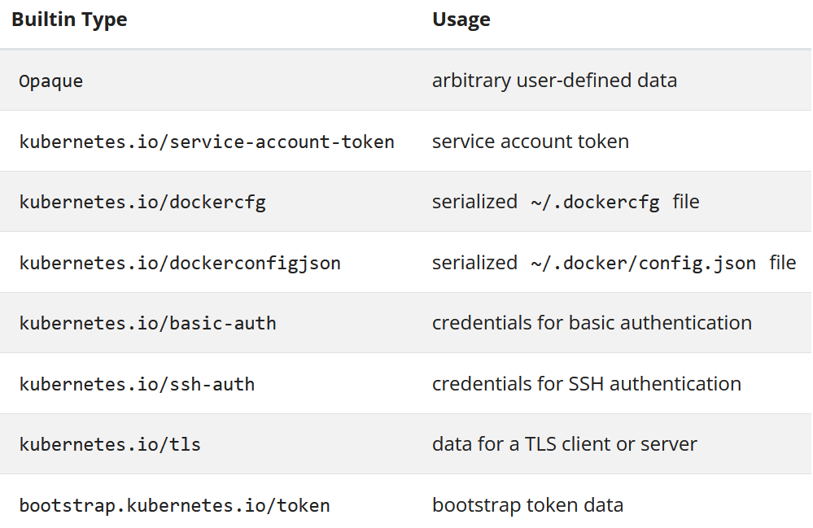

Slide 75
Service account token Secrets
apiVersion: v1
kind: Secret
metadata:
name: secret-sa-sample
annotations:
kubernetes.io/service-account.name: "sa-name"
type: kubernetes.io/service-account-token
data:
# You can include additional key value pairs as you do with Opaque Secrets
extra: YmFyCg==

Slide 76
Docker config Secrets
You can use one of the following type values to create a Secret to store the credentials for accessing a Docker registry for images.
kubernetes.io/dockercfg
kubernetes.io/dockerconfigjson
The kubernetes.io/dockercfg type is reserved to store a serialized ~/.dockercfg which is the legacy format for configuring Docker command line. When using this Secret type, you have to ensure the Secret data field contains a .dockercfg key whose value is content of a ~/.dockercfg file encoded in the base64 format.
The kubernetes.io/dockerconfigjson type is designed for storing a serialized JSON that follows the same format rules as the ~/.docker/config.json file which is a new format for ~/.dockercfg. When using this Secret type, the data field of the Secret object must contain a .dockerconfigjson key, in which the content for the ~/.docker/config.json file is provided as a base64 encoded string.

Slide 77
Docker config Secrets
Below is an example for a kubernetes.io/dockercfg type of Secret:
apiVersion: v1
kind: Secret
metadata:
name: secret-dockercfg
type: kubernetes.io/dockercfg
data:
.dockercfg: |
"<base64 encoded ~/.dockercfg file>"

Slide 78
Basic authentication Secret
The kubernetes.io/basic-auth type is provided for storing credentials needed for basic authentication. When using this Secret type, the data field of the Secret must contain one of the following two keys:
username: the user name for authentication;
password: the password or token for authentication.
Both values for the above two keys are base64 encoded strings. You can, of course, provide the clear text content using the stringData for Secret creation.

Slide 79
SSH authentication secrets
The builtin type kubernetes.io/ssh-auth is provided for storing data used in SSH authentication. When using this Secret type, you will have to specify a ssh-privatekey key-value pair in the data (or stringData) field as the SSH credential to use.
apiVersion: v1
kind: Secret
metadata:
name: secret-ssh-auth
type: kubernetes.io/ssh-auth
data:
# the data is abbreviated in this example
ssh-privatekey: |
MIIEpQIBAAKCAQEAulqb/Y ...

Slide 80
TLS secrets
Kubernetes provides a builtin Secret type kubernetes.io/tls for storing a certificate and its associated key that are typically used for TLS .
This data is primarily used with TLS termination of the Ingress resource, but may be used with other resources or directly by a workload.
When using this type of Secret, the tls.key and the tls.crt key must be provided in the data (or stringData) field of the Secret configuration, although the API server doesn't actually validate the values for each key.

Slide 81
TLS secrets
apiVersion: v1
kind: Secret
metadata:
name: secret-tls
type: kubernetes.io/tls
data:
# the data is abbreviated in this example
tls.crt: |
MIIC2DCCAcCgAwIBAgIBATANBgkqh ...
tls.key: |
MIIEpgIBAAKCAQEA7yn3bRHQ5FHMQ ...

Slide 82
Using Secrets as files from a Pod
To consume a Secret in a volume in a Pod:
Create a secret or use an existing one. Multiple Pods can reference the same secret.
Modify your Pod definition to add a volume under .spec.volumes[]. Name the volume anything, and have a .spec.volumes[].secret.secretName field equal to the name of the Secret object.
Add a .spec.containers[].volumeMounts[] to each container that needs the secret. Specify .spec.containers[].volumeMounts[].readOnly = true and .spec.containers[].volumeMounts[].mountPath to an unused directory name where you would like the secrets to appear.
Modify your image or command line so that the program looks for files in that directory. Each key in the secret data map becomes the filename under mountPath.

Slide 83
Projection of Secret keys to specific paths
apiVersion: v1
kind: Pod
metadata:
name: mypod
spec:
containers:
- name: mypod
image: redis
volumeMounts:
- name: foo
mountPath: "/etc/foo"
readOnly: true
volumes:
- name: foo
secret:
secretName: mysecret
items:
- key: username
path: my-group/my-username

Slide 84
Projection of Secret keys to specific paths
What will happen:
username secret is stored under /etc/foo/my-group/my-username file instead of /etc/foo/username.
password secret is not projected.
If .spec.volumes[].secret.items is used, only keys specified in items are projected. To consume all keys from the secret, all of them must be listed in the items field. All listed keys must exist in the corresponding secret. Otherwise, the volume is not created.

Slide 85
Using Secrets as environment variables
To use a secret in an environment variable in a Pod:
Create a secret or use an existing one. Multiple Pods can reference the same secret.
Modify your Pod definition in each container that you wish to consume the value of a secret key to add an environment variable for each secret key you wish to consume. The environment variable that consumes the secret key should populate the secret's name and key in env[].valueFrom.secretKeyRef.
Modify your image and/or command line so that the program looks for values in the specified environment variables.

Slide 86
Using Secrets as environment variables
apiVersion: v1
kind: Pod
metadata:
name: secret-env-pod
spec:
containers:
- name: mycontainer
image: redis
env:
- name: SECRET_USERNAME
valueFrom:
secretKeyRef:
name: mysecret
key: username
- name: SECRET_PASSWORD
valueFrom:
secretKeyRef:
name: mysecret
key: password
restartPolicy: Never

Slide 87
Immutable Secrets
FEATURE STATE: Kubernetes v1.21 [stable] : immutable: true
The Kubernetes feature Immutable Secrets and ConfigMaps provides an option to set individual Secrets and ConfigMaps as immutable. For clusters that extensively use Secrets (at least tens of thousands of unique Secret to Pod mounts), preventing changes to their data has the following advantages:
protects you from accidental (or unwanted) updates that could cause applications outages
improves performance of your cluster by significantly reducing load on kube-apiserver, by closing watches for secrets marked as immutable.

Slide 88
Questions?
andry.cheredarchuk@gmail.com

